Slide 1

UNAIDS | SEPTEMBER 2025
Resource Tracking and Transactions in NASA
NATIONAL AIDS SPENDING ASSESSMENT
PRESENTER NAME

Slide 2

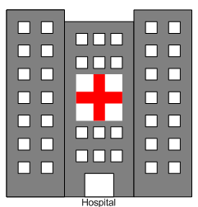







Resource Tracking
Resource tracking is based on a methodology to reconstruct all the financial transactions related to the National Response to HIV and AIDS epidemic It helps us understand how funding, services, and other critical components move through the system to address HIV/AIDS
MoH
Financial Entity
Agent Purchaser
Provider
ASC
Beneficiaries
PF

Slide 3
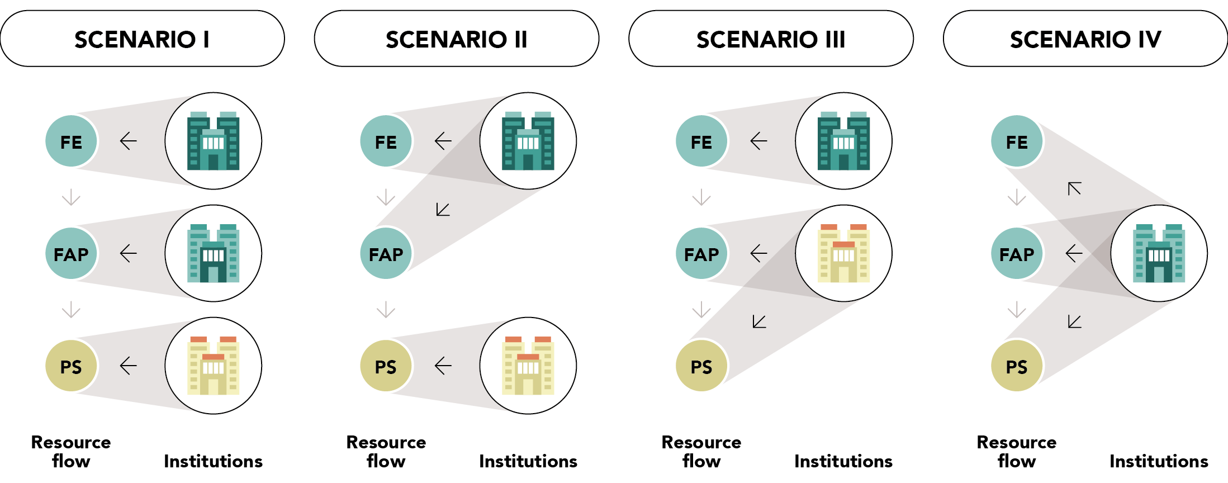
Resource Tracking and Role of Institutions

Slide 4
The flow of resources within the HIV response
Scenario I: one transaction
Scenario II: two transactions
Scenario III: four transactions
FE
FE
FE₁
FE₂
REV
REV
SCH
SCH
FAP₁
FAP₂
FAP
FAP
1
4
3
2
PS
PS ₁
PS₁
PS₂

Slide 5
NASA Principles
NASA is guided by 3 principles
1. Data triangulation: triangulate and cross-check data from different sources (FE, FAP &PS) to avoid double counting
2. NASA captures only complete transactions All 9 vectors are mapped to recreate a complete transaction
3
3. Capture only actual expenditure, HIV expenditures: Goods and services delivered to a Beneficiary Population. Not budgets or commitments

Slide 6
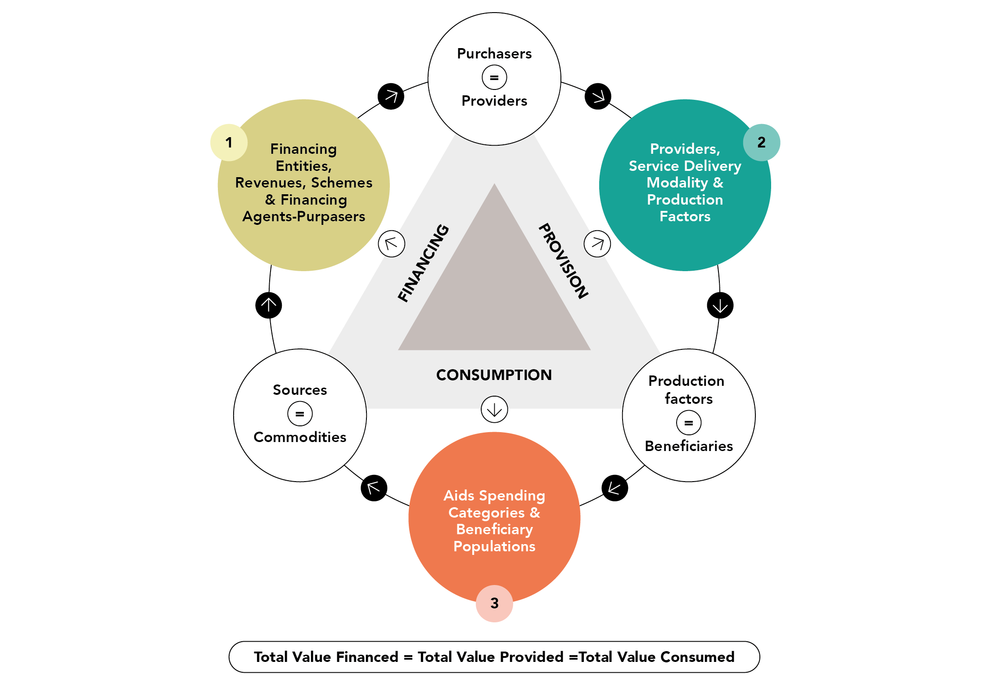
NASA principle 1: Data Triangulation
=
Financing
Provision
=
=
Consumption

Slide 7
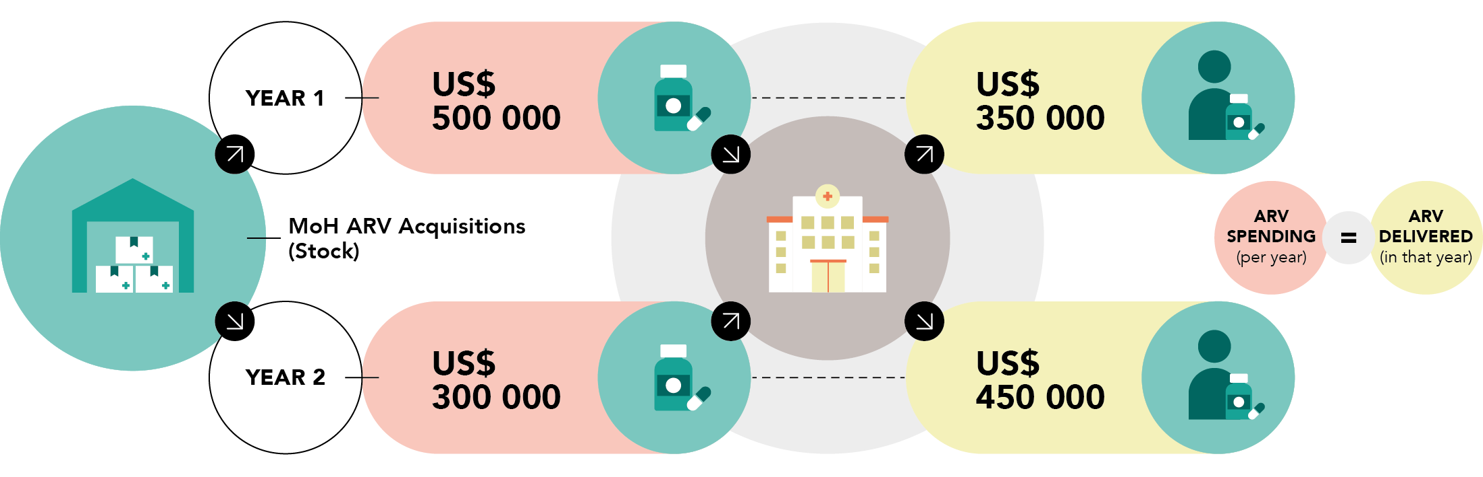

NASA principle 2 : Actual spending on consumed goods / delivered services is captured (accrual / matching accounting)
NASA tracks the value of resources consumed during the implementation of
the national HIV response ! Not resources allocated, resources committed or budget
-Actual spending Y1: 500.000? or 350.000?
-Actual spending Y2: 300.000? or 450.000?

Slide 8


NASA Principle: Actual spending not budgets or commitments
✗ Resources allocated, resources committed, budgets, nor estimated resource needs…
✗ Resource allocated are usually not equal to Budget executed or actual expenditures…
NASA tracks the value of resources consumed during the implementation of the national HIV response !

Slide 9
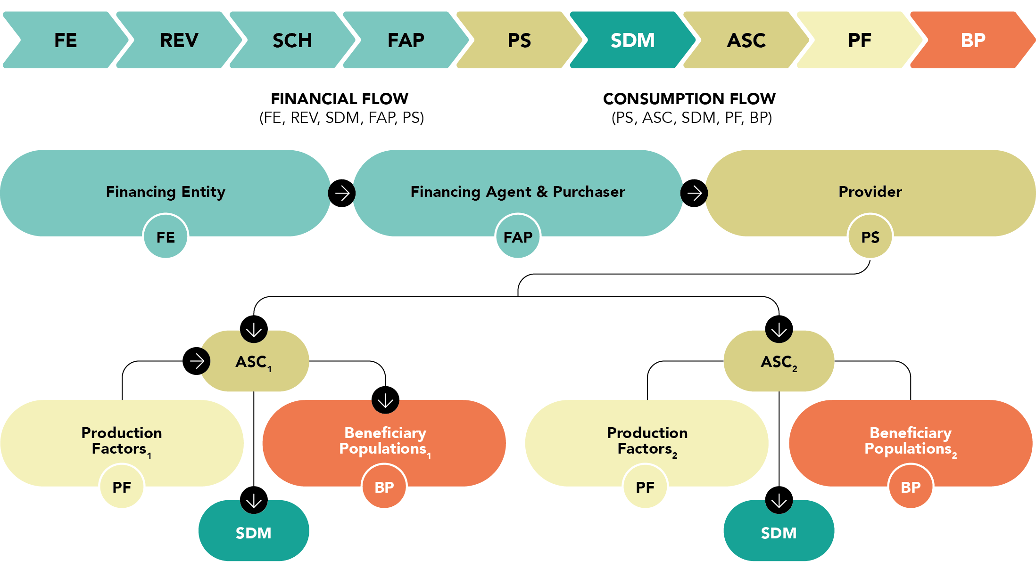
Transactions in NASA
A transaction represents the recorded transfer of resources between economic agents, allowing us to trace the flow of funds from their origin through to the purchaser, the provider, and ultimately to the delivery of services.
In the NASA framework, the transaction is the fundamental unit of financial tracking: it captures how resources move from a financing source to an implementing agent, who then pays a provider to deliver one or more AIDS Spending Categories (ASCs) to beneficiary populations—whether explicitly identified or not—through the use of production inputs.

Slide 10
Recreating transactions
Recreating transactions involves tracing the flow of funds from the source (e.g., government budget allocations, donor contributions) to various implementing agencies, service providers, and recipients.
Notes:
The identification of transactions starts during the planning step when mapping the different actors in the HIV response. The source-agent-provider relation is identified in this phase, as well as the funding transfer mechanisms and activities could also be identified

Slide 11
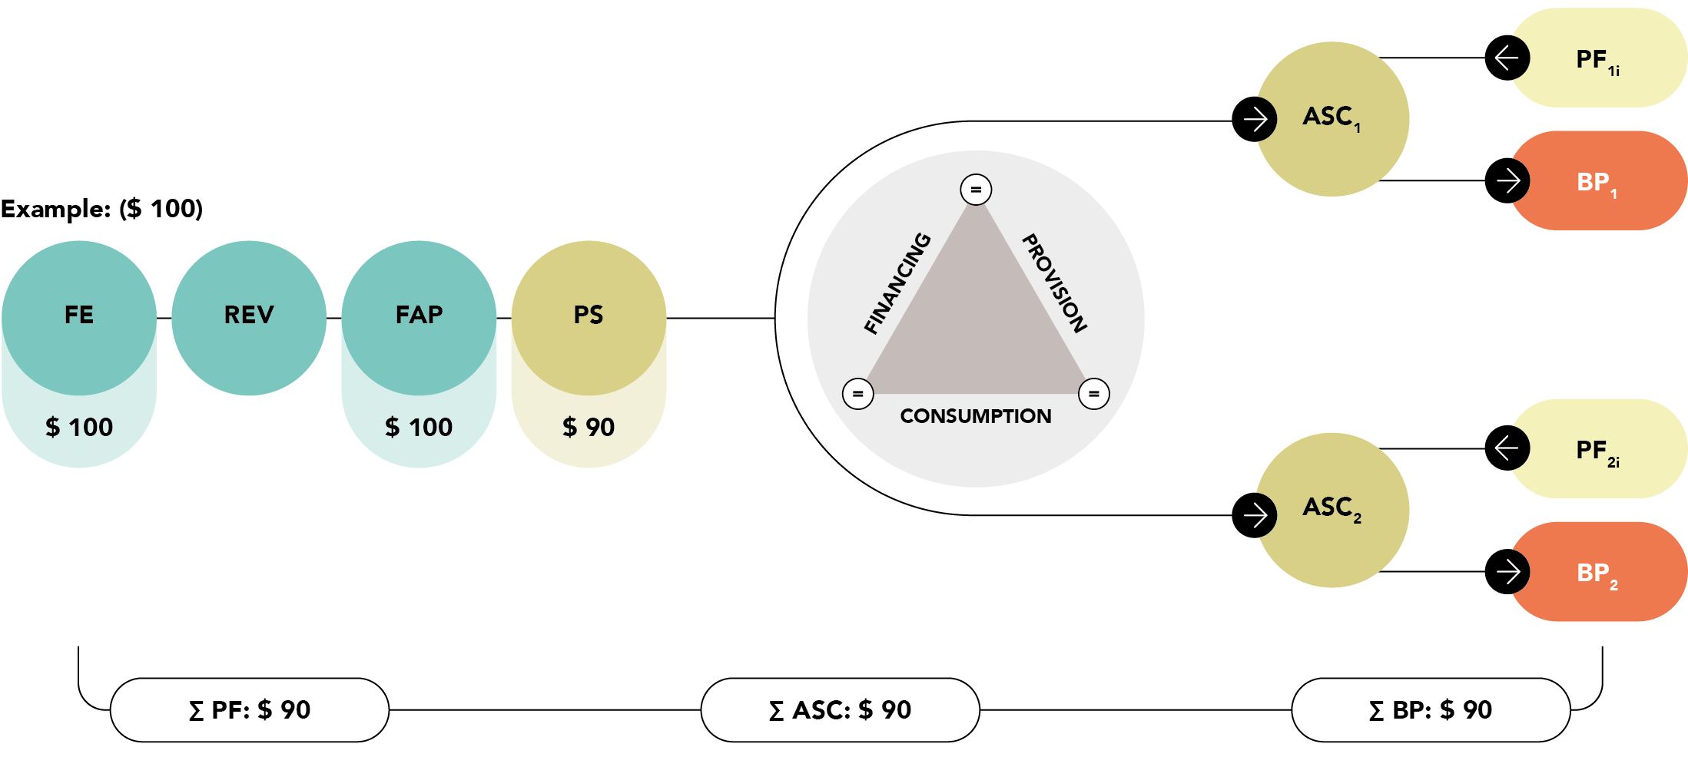
NASA principle 3: Only capture complete & balanced transactions
-Expenditure: 100? 190? or 90?

Slide 12
Transfer of transactions to DCTs and RTT
Once transactions have been correctly recreated in Excel, they can be copied into the Data consolidation tool (DCT) which can then be imported into the NASA Resource Tracking Tool (RTT), which assists to consolidate and summarize all the data.

Slide 13
THANK YOU
For more information, contact UNAIDS Resource Tracking:
Teresa Guthrie
guthriet@unaids.org

