Slide 1

UNAIDS | JAN 2026
Resource Tracking and Transactions in NASA
PRESENTER NAME

Slide 2
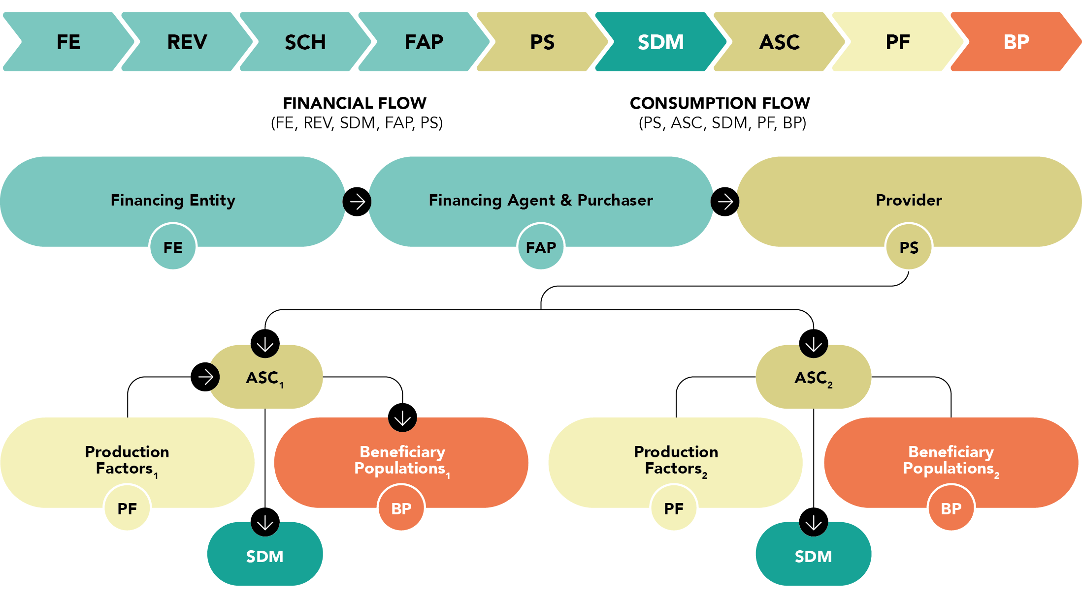
Transactions in NASA
A transaction represents the recorded transfer of resources between economic agents, allowing us to trace the flow of funds from their origin through to the purchaser, the provider, and ultimately to the delivery of services.
In the NASA framework, the transaction is the fundamental unit of financial tracking: it captures how resources move from a financing source to an implementing agent, who then pays a provider to deliver one or more AIDS Spending Categories (ASCs) to beneficiary populations, whether explicitly identified or not, through the use of production inputs.

Slide 3
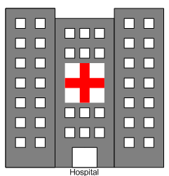






Resource Tracking
Resource tracking is based on a methodology to reconstruct all the financial transactions related to the National Response to HIV/AIDS epidemic. It helps us understand how funding, services, and other critical components move through the system to address HIV/AIDS.
MoH

Slide 4
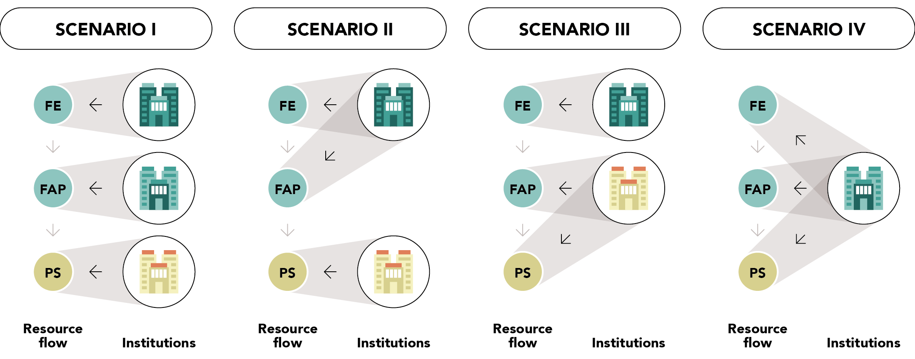
Resource Tracking and Role of Institutions

Slide 5
The flow of resources within the HIV response
SCENARIO I: one transaction
FE
REV
SCH
FAP
PS
FE
REV
SCH
F
AP
PS
ASC
SDM
PF
BP
PS₂
FE
REV
SCH
FAP
SCENARIO II: two transactions
PS₁
REV
F
FE
SCH
AP
PS
ASC
SDM
PF
BP
REV
F
FE
SCH
AP
PS
ASC
SDM
PF
BP
FE₂
FAP₂
2
3
PS₁
SCENARIO III: four transaction
FE₁
FAP₁
4
1
REV
SCH
F
FE
AP
PS
ASC
SDM
PF
BP
REV
SCH
F
FE
AP
PS
ASC
SDM
PF
BP
REV
SCH
F
FE
AP
PS
ASC
SDM
PF
BP
REV
SCH
F
FE
AP
PS
ASC
SDM
PF
BP

Slide 6
NASA Principles
NASA is guided by 3 principles
1.
Data triangulation: triangulate and cross-check data from different sources (FE, FAP &PS) to avoid double counting
2.
NASA captures only complete transactions. All 9 vectors are mapped to recreate a complete transaction
3.
Capture only actual expenditure, HIV expenditures: Goods and services delivered to a Beneficiary Population. Not budgets or commitments

Slide 7
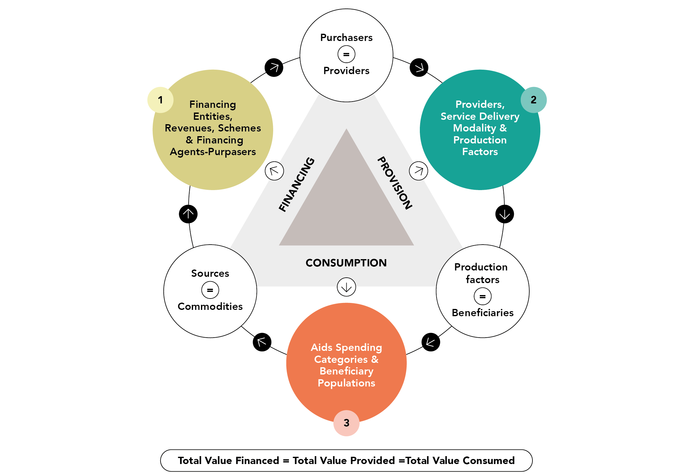
NASA principle 1:
Data triangulation
=
FINANCING
PROVISION
=
CONSUMPTION
=

Slide 8
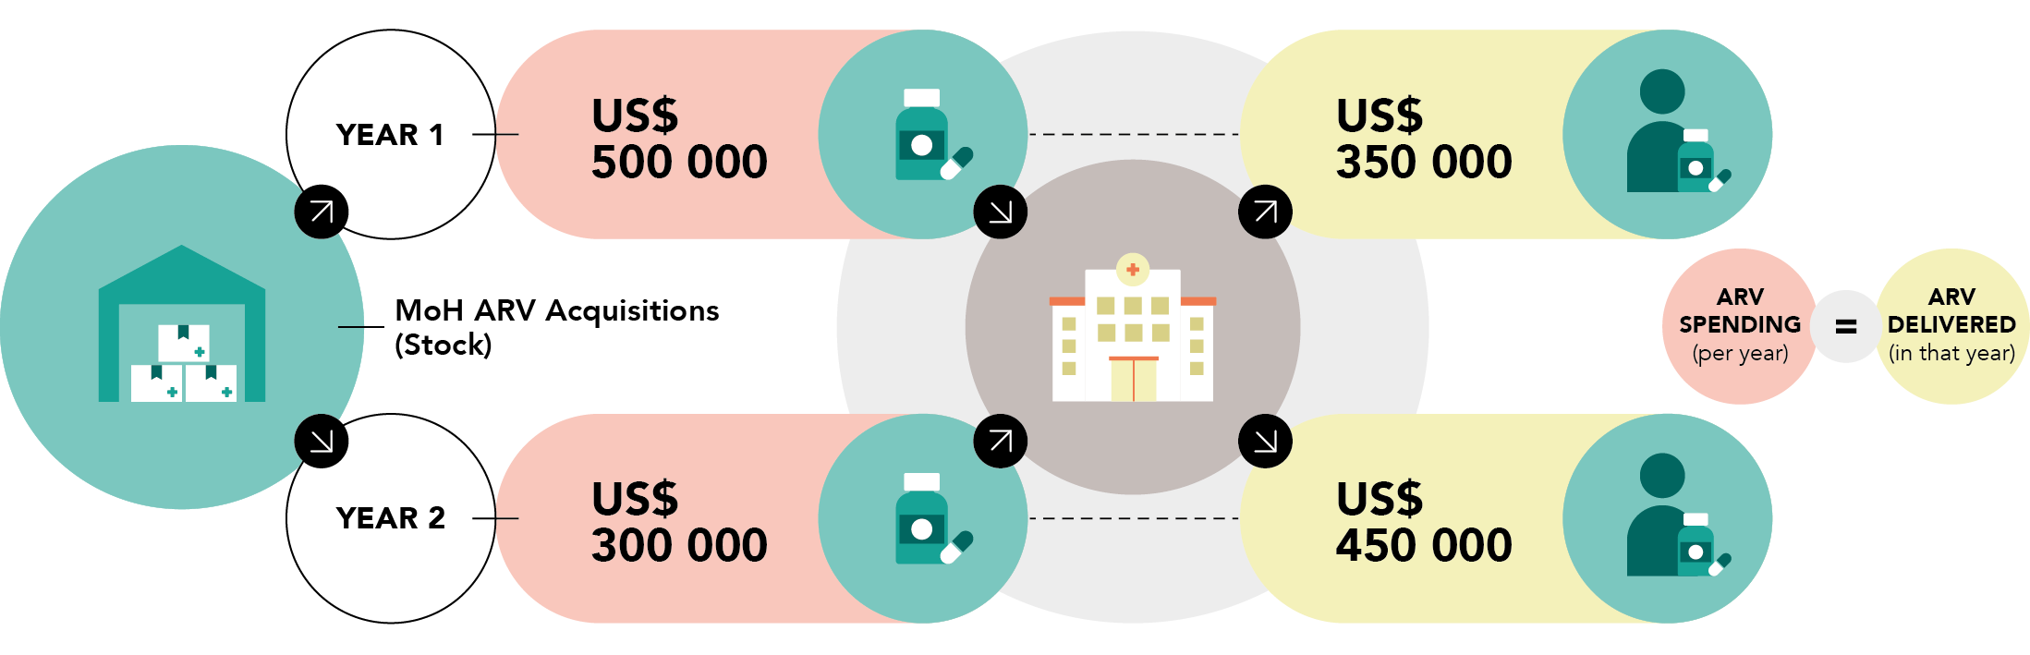
NASA principle 2:
Actual spending on consumed goods / delivered services is captured (accrual / matching accounting)
NASA tracks the value of resources consumed during the implementation of the national HIV response! Not resources allocated, resources committed or budget
- Actual spending Y1: 500.000? or 350.000?
- Actual spending Y2: 300.000? or 450.000?

Slide 9
NASA Principle:
Actual spending not budgets or commitments
✗ Resources allocated, resources committed, budgets, nor estimated resource needs…
✗ Resource allocated are usually not equal to Budget executed or actual expenditures…
NASA tracks the value of resources consumed during the implementation of the national HIV response!

Slide 10
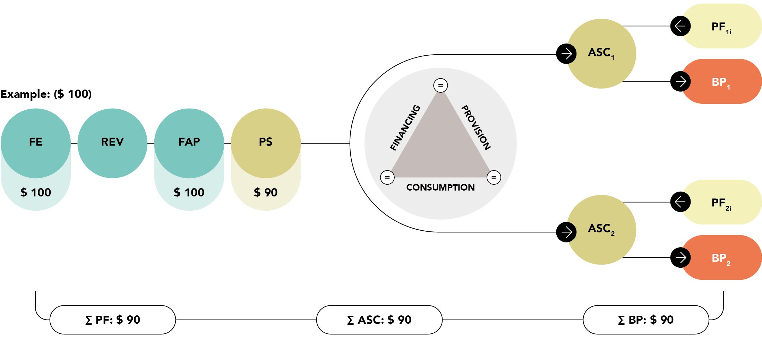
NASA principle 3:
Only capture complete & balanced transactions
- Expenditure: 100? 190? or 90?

Slide 11
Transfer of transactions to DCTs and RTT
Once transactions have been correctly recreated in Excel, they can be entered or copied into the Data consolidation tool (DCT) which can then be imported into the NASA Resource Tracking Tool (RTT), which assists to consolidate and summarize all the data.

Slide 12
THANK YOU
For more information, contact UNAIDS Resource Tracking:
Teresa Guthrie
guthriet@unaids.org

