Slide 1

UNAIDS | JAN 2026
NASA ANALYSIS:
ADDITIONAL INSIGHTS
PRESENTER NAME

Slide 2
Additional analyses for greater utility
In addition to the usual / traditional NASA tables / figures / bivariate matrices, please undertake additional value-add analyses, where possible:
1
Time trends
2
Equity analysis per province
3
Allocative equity across provinces
4
Adequacy and funding gap analysis
5
Allocative efficiency
6
Absorptive capacity
7
Technical efficiency – ART and VMMC examples
8
Benchmarking and comparisons

Slide 3
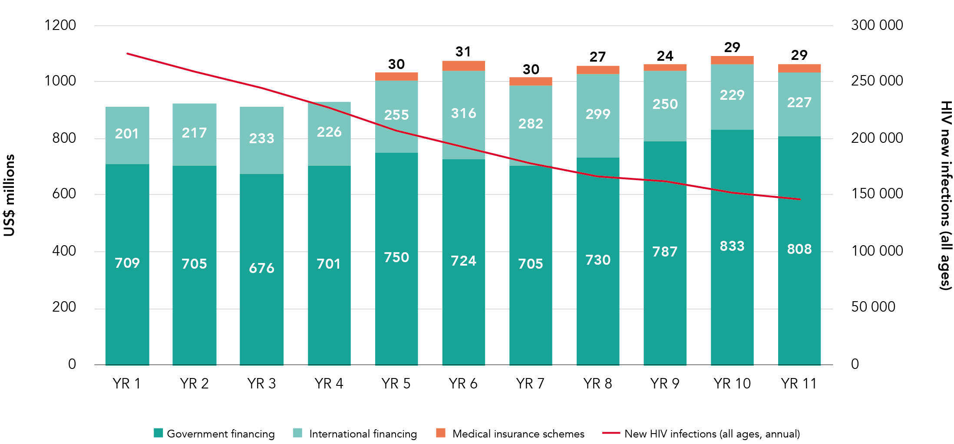
1. Time trends

Slide 4
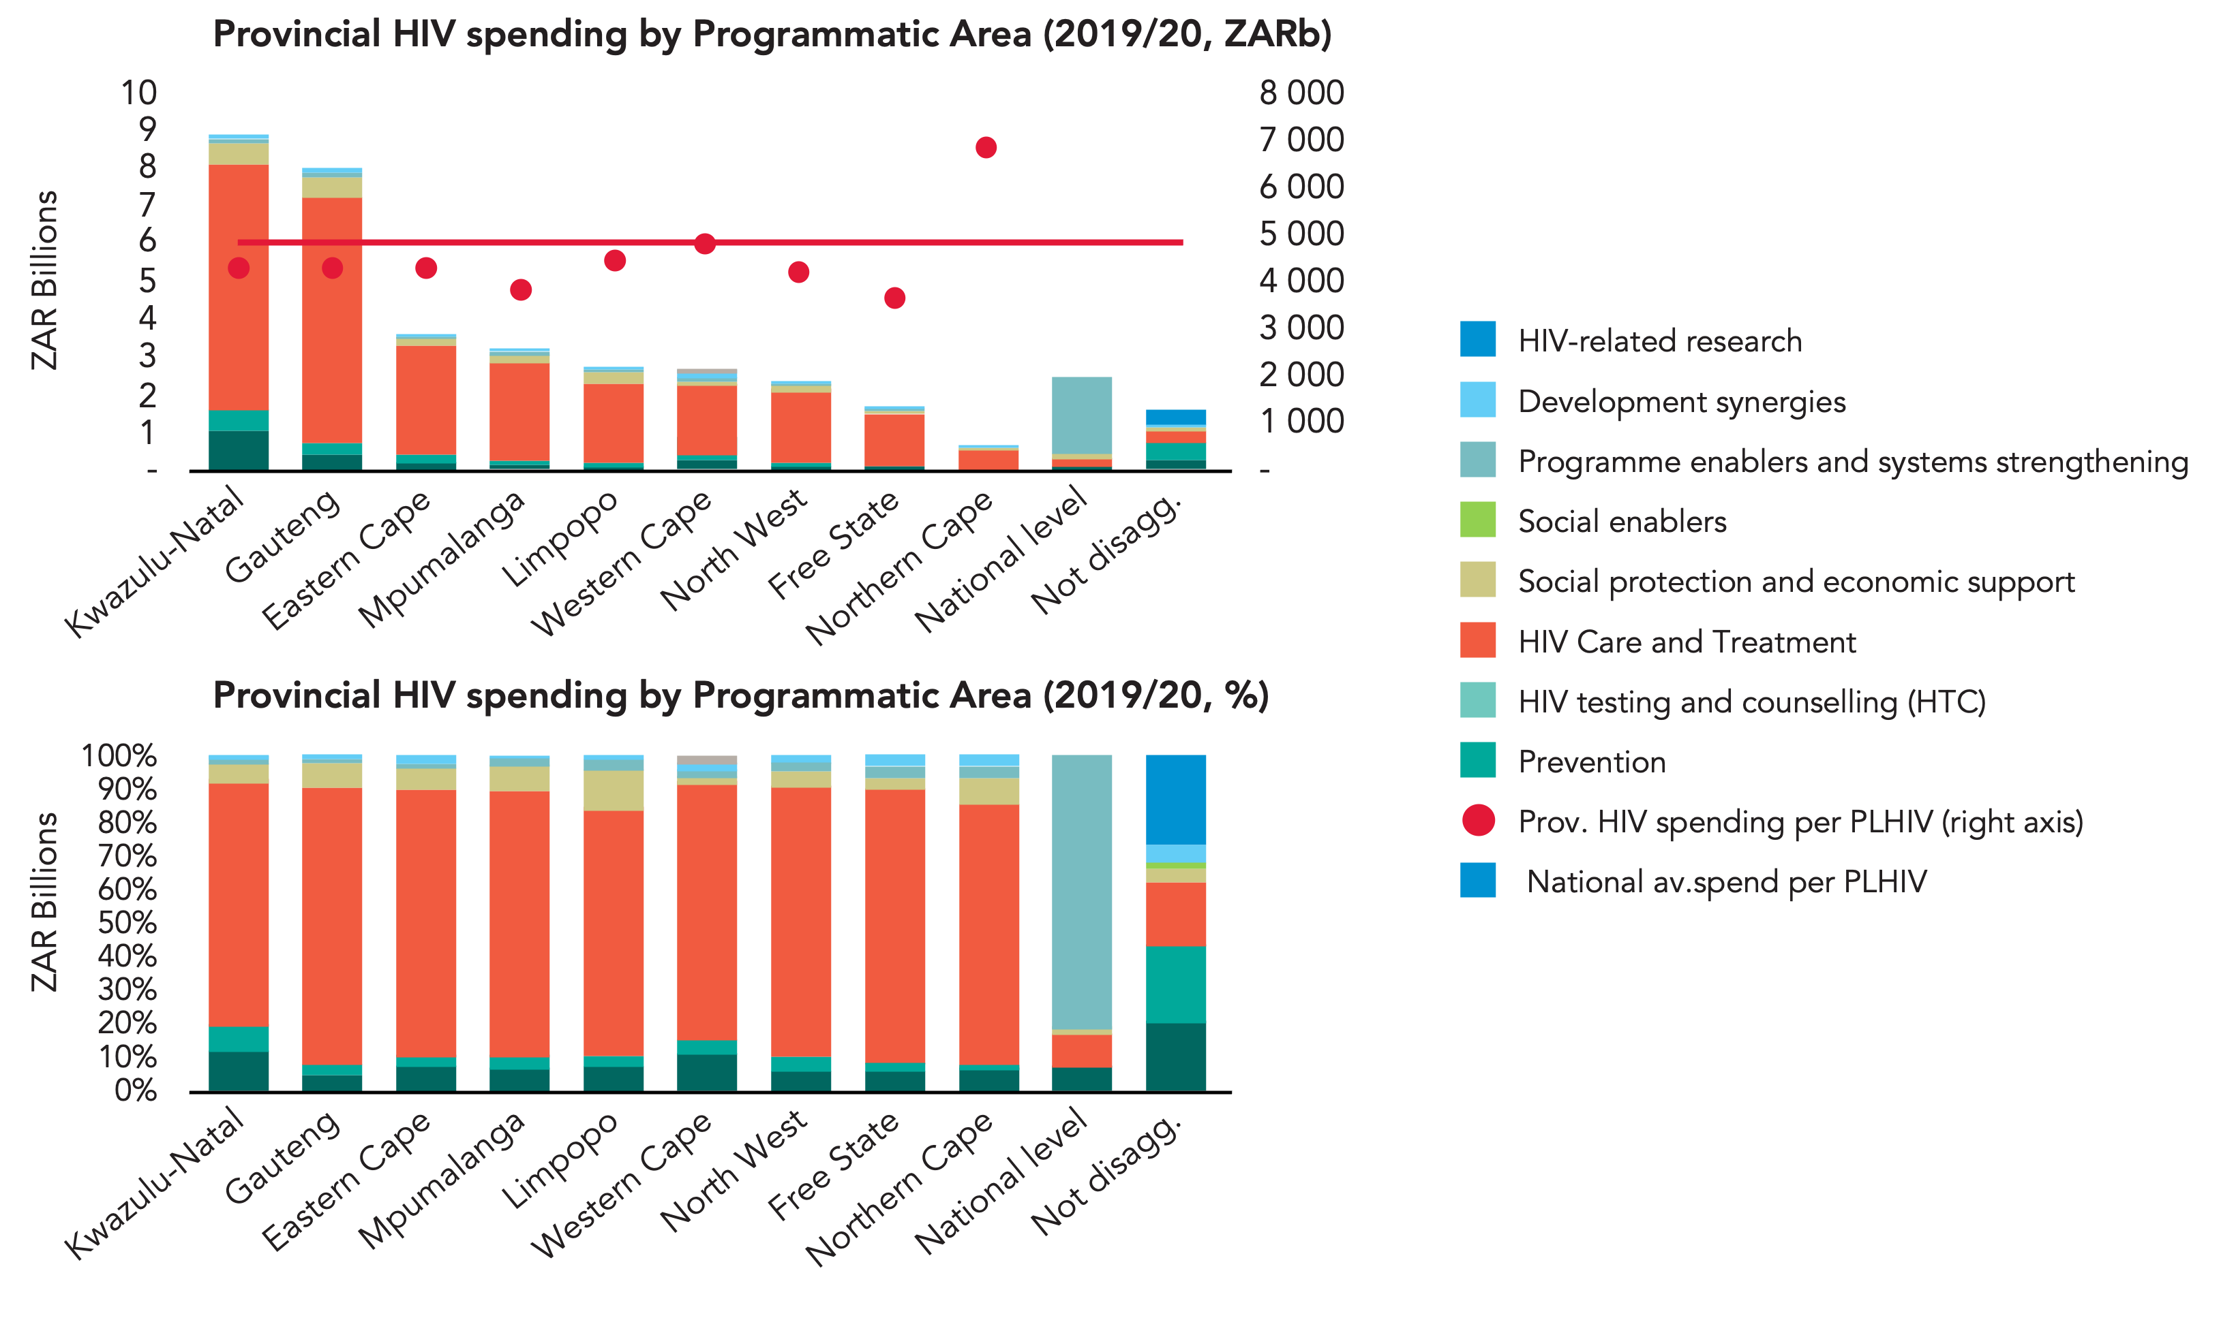
2. Equity analysis – spend per PLHIV across provinces

Slide 5
3. Allocative equity across provinces – spending per PLHIV

Slide 6
4. Adequacy of funding and Funding Gap Analysis (i)
NSP VS Actual spending: Gap analysis
800
600
400
US$ millions
623
486
672
539
200
0
-136
-134
-200
NSP Resources needed
Spending (NASA)
Shortfall
NSP Resources needed
Spending (NASA)
Shortfall
YR 1
YR 2
NSP VS Actual spending: HIV treatment and care
400
2 500 000
300
2 000 000
200
332
360
Total cost / spend (US$ millions)
260
265
1 500 000
100
0
1 000 000
-72
-95
500 000
-100
-200
NSP Resources needed
Spending (NASA)
Shortfall
NSP Resources needed
Spending (NASA)
Shortfall
0
# ART patients (target & coverage)
YR 1
YR 2

Slide 7
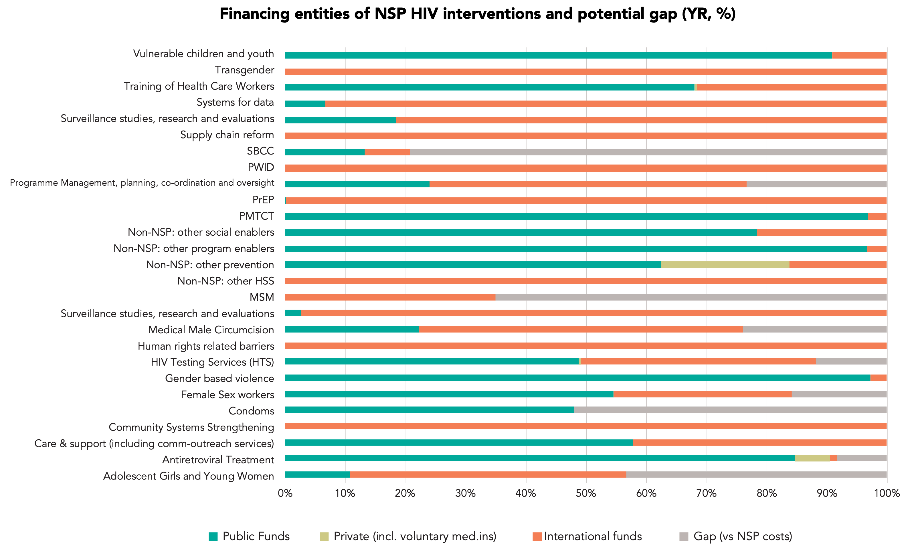
Funding Gap Analysis (ii)

Slide 8
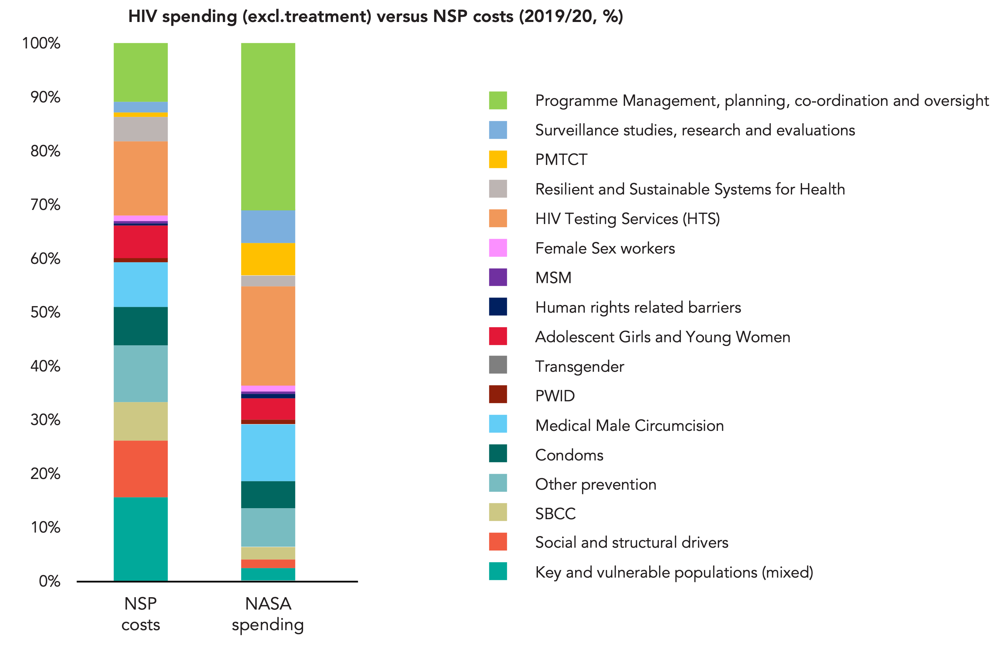
5. Allocative efficiencies – matching NSP priorities (or investment case?)

Slide 9
6. Absorptive capacity – comparison of budget and expenditure
GF disbursement VS spending
200
120%
180
160
100%
140
80%
120
100
US$ millions
Absorption rate (%)
80
60%
60
NASA expenditure data missing
NASA expenditure data missing
40%
40
20%
20
0
0%
YR 1
YR 2
YR 3
YR 4
YR 5
YR 6
GF disbursement records (HIV&TB/HIV&TB)
GF expenditures (NASA)
Absorption rate (%)
PEPFAR budgets vs expenditure (US$m, %) (Source of data: PEPFAR Spotlight)
500
120%
400
100%
300
80%
US$ Millions
Absorption rate (%)
60%
200
40%
Add comparison of govt budget (e.g., AIDS Levy) vs spend, if data available
100
20%
-
0%
2017
2018
2021
2022
2023
PEPFAR OU Budget
PEPFAR ER expenditure
Absorption rate (%)

Slide 10
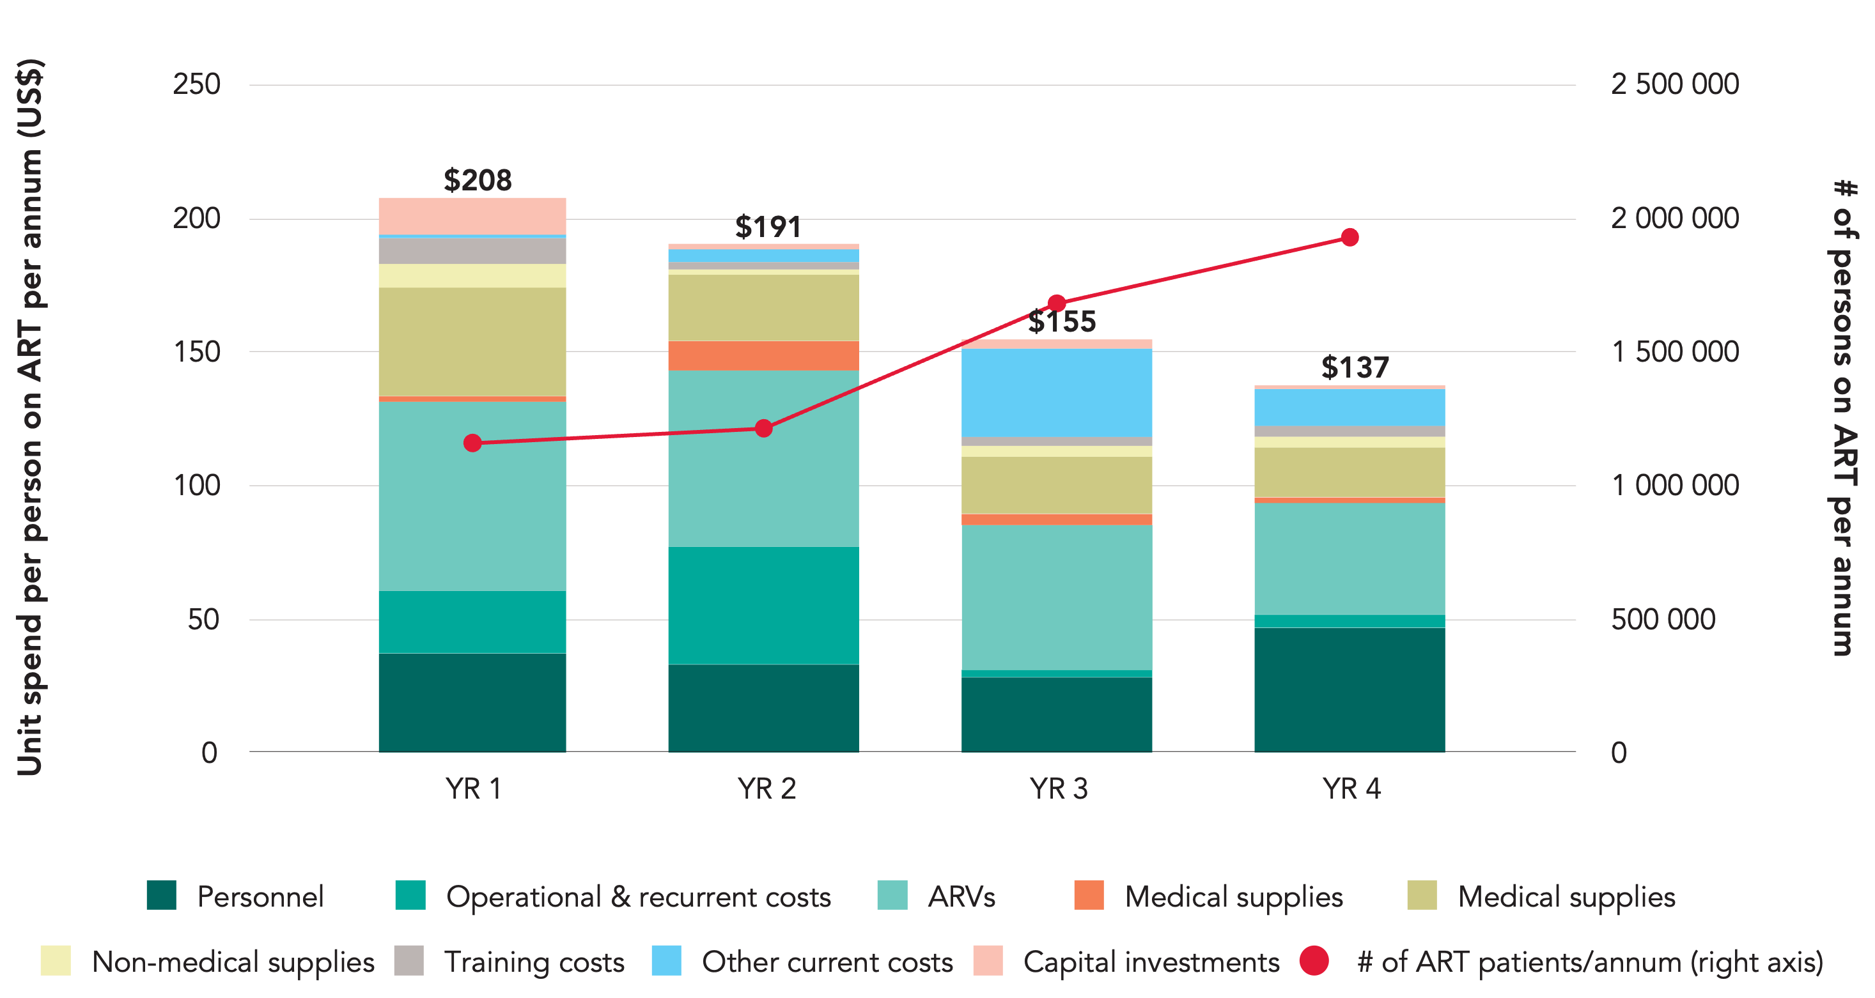
7a. ART Technical efficiency – spending per person on ART
by PF over time

Slide 11
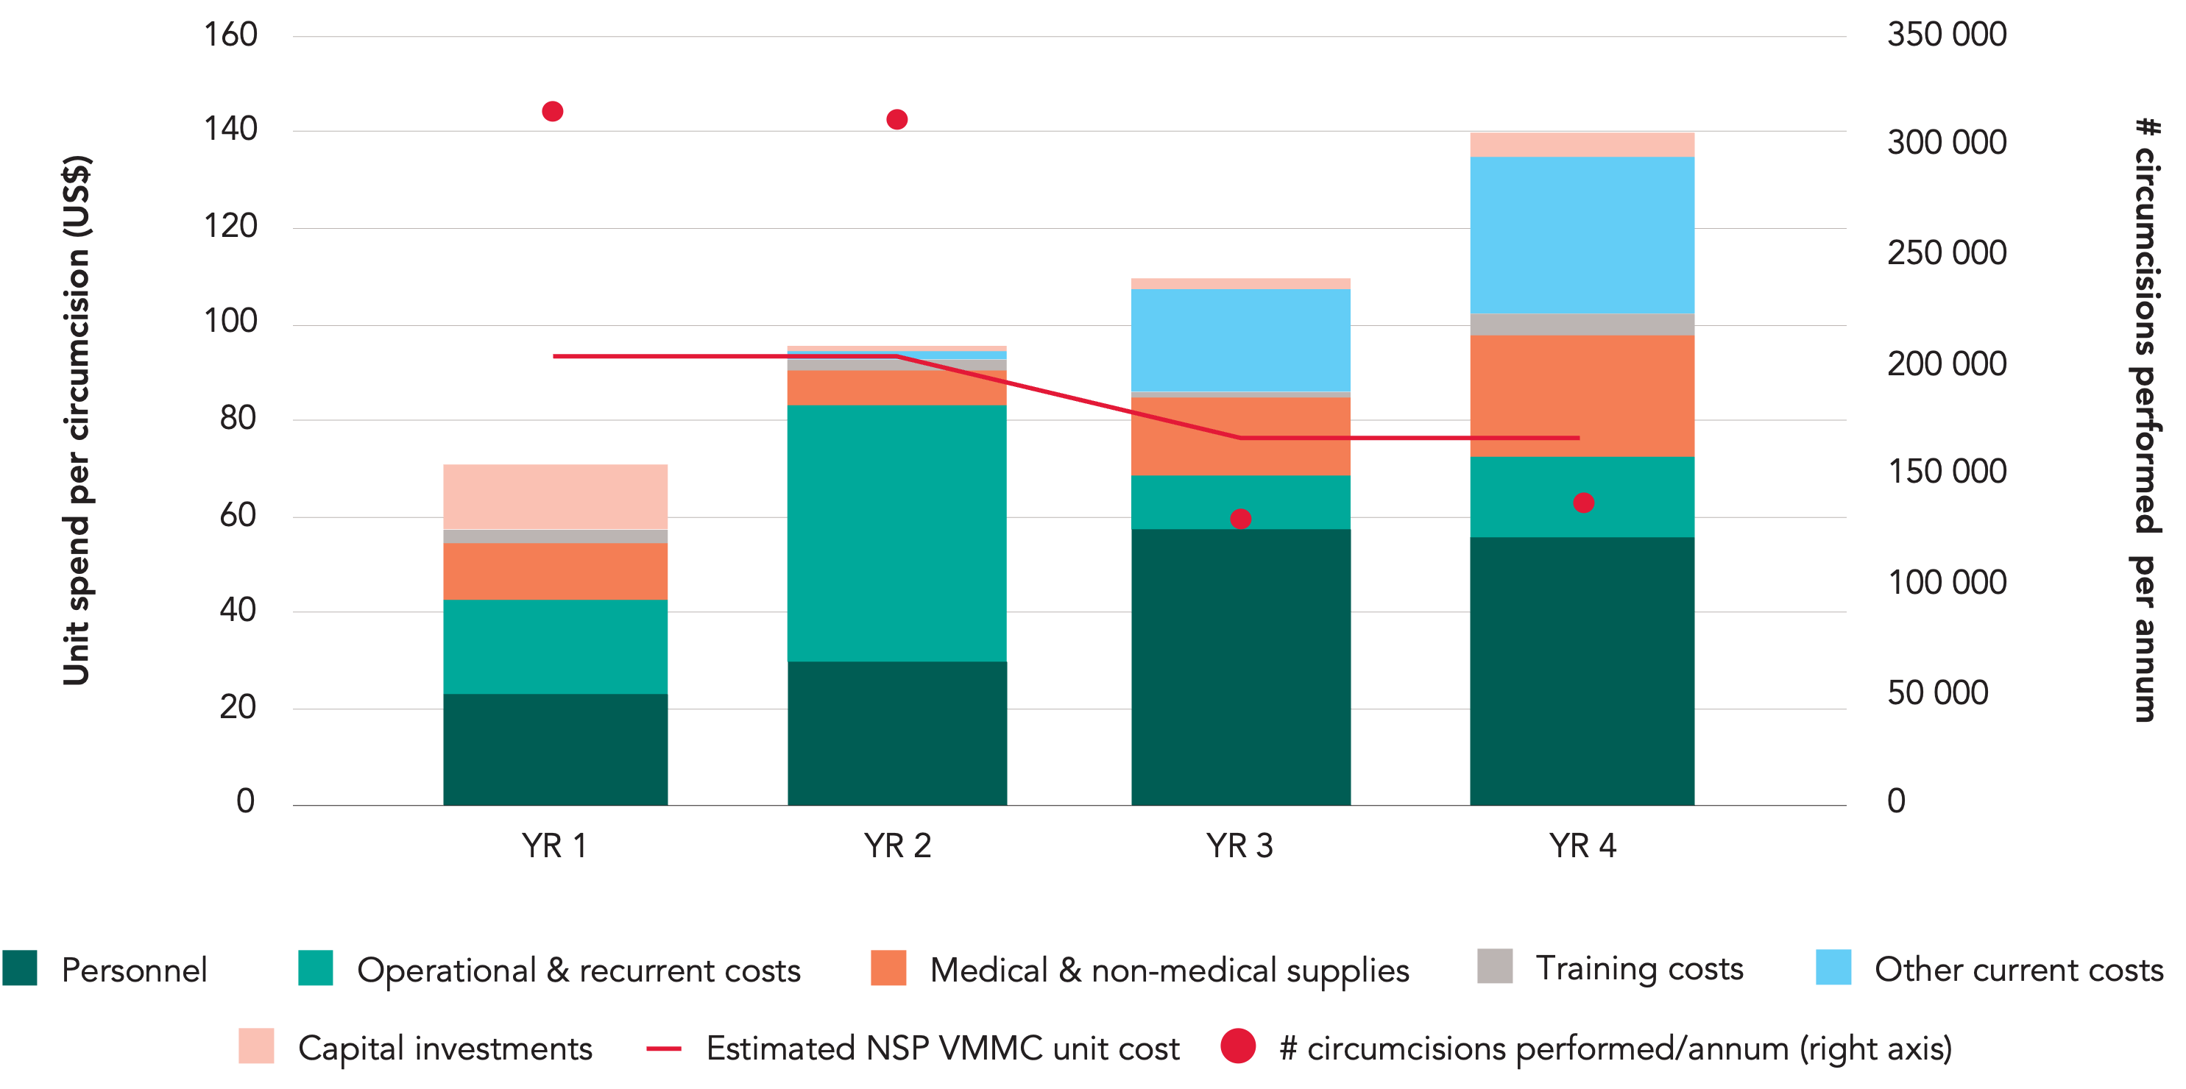
7b. VMMC Technical efficiency – spending per circumcision
by PF over time

Slide 12
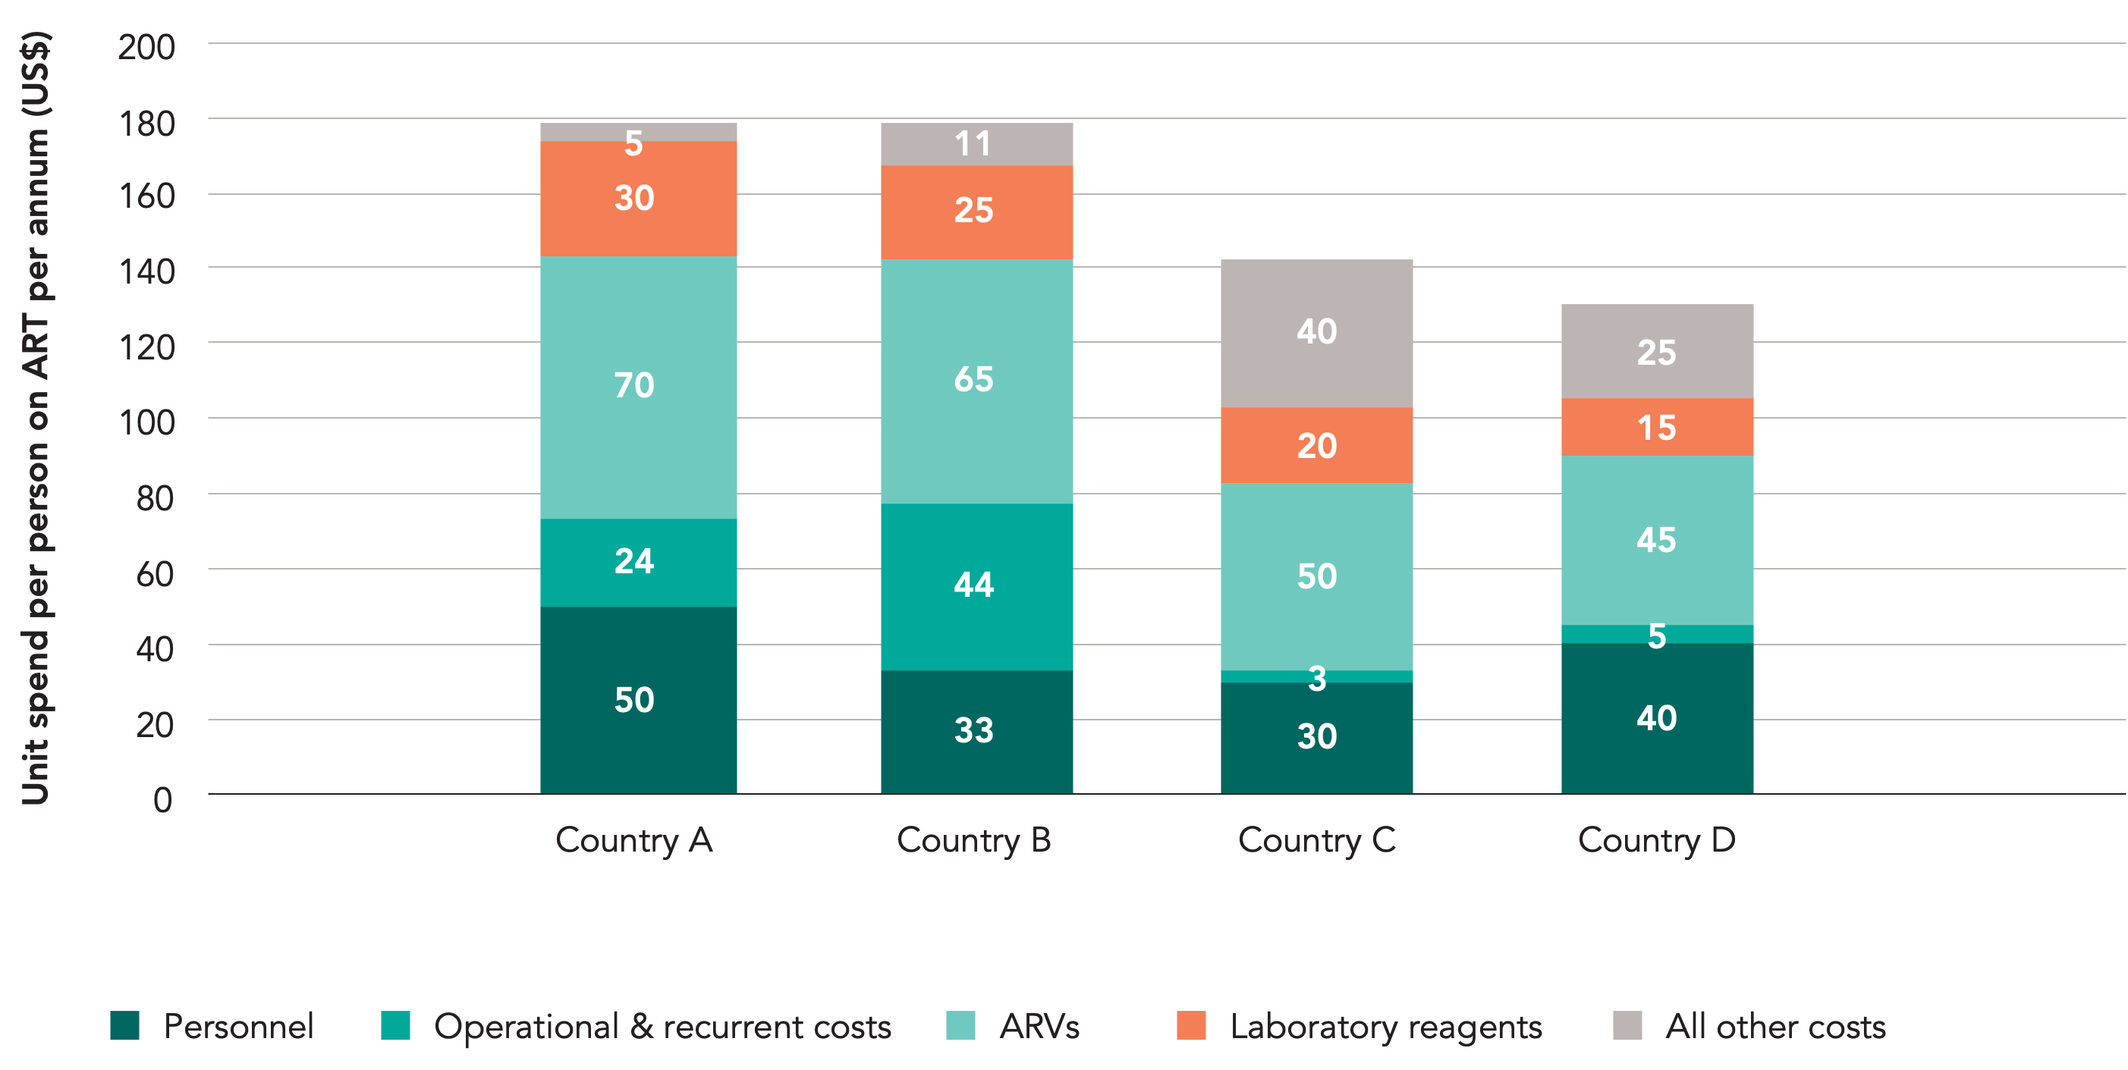
8. Benchmarking – comparison with other countries spending per person on ART

Slide 13
9. Other comparisons
Total HIV spending as a % of country’s GDP
Public HIV spending as a % of country’s total public expenditure
Health-related HIV spending as a % of total health expenditure
Per capita HIV spending (USD) compared to other countries in the region
Per capita HIV spending (USD) compared across provinces / districts (sub-national areas)
ART spending per person on ART compared to other countries in the region (see example below)
ARV (medicines only) spending per person on ART compared to ARV commodity prices available via GF, Clinton Foundation or other pooled procurement options
VMMC spending per circumcision compared to other countries in the region
Provincial / district (sub-national) units of expenditure comparison (for specific interventions) which can highlight potential inefficiencies between sub-national areas others?

Slide 14
THANK YOU
For more information, contact UNAIDS Resource Tracking:
Teresa Guthrie
guthriet@unaids.org

