Slide 1

UNAIDS | SEP 2025
National AIDS Spending Assessment (NASA)
CONCEPTUAL FRAMEWORK
PRESENTER NAME, COUNTRY & DATE OF TRAINING

Slide 2
OUTLINE
NASA framework and objectives
Importance & value-add of NASA
NASA principles
NASA implementation process
Examples of NASA data and utility

Slide 3
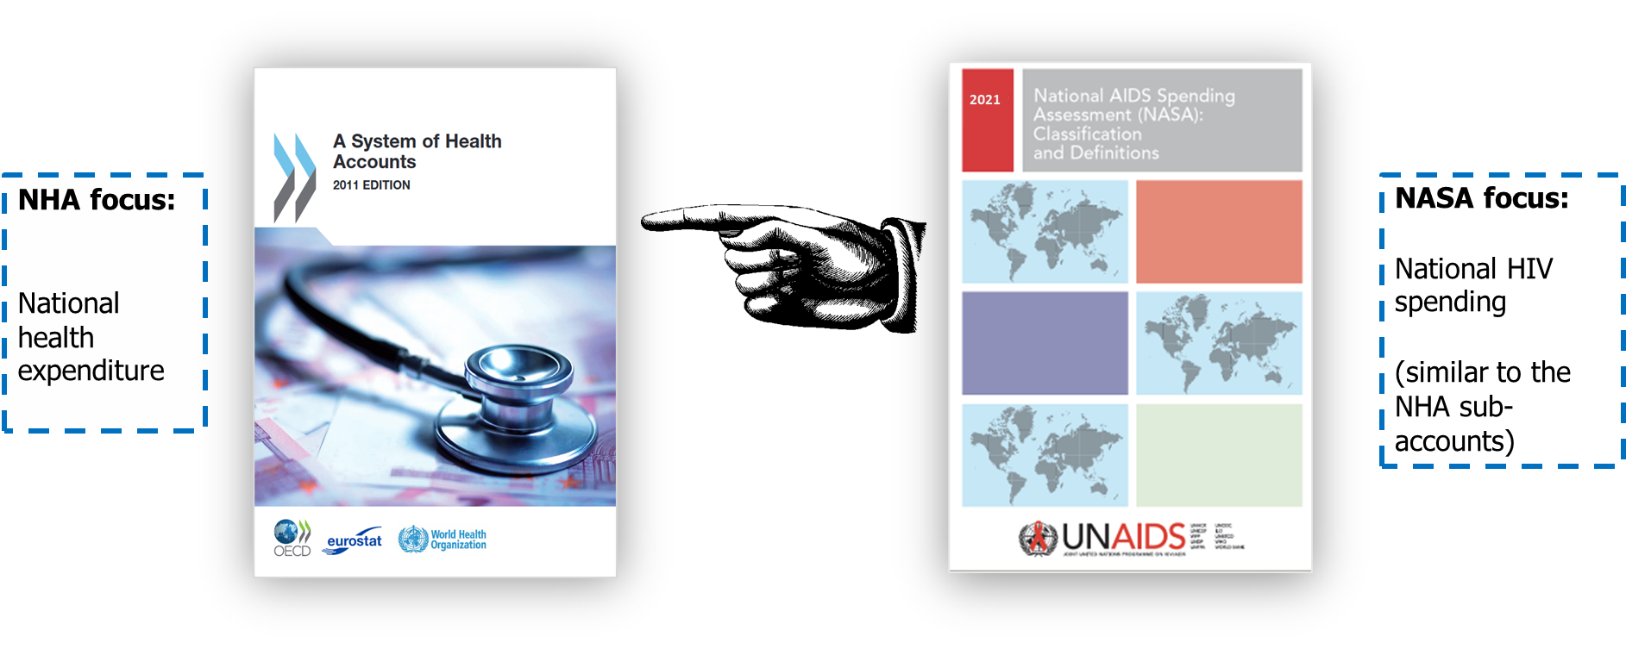
NASA and the System of Health Accounts
NASA is inspired by broader national accounting systems. Its methods are mainly based on principles underpinned by the System of Health Accounts (SHA) - National Health Accounts (NHA).

Slide 4




What is NASA?
A methodology to measure and track resources of the national responses to HIV. It is used to estimate HIV expenditure
Resource tracking tool used by countries to track and analyze the amount of funding being invested in HIV and AIDS-related programs and services.
It is a systematic and standardized approach to collecting, analyzing, and reporting financial data related to the HIV response.
NASA comprehensively collects information on funding for various HIV program areas. The data collected is used to develop a comprehensive picture of the financing landscape for the HIV response in a particular country,

Slide 5
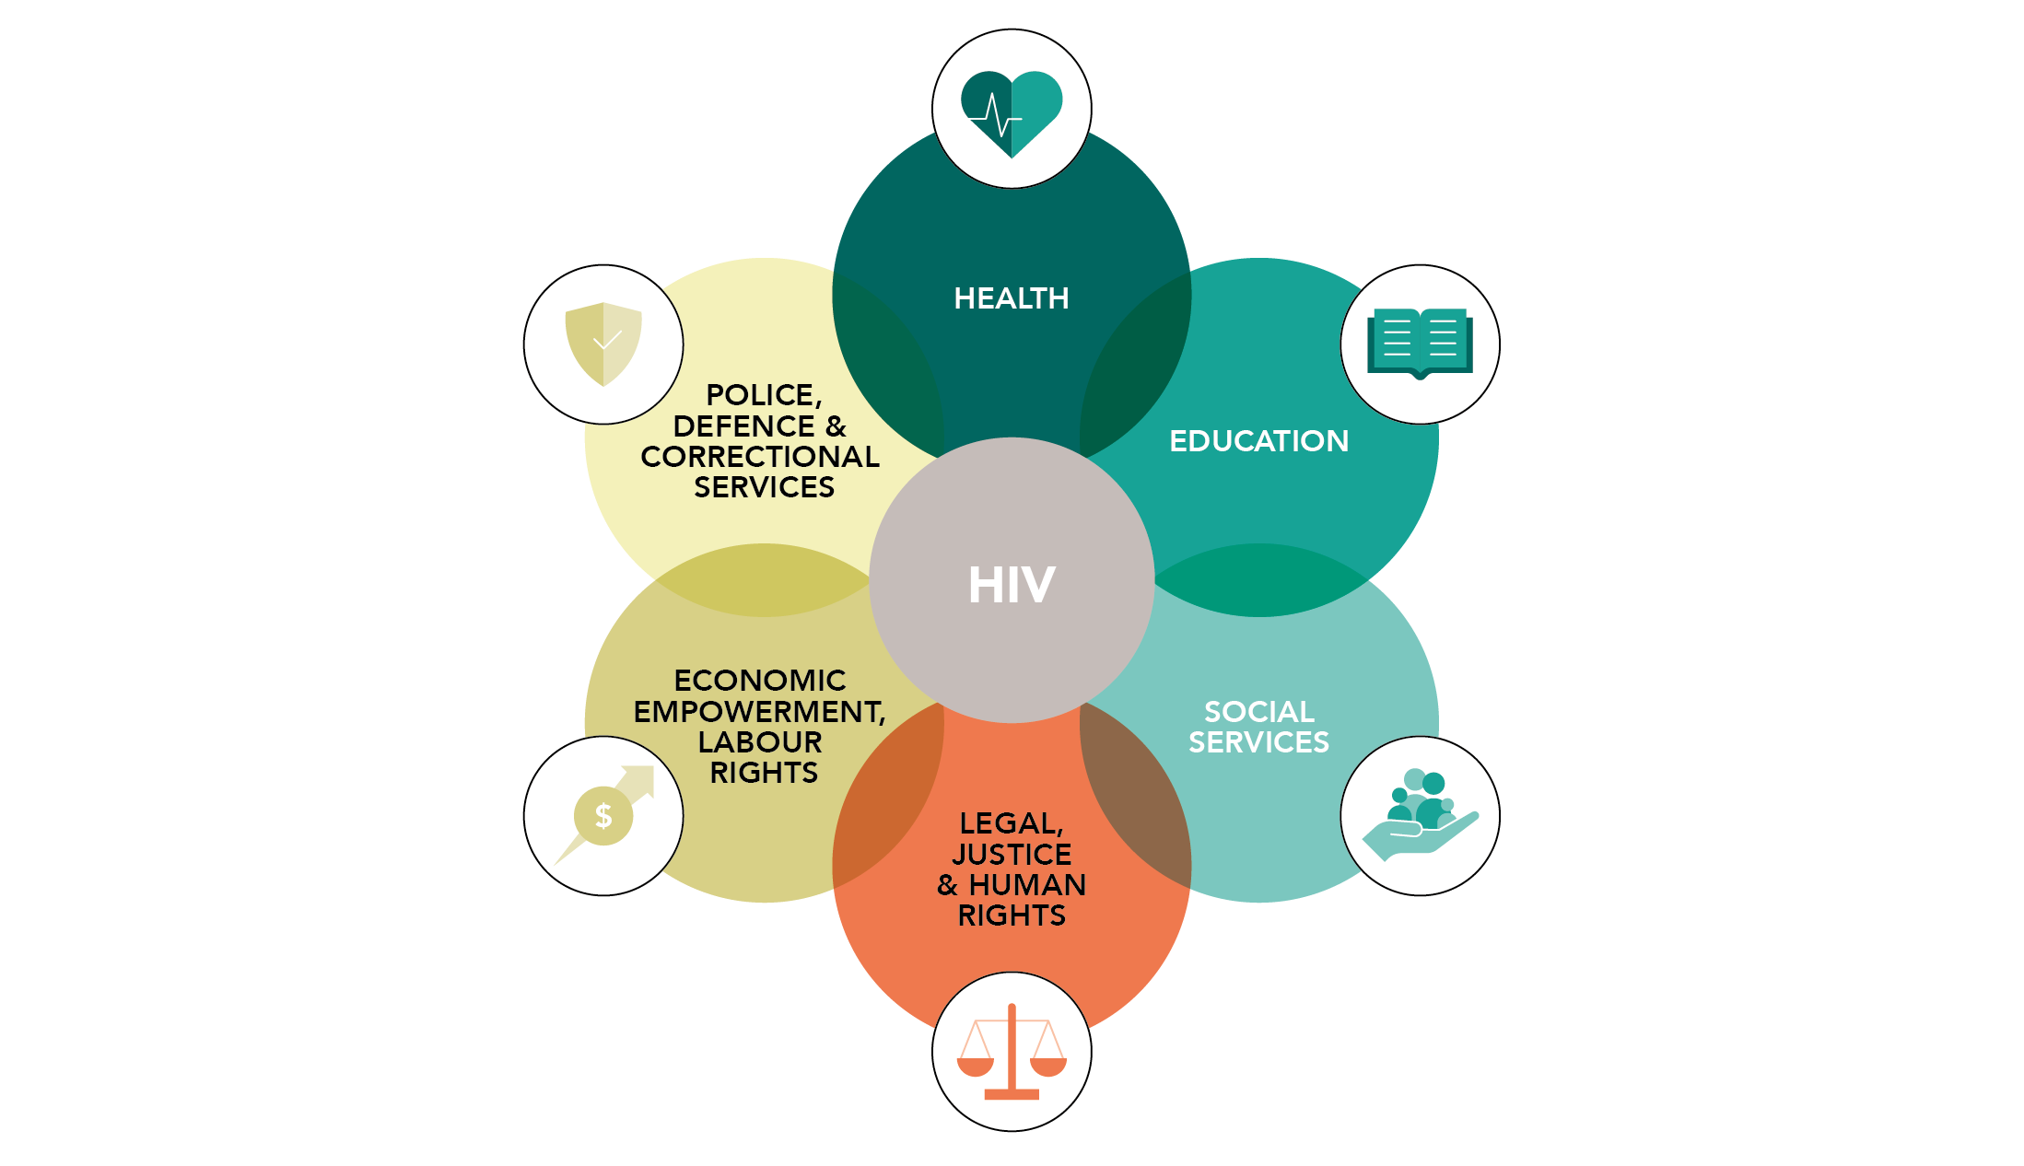
What does NASA measure?
NASA measures the expenditures incurred in the implementation of the National HIV response. This process includes assessing the value of goods and services consumed during the execution of the National Multisectoral Response
NASA is not limited to health expenditures. NASA follows the basic framework and templates of the National Health Accounts but embraces the tracking of social mitigation, education, labour, justice, and other sectors’ expenditures to embody the multi-sectoral response.

Slide 6










NASA Objectives
NASA attempts to answer the following questions:
$ MoF
Who pays and who purchases? (F. entities & F. Agents) - which Revenue and through which Schemes?
Sufficiency? Sustainability?
Clinic
Who provides the services? (Providers of Services)
Response actors - Role of CLOs, social contracting?
Operational efficiencies?
What was provided? (AIDS Spending Categories)
Optimal / prioritized?
Allocative efficiency?
Who benefits? (Beneficiary Population)
Focus on KPs
Equity? Adequate for vulnerable?
What cost components / drivers? (Production Factors)
Cost per output/ outcome?
Technical efficiency?
What Service delivery model
Review of service delivery modality /
Operational efficiency?
Facility level
Community level

Slide 7
Importance of NASA
1. Resource Allocation and Planning:
NASA helps governments and organizations allocate resources effectively by assessing how funds are utilized in the HIV response.
It provides insights into where investments are most needed, allowing for better planning and prioritization
2. Transparency and Accountability:
By tracking expenditures related to HIV programs, NASA promotes transparency and accountability.
It ensures that funds are used efficiently and that there is transparency in financial reporting
3. Data-Driven Decision-Making:
Policymakers, program managers, and stakeholders use NASA data to make informed decisions.
It informs policy adjustments, program scale-up, and targeted interventions.
4. Advocacy and Funding Requests:
Organizations can use NASA findings to advocate for increased funding from donors and governments.
It strengthens the case for sustained investment in HIV prevention, treatment, and care.

Slide 8
NASA value-add
NASA
NASA
NASA
Global Fund request for funding – the financial landscape
Sustainability planning – understanding the current donor dependency
GAM reporting (indicator 8.3)
Flexible to include new services, e.g. PrEP, KPs, more TB details
To track spending according to the country’s priorities outlined in NSP
NASA can track expenditure according to the Resource Needs (RN) Categories
Resource Needs Categories: services with “proven impact” allocative efficiency
Allows to measure the funding gaps – for financing and resource mobilization
Leads to routine collection of financial data – should be a part of the NAC’s M&E

Slide 9
Utility of NASA data – relevant to Sustainability planning
Captures multi-sectoral & multi-partner HIV/AIDS response, according to the NSP (SRM?) priority areas / interventions
Indicates past HIV expenditures (retrospective) and trends in financing. Allows countries to predict patterns.
Financing architecture & flows, decisions, power, schemes, architecture. Countries might consider new / different financing arrangements (e.g social health insurance)
When compared to the NSP costing / resources needed, per intervention and per funder, calculated financial gap analysis will highlight areas most vulnerable / unsustainable without external support. Relies heavily on well-costed NSPs.
Detailed data per intervention - alignment to NSPs, Investment Case priorities / high impact interventions – measures allocative efficiencies and informs reprioritization – moving towards most impactful investments with reduced funding. Also enhances co-ordination between funders.
Provides sub-national picture – by region / province / district. This may be important for decentralized / federal state planning.
Provides detailed data per service provider types that reflects the multi-sectoral and complex HIV response that needs to be sustained (eg. measures social contracting of NGOs, community-level organisations etc.).
Includes insights into the community-led response / CLOs – to ensure their protection & promotion.
Provides detailed data per cost components/ items (commodities / human resources etc.) that can be linked to specific interventions – which allows for the measure of technical efficiencies, highlighting areas where saving could be made (making reducing funding go further).
Detailed analysis of donor contributions to commodities and human resources will flag areas most vulnerable to reducing external aid.
Provides detailed data by beneficiary and performance indicators (linked to the specific interventions) – allows for Equity analyses, Units of expenditure comparisons, value-for-money measures – informing more efficient implementation choices.

Slide 10
Additional data collection, triangulation and analysis beneficial to SRM
A comparison of NASA data with past budgets / commitments to measure absorption capacity & identify potential areas of wastage which could be reduced / bottlenecks to be addressed to ensure optimal use of available funds.
To collect future budgets / commitments to predict trends in financing / funders’ priorities.
Comparison of future budgets with estimated resources needed per intervention (sound costings of NSPs / SRMs would be required) to identify future areas of risk / vulnerability.
Creation of funding landscape tables (similar to those used for Global Fund funding requests).
Model the impact of future changes in funding in key interventions and their savings/ costs. E.g. a 10% reduction in ART funding could result in xx% reduction in treatment coverage, reduced viral suppression, increased mortality, production losses, increased new infections, increased treatment cost…)
Estimate the potential savings through integrated HIV services (limited to health services in health settings?) – or make use of existing studies.
Model alternative / innovative financing sources and their potential contributions (existing evidence shows very small contribution and high administration costs)? Not at moment…

Slide 11
NASA Principles
NASA is guided by 3 principles
1. Data triangulation: triangulate and cross-check data from different sources (FE, FAP &PS) to avoid double counting
2. NASA captures only complete transactions All 9 vectors are mapped to recreate a complete transaction
3
3. Capture only actual expenditure, HIV expenditures: Goods and services delivered to a Beneficiary Population. Not budgets or commitments

Slide 12
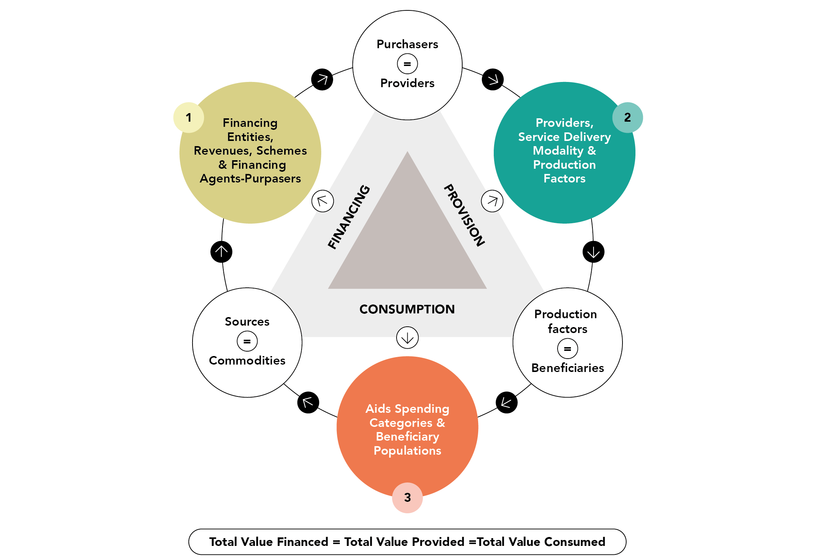
NASA Principle 1: Data triangulation (top-down & bottom-up)

Slide 13
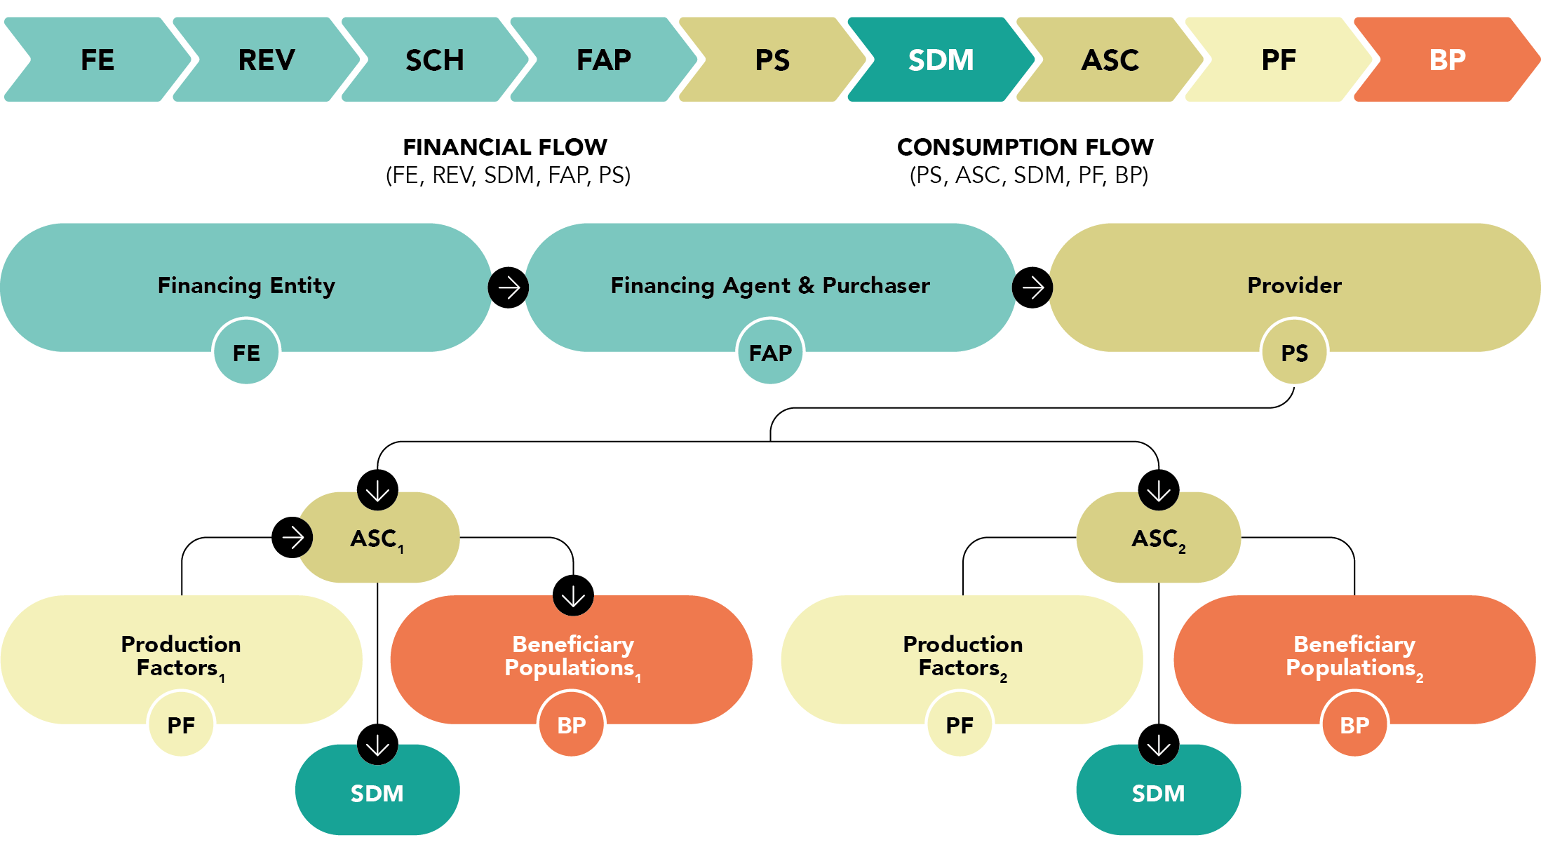
NASA Principle 2: Complete transactions with all vectors

Slide 14
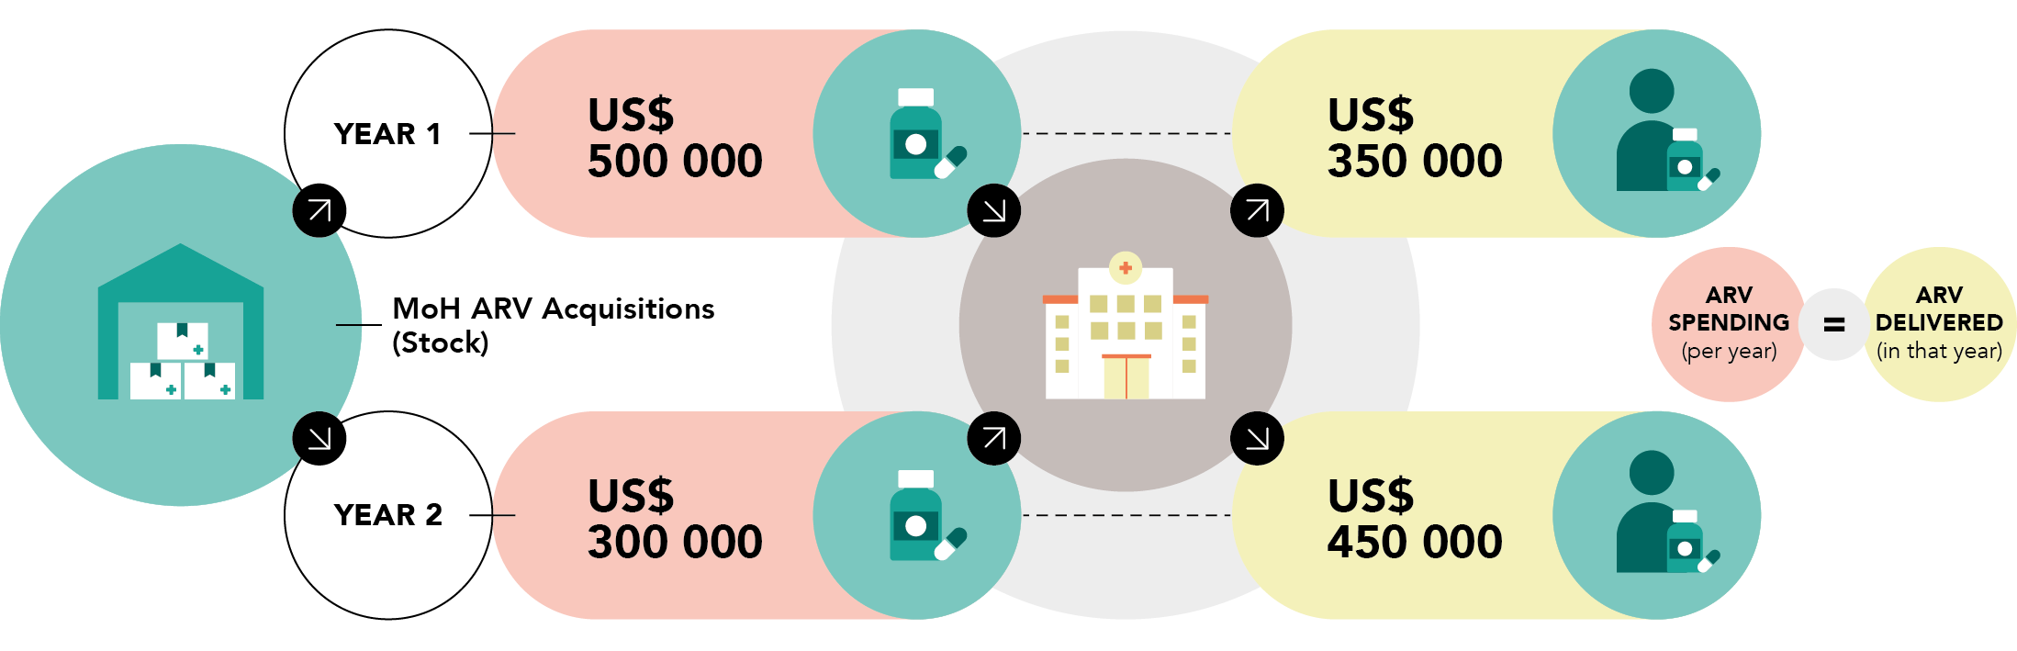
NASA Principle 3: Spending on consumed goods / delivered services is captured (accrual / matching accounting)

Slide 15


NASA Principle 3. Actual spending not budgets or commitments
✗ Resources allocated, resources committed, budgets, nor estimated resource needs…
✗ Resource allocated are usually not equal to Budget executed or actual expenditures…
NASA tracks the value of resources consumed during the implementation of the national HIV response !

Slide 16
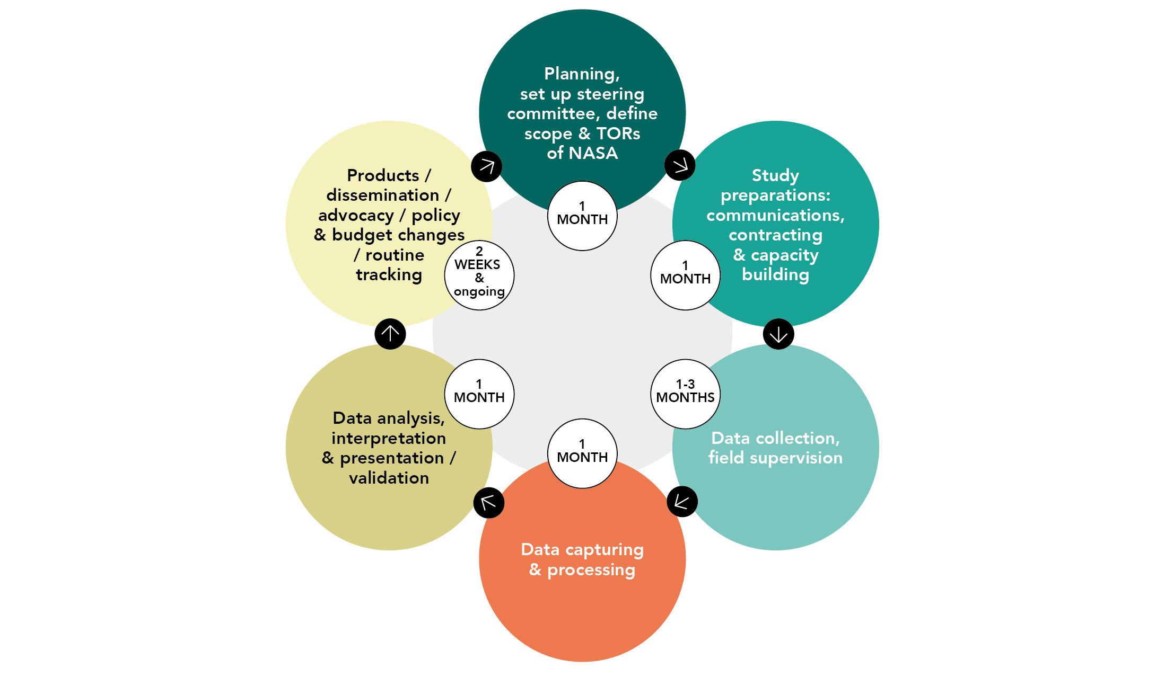
An outline of NASA process & key steps
1. Define the Scope, Timeline, and Budget for NASA - guided by the Technical Working Group which includes civil society representatives, programme managers and policy & budgetary decision-makers – to ensure the questions to be answered by NASA are relevant to all stakeholders.
2. Identify and select organizations from which data will be collected. These organizations play a crucial role in providing relevant information.
3. Train data collectors to ensure they follow standardized procedures during data collection. 4. Data collection, cleaning & capturing.
5. Implement quality assurance measures throughout data collection to maintain accuracy and completeness. Regular checks are essential.
6. Generate Estimations and Create Bivariate Matrices – validation of draft findings
7. Draft comprehensive report / briefs / slide decks etc. summarizing findings and conclusions.
8. Disseminate the results to relevant stakeholders, promote use of data to inform planning etc.

Slide 17
Where Funds, Time or Data require a NASA basic or a NASA plus
UNAIDS provides a range of resource tracking options to meet country needs and capacity
These include:
NASA basic option (without detailed primary data collection and which loses detail and comprehensiveness)
Commodities (health products only) review
Usual NASA (with very granular, comprehensive data)
NASA plus – which has the option to add a deeper dive into the community-led response, and/or TB
RAFT for PEPFAR data – Rapid HIV/AIDS Response Financing tool which consolidates all PEPFAR financial data to assist countries prioritize actions to address gaps
Joint SHA-NASAs are also an option for countries with a strong health accounts team, with NASA experience (this process is longer than the usual NASA and more complex, if done correctly)
The characteristics of the first three are displayed on the next two slides:

Slide 18
Range of HIV Resource Tracking Options and the data provided
Note joint SHA-NASAs are not discussed here as they are more labor & time intensive

Slide 19
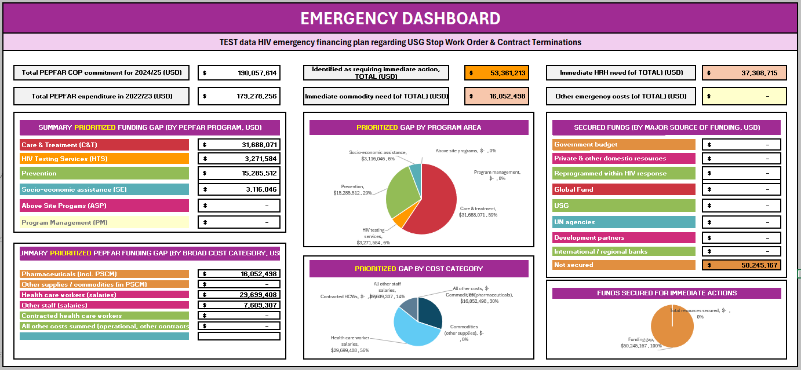
Rapid HIV/AIDS Response Financing tool for PEPFAR situation

Slide 20
Examples of NASA results and their utility

Slide 21
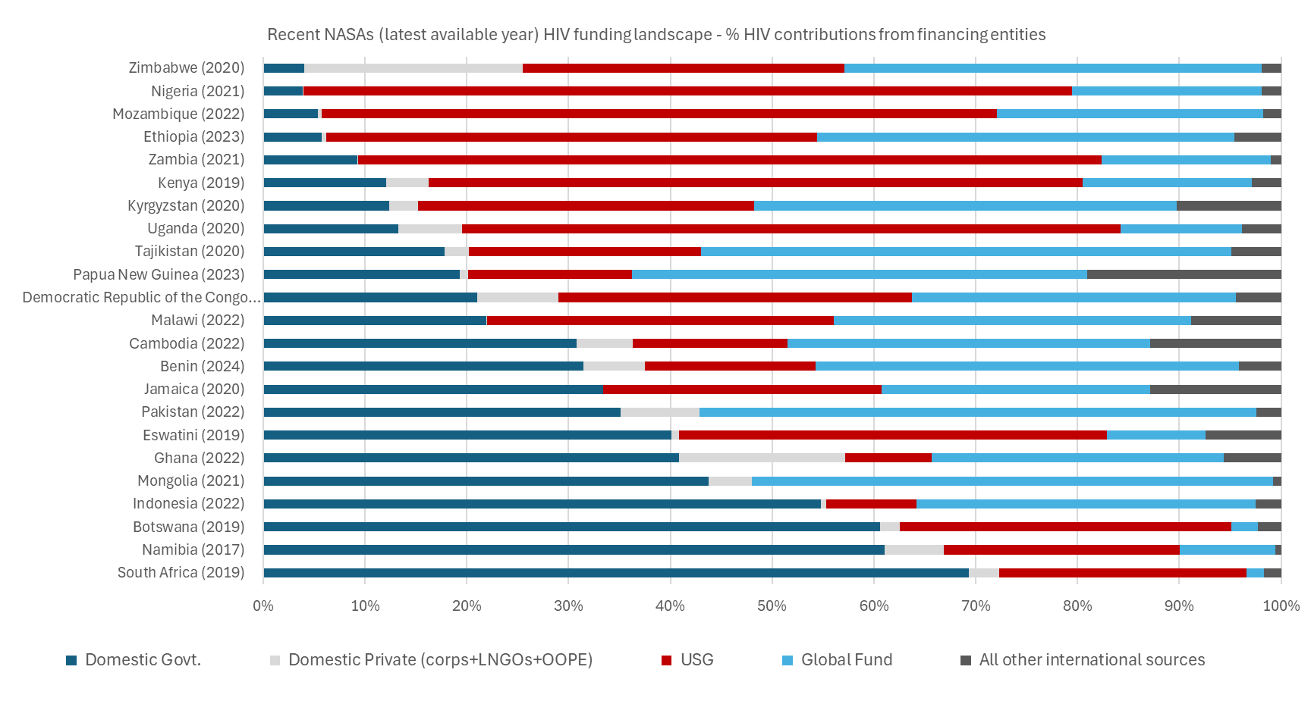
Funding landscape tables – total HIV spending by financing entities

Slide 22
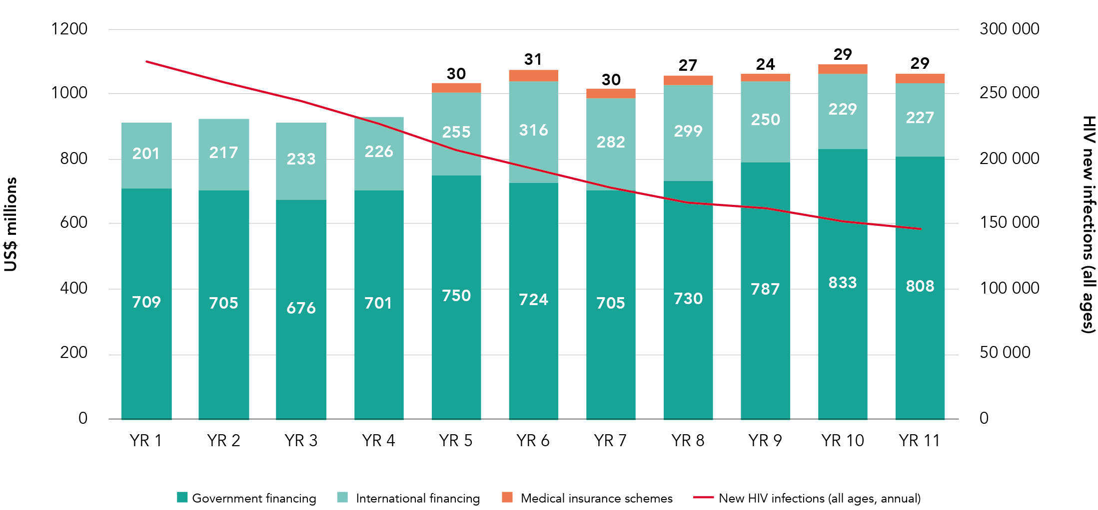
NASA data to show the impact of HIV expenditure over time, ownership of the response, sustainability

Slide 23
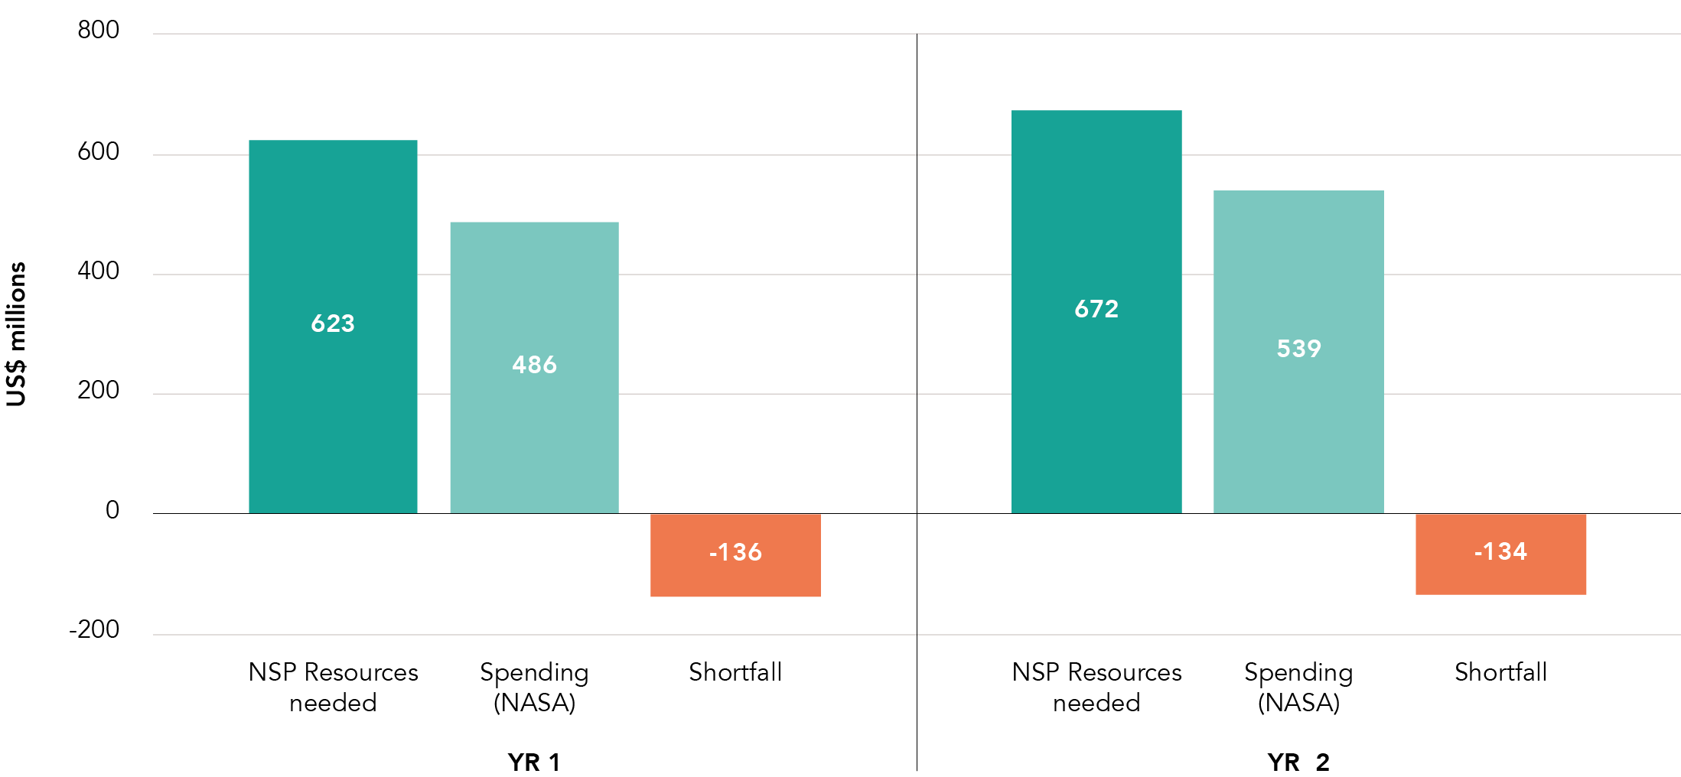
Adequacy of funding in past informs future resource mobilization efforts

Slide 24
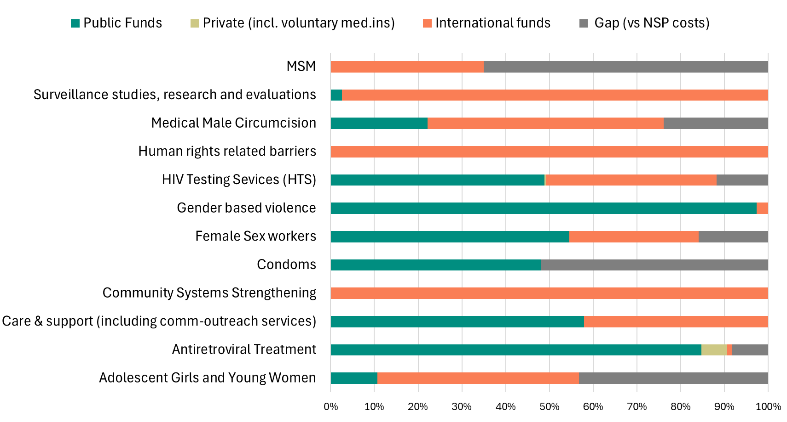
NASA data to show the sustainability / vulnerability of specific interventions – spending by source

Slide 25
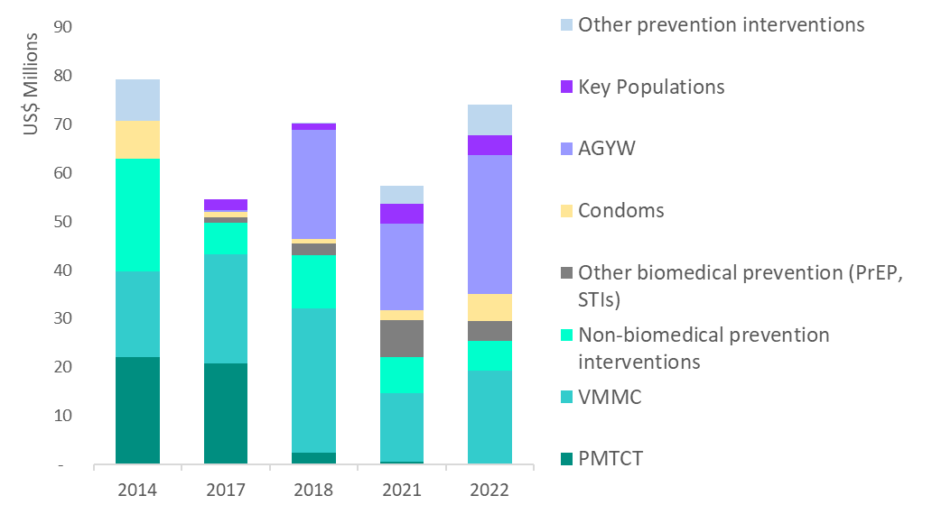
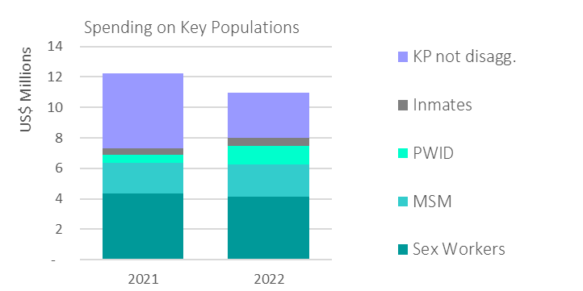
NASA Granular details
DEEPER DIVE INTO PREVENTION EFFORTS
DEEPER DIVE INTO KP SPENDING

Slide 26
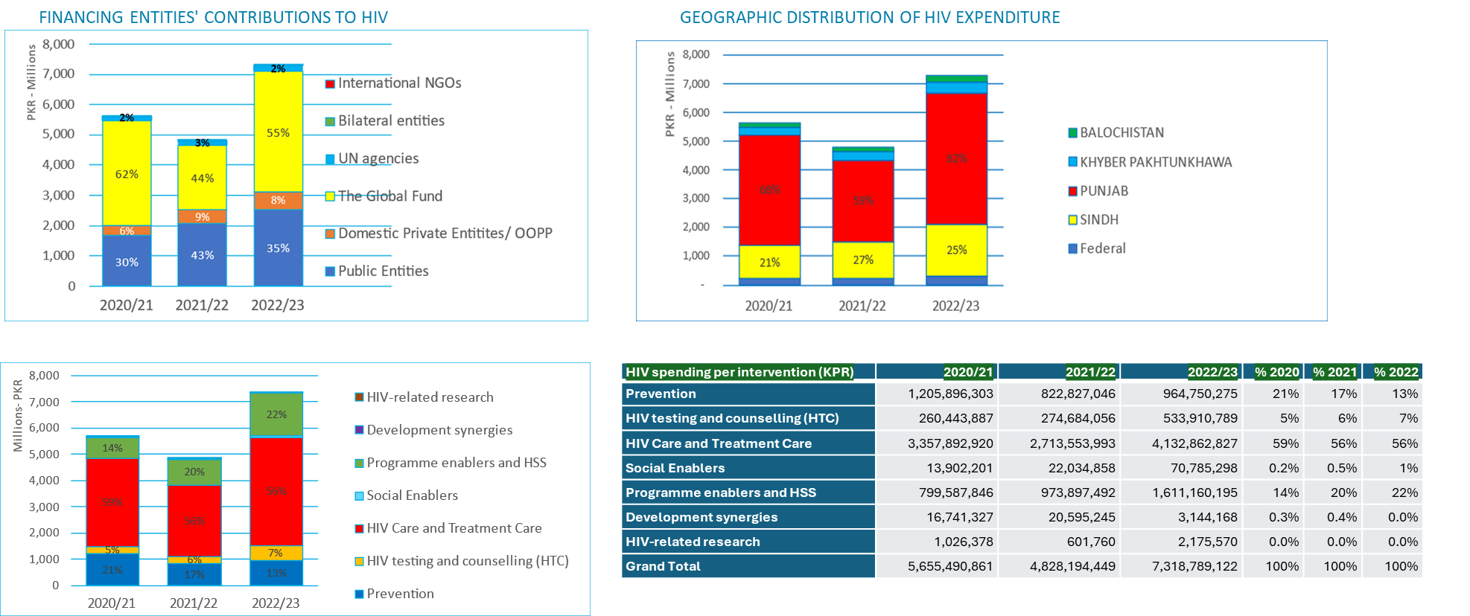
NASA Results and cross-tabulation system
NASA report typically includes matrices, summary tables, auxiliary tables and summary indicators to facilitate the situation analysis and exposition to selected audiences.

Slide 27
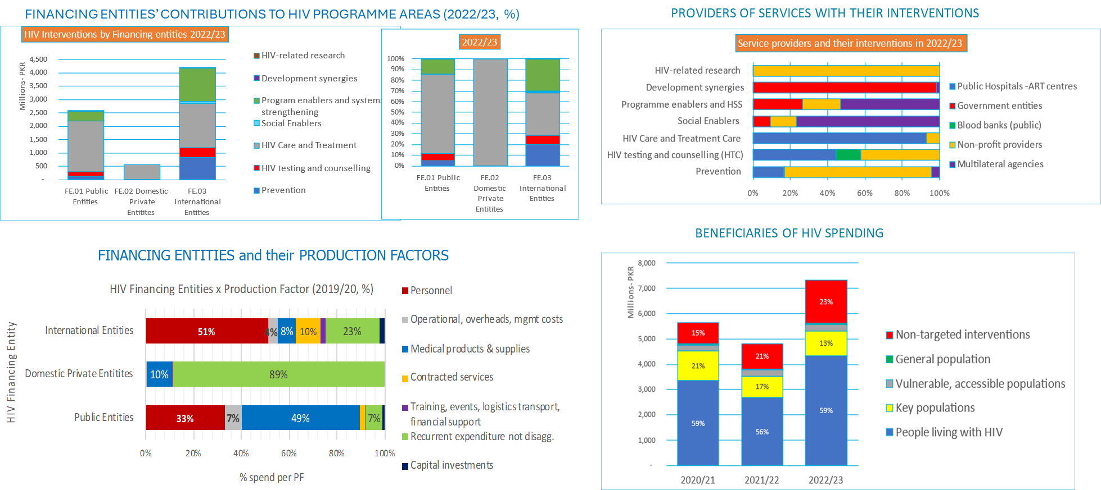
NASA Results and cross-tabulation system

Slide 28
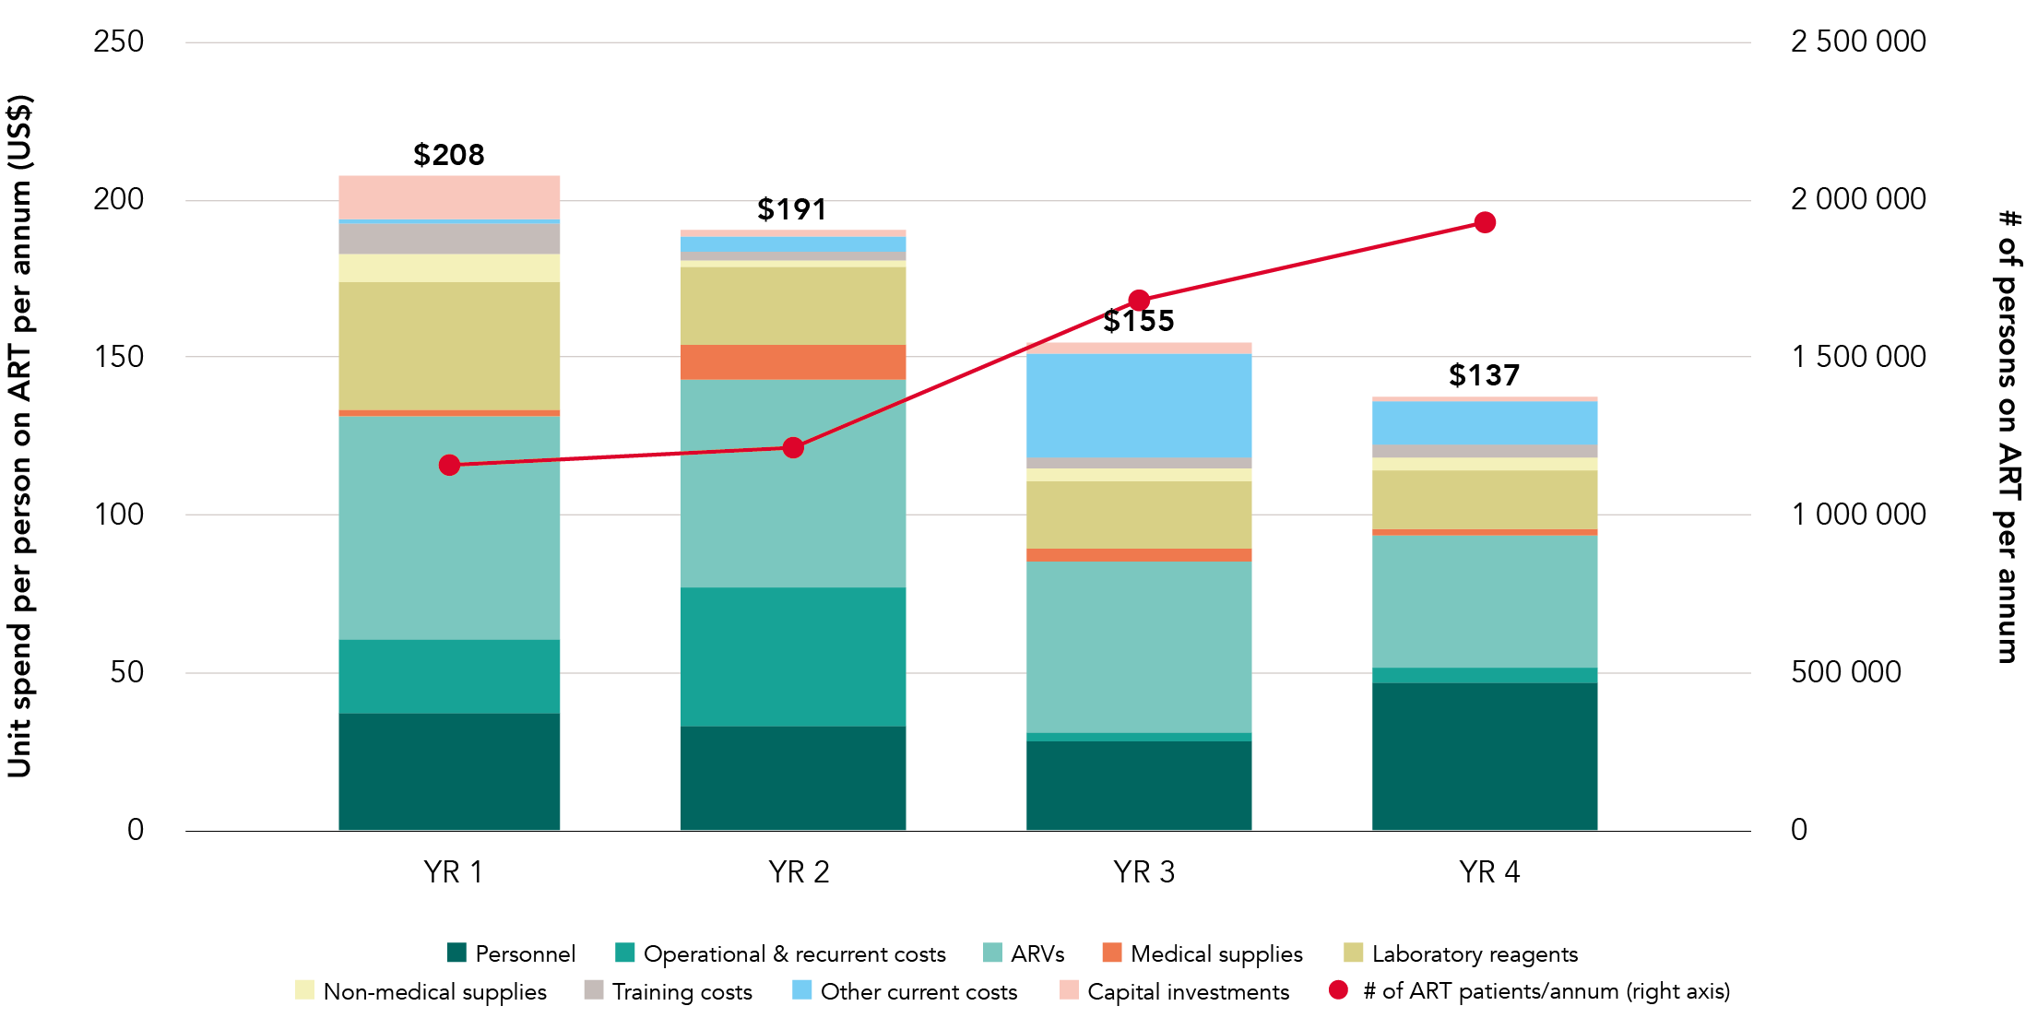
Using NASA units of expenditure (spend per output / come) to examine technical efficiencies:
a. Spend per person on ART per year, over time

Slide 29
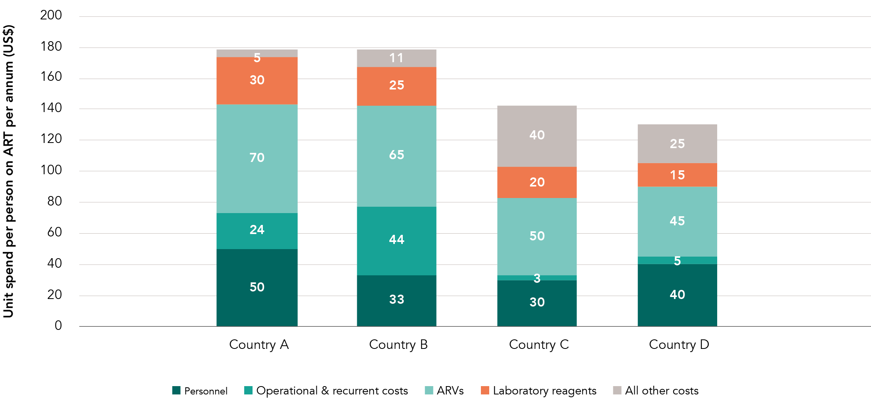
Regional comparisons – benchmarking for efficiency gains

Slide 30
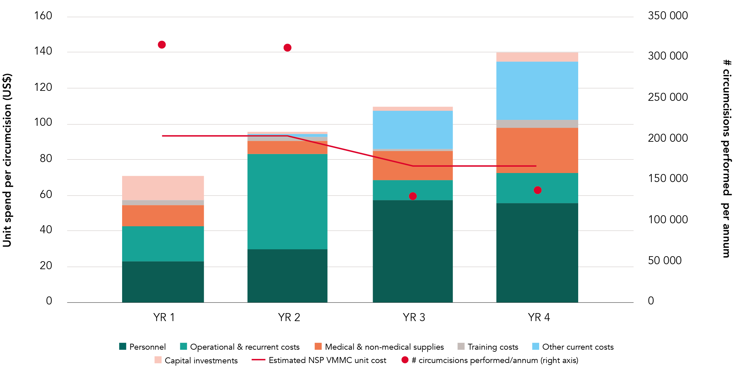
Using NASA units of expenditure (spend per output / come) to examine technical efficiencies:
b. Spend per circumcision, over time

Slide 31
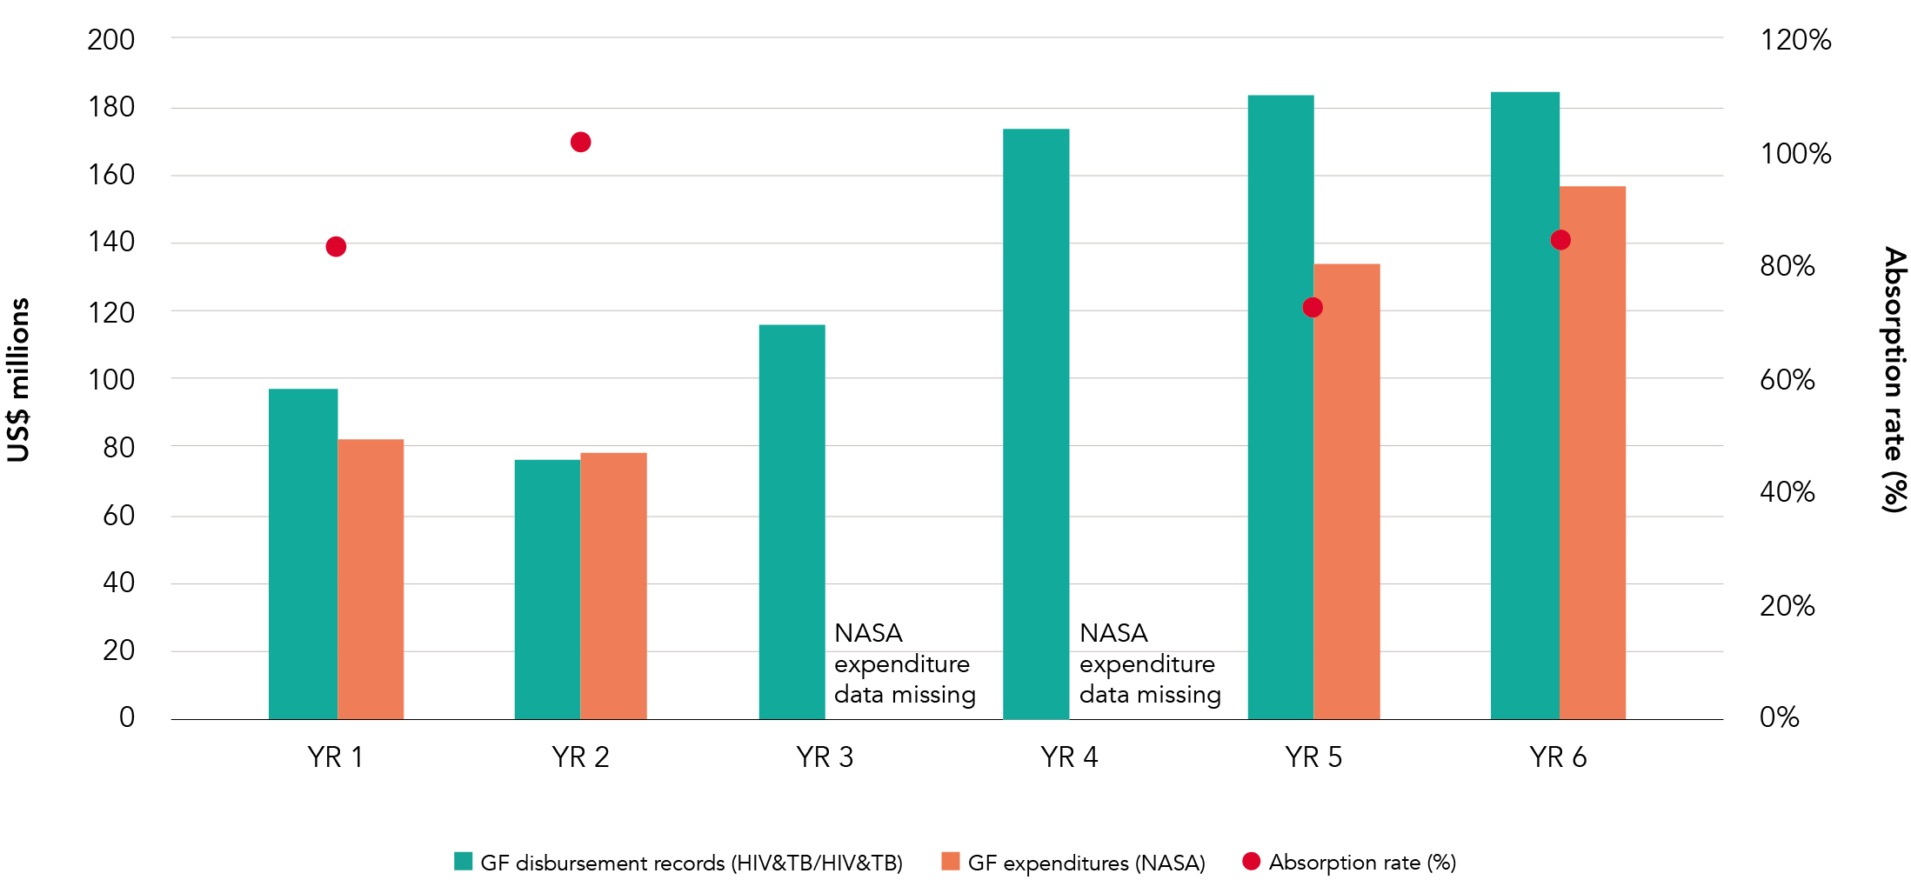
Explore bottlenecks in spending – are available funds being absorbed optimally? Disbursement vs spending

Slide 32
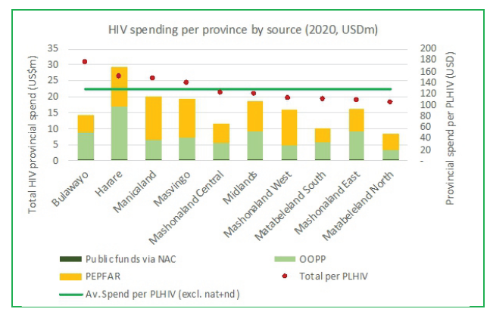
Equity analysis – does spending match the burden of disease?

Slide 33
THANK YOU
For more information, contact UNAIDS Resource Tracking:
Teresa Guthrie
guthriet@unaids.org

