Slide 1

UNAIDS | JAN 2026
National AIDS Spending Assessment (NASA)
DATA COLLECTION APPROACHES
PRESENTER NAME, COUNTRY & DATE OF TRAINING

Slide 2
Outline
Develop a workplan
Develop data collection plan
Data collection approaches
Sources of data
Examples of data reporting templates
NASA tools
Managing large datasets
When to use costing techniques and estimations

Slide 3
NASA workplan - This serves as a guide rather than a definitive model
Phases
Activities
Lead
agency
WEEKS in MTH1
MTH
MTH
MTH
MTH
MTH
MTH
1
2
3
4
2
3
4
5
6
7
1.1
Official letters to constitute the NASA team, contracting of technical support (if needed)
1.2
Establish a NASA steering committee and raise awareness about the NASA
Planning, mapping stakeholders and capacity building
1.3
Development of Inception report which outlines the agreed approach
1
1.4
Stakeholder mapping (development of register with updated contact details)
1.5
Letters to stakeholders (Departments, Dev. Partners, Private Sector)
1.6
Development of data collection tools / adjustment of UNAIDS tools (if changes needed)
1.7
Training of research team and other relevant staff (designated to institutionalise NASA)
2.1
Sample respondents from stakeholder mapping (sampling frame)
2.2
Develop/ finalise the data collection plan
2.3
Data collection
2
Sampling, Data Collection and Quality Control
2.4
Data processing
2.5
Data Entry (RTT)
2.6
Data analysis and validation (Steering committee, NAC & stakeholders)
2.7
Presentation of the results
3.1
Finalisation of report and other products
3
Drafting the report and Dissemination
3.2
Finalisation of report and other products
3.3
Report dissemination, other activities to ensure application of NASA data

Slide 4
NASA data collection plan – This serves as a guide rather than a definitive model
Customize data collection tool
Train data collectors
Launching the data collection
Track progress to completion

Slide 5
Data collection approaches
Source 1
ALL
Source 1
Agent 1
Agent 1
ALL
Agent3
P1
P2
P3
P4
ALL /OR SAMPLED
P5
P6
Programme/
Activity
Programme/
Activity
Programme/
Activity
Programme/
Activity
Programme/
Activity
Programme/
Activity
Programme/
Activity
Programme/
Activity

Slide 6
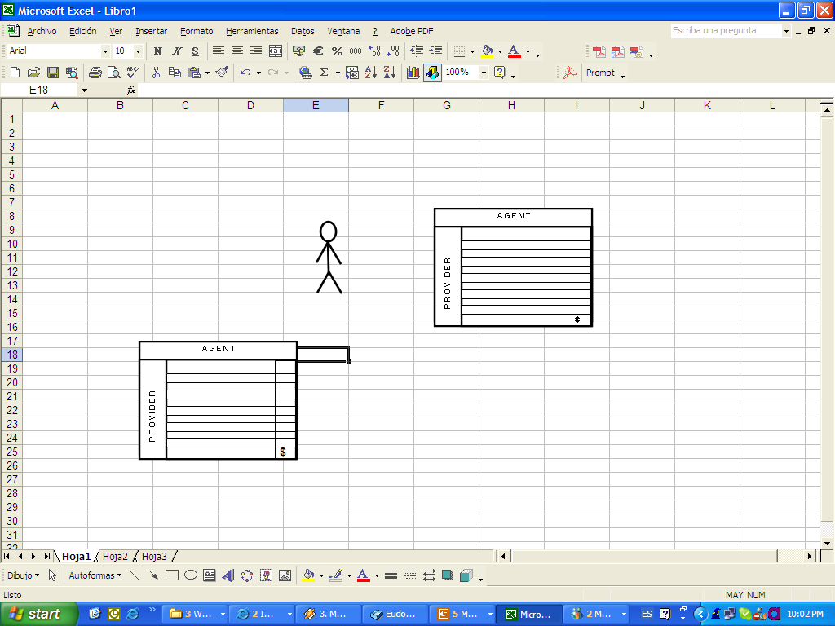
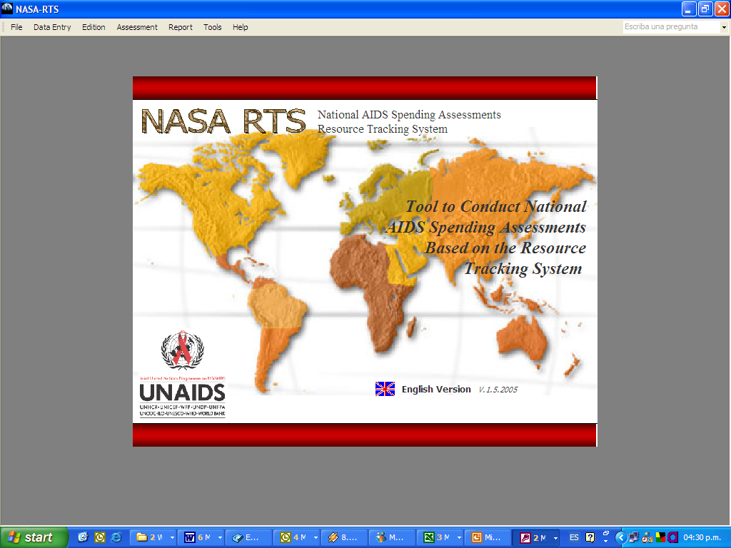
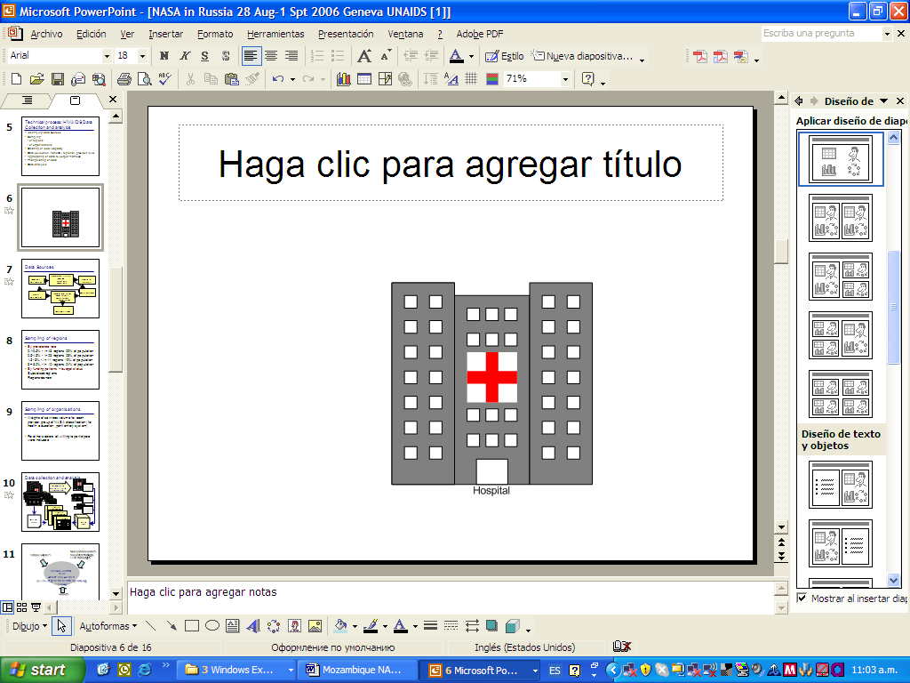
Data collection: traditional approach
- Actors (Financing entity, Financing Agents, Providers)
NAC-

Slide 7
Data collection: Routinized approach (Institutionalization)
- Actors (Financing entity, Financing Agents, Providers)
NAC-

Slide 8


DATA COLLECTION strategies : National Response
-NASA researcher
Interviews
- Information system (reports on expenditure)
Expenditure report
+ MoH
Desktop review
NAC-
NGO “A”
NGO “B”
HIV Clinic

Slide 9

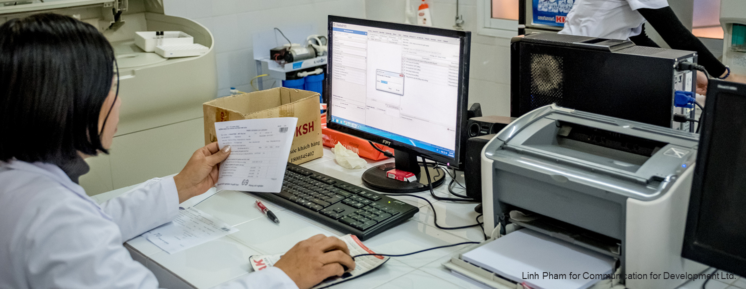
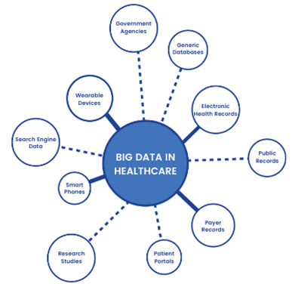
Sources of data
PRIMARY DATA SOURCE
SECONDARY DATA SOURCE
Donors
NGOs /CLOs
Universities
Corporations
Medical insurance
Government Ministries/departments
HIV estimates
Government budget documents
NSP reports
NHA/SHA report
Household OOP survey report
HIV program reports

Slide 10
Sources of data
International partners
Private sector
Public sector
Global Fund: Obtain the Principal Recipients’ Annual Financial Reports (AFRs) or PUDRs.
PEPFAR, obtain the ER (FY) from the country office or Panorama spotlight
UN agencies. Annual expenditure report in different formats
Other development partners ( their Head Quarters (in-country) will provide data.
Insurance schemes: HIV Expenditure data from insurance companies and other business sector
The providers can supply adequate details of the ASC and the BP. And will provide the actual spending (vs committed or transferred
Out-of-pocket – approaches - based on available NHA or Household Survey data.
MOF budget and allocation data
MOH annual expenditure reports related to HIV.
NAC Annual Expenditure reports
Other Government Ministries with known health and HIV non-health expenditures

Slide 11
NASA TOOLS
Data collection template & Data consolidation tool (DCT)

Slide 12

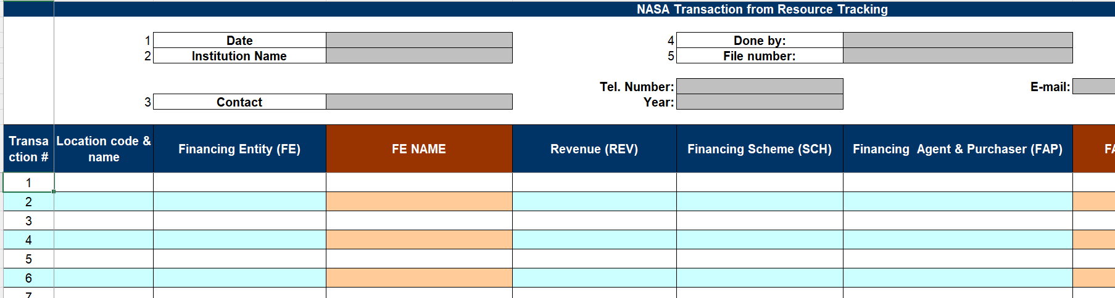
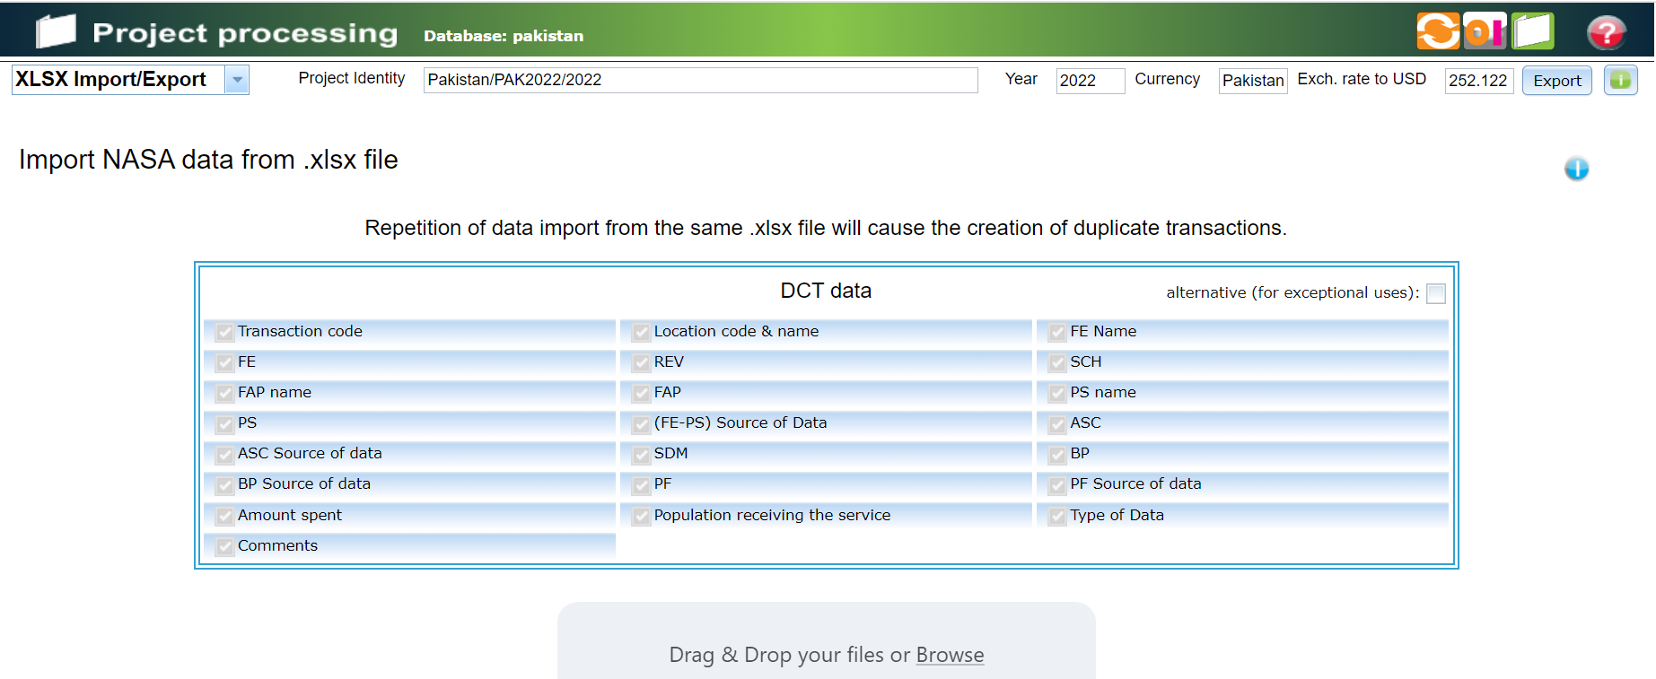
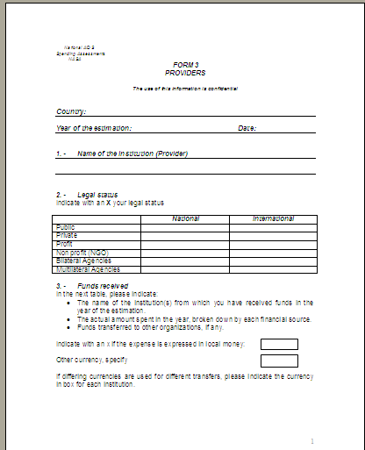
Nasa tools: Data collection template & Data consolidation tool (DCT)
Estimations
Data Consolidating Tool - Excel® File
- Resource Tracking Tool (RTT)
Primary data source
Disclaimer: The data collection tool is intended as guidance and should not be treated as a definitive model

Slide 13
Data collection template 1 – simple format
Disclaimer: This tool is intended as guidance and should not be treated as a definitive model

Slide 14
Data collection template 2 – dataset format
Disclaimer: This tool is intended as guidance and should not be treated as a definitive model

Slide 15
Data consolidation tool- DCT

Slide 16
NASA Data Preparation: Managing Large Data Sets
PEPFAR
Global Fund
Govt accounting system outputs
Health insurance data

Slide 17
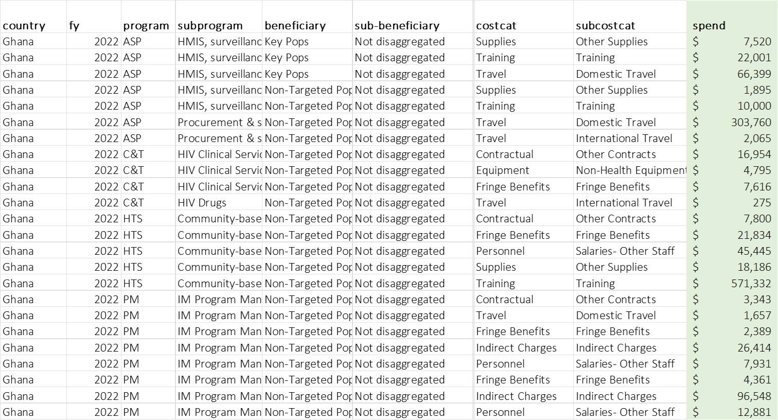
PEPFAR Expenditure reporting data from panorama Spotlight portal (new situation is uncertain)

Slide 18
Global Fund PRs’ Expenditure reports
(from accounting systems’ general ledger reports – not PUDRs!)

Slide 19
Government Accounting Records

Slide 20
Health Insurance Records
Show country example if available
It is important to set up a logical crosswalk that can be applied, adjusted and used in future NASAs.

Slide 21
UNAIDS crosswalk (mapping) of PEPFAR categories to NASA categories
(Example extract of a few combinations, from over 600)
Using ‘vlookup’ the correct NASA categories (ASC, SDM, BP and PF) can be applied to every transaction. The PS code is based on the IP details, if provided. FE and FAP are USG, and REV is bilateral transfers. NASA team should agree on the correct SCH. Once the columns with the required vectors for each NASA transaction have been correctly structured, they are pasted into the DCT_alt_import sheet and can be imported into RTT.

Slide 22
UNAIDS crosswalk (mapping) of GF GC7 categories to NASA categories
(Example extract of a few combinations, from over 600)
It is important to obtain the correct expenditure data reports from PRs (general ledger reports). Using ‘vlookup’ the correct NASA categories (ASC, SDM, BP and PF) can be applied to every transaction. The PS code is based on the PR and SR details, if provided. FE is GF, and REV is bilateral transfers, or external transfers managed by govt. NASA team should agree on the correct FAP and SCH. Once the columns with the required vectors for each NASA transaction have been correctly structured, they are pasted into the DCT_alt_import sheet and can be imported into RTT.

Slide 23
Exercises
Details of the data collection and data entry exercises are provided in the annex document.

Slide 24
Using costing techniques (sparingly) to estimate expenditures

Slide 25
Cases where costing techniques might be necessary i.
Cost estimation: PxQ (price x quantity)
In case, when we know a number of commodities distributed/donated (if this not available, than procured), but we don’t know a unit price of this commodity, we apply average country cost of commodity from pharmacies, or MOH procurement list and multiply by number of commodities used.
Also applied for private sector, where we know how many tests/ consultations/ screenings was done, and we know a price from the price list, then we can also multiply number of services reported by a price per one.
Program areas where this approach may be applied:
HIV tests for testing
Condoms/lubricants for KPs
Syringes
STI services/HIV testing/ x-ray/ other lab services/ OI prevention
Treatment in private sector

Slide 26
Cases where costing techniques might be necessary ii.
Split rules/distribution keys
2.1. When we know the total amount spent on similar activities but without break down by BP, we apply split rules based on coverages.
For example, 1000 USD spent on HIV testing of KPs but we can’t break down by BP. We know that 500 people where covered: 100 MSM, 250 SW and 150 PWID.
So MSM – 20% - 200 USD
SW -50% - 500 USD
PWID – 30% - 300 USD
Program areas where this approach may be applied:
Mostly preventive services for KPs where NGOs are covering more than one KP.
PrEP
HIV testing

Slide 27
Cases where costing techniques might be necessary iii.
Split rules/distribution keys
2.2. When we know expenditure of facility on HR involved in clinical services (can also be applied for NGO staff where multi KPs are covered) for PLWH but they don’t track services separately, we can or report all as treatment not broken down by type (not recommended), or apply split rule based on LOE.
For example, doctor spends 20% on consultation during HIV testing for GP, 50% on ART prescriptions, 30% on OI treatment. His/her annual salary is 30k USD.
HIV testing for GP – $30k*20%=6000 USD
ART – $30k*50%=15000 USD
OI treatment $30k*30%= 9000USD
Program areas where this approach may be applied:
Preventive services for KPs where services provider covers more than 1 type of KP
Preventive and clinical services in facilities

Slide 28
Cases where costing techniques might be necessary iv.
Estimating the share of operational and human resources costs for HIV
In case, we know expenditure of the facility than provides multi services for different BPs, but some of these BPs are out of NASA interest. So we need to calculate the share of those BPs that should be captured in NASA.
For example, we know that 150k USD was spent on TB treatment, 5000 people were covered. But only 500 are PLWH.
In this case we need to estimate expenditure on PLWH exclusively: (15000/5000)*500=1500 USD was spent on PLWH.
When we have breakdown by cost categories (PF), we apply this recalculation individually for each cost category.
Program areas where may be applied:
Mostly clinical or lab services
Other integrated services

Slide 29
Cases where costing techniques might be necessary v.
Costs extrapolation (to whole country)
In case, we know that there 50 ART sites in country, but we were able to collect information only from 10 of them due to some limitations/factors of influence. And we need to estimate expenditure on all 50 sites.
We take expenditure of each of available ART sites, divide by their annual coverage of PLWH (or individually every reported service reported under ART site) and estimate expenditure per unit.
Then we calculate average expenditure per unit for 10 available sites (or services under sites – preferably, better data desegregation), and apply for the other 40 ART sites where data is missed.
Program areas where may be applied:
Mostly clinical or lab services
Other integrated services
Make sure to record and report ALL cases where such assumptions and costing estimations were used in NASA

Slide 30
THANK YOU
For more information,
contact UNAIDS Resource Tracking:
Teresa Guthrie
guthriet@unaids.org

