Slide 1

UNAIDS | JAN 2026
NASA classifications
PRESENTER NAME

Slide 2
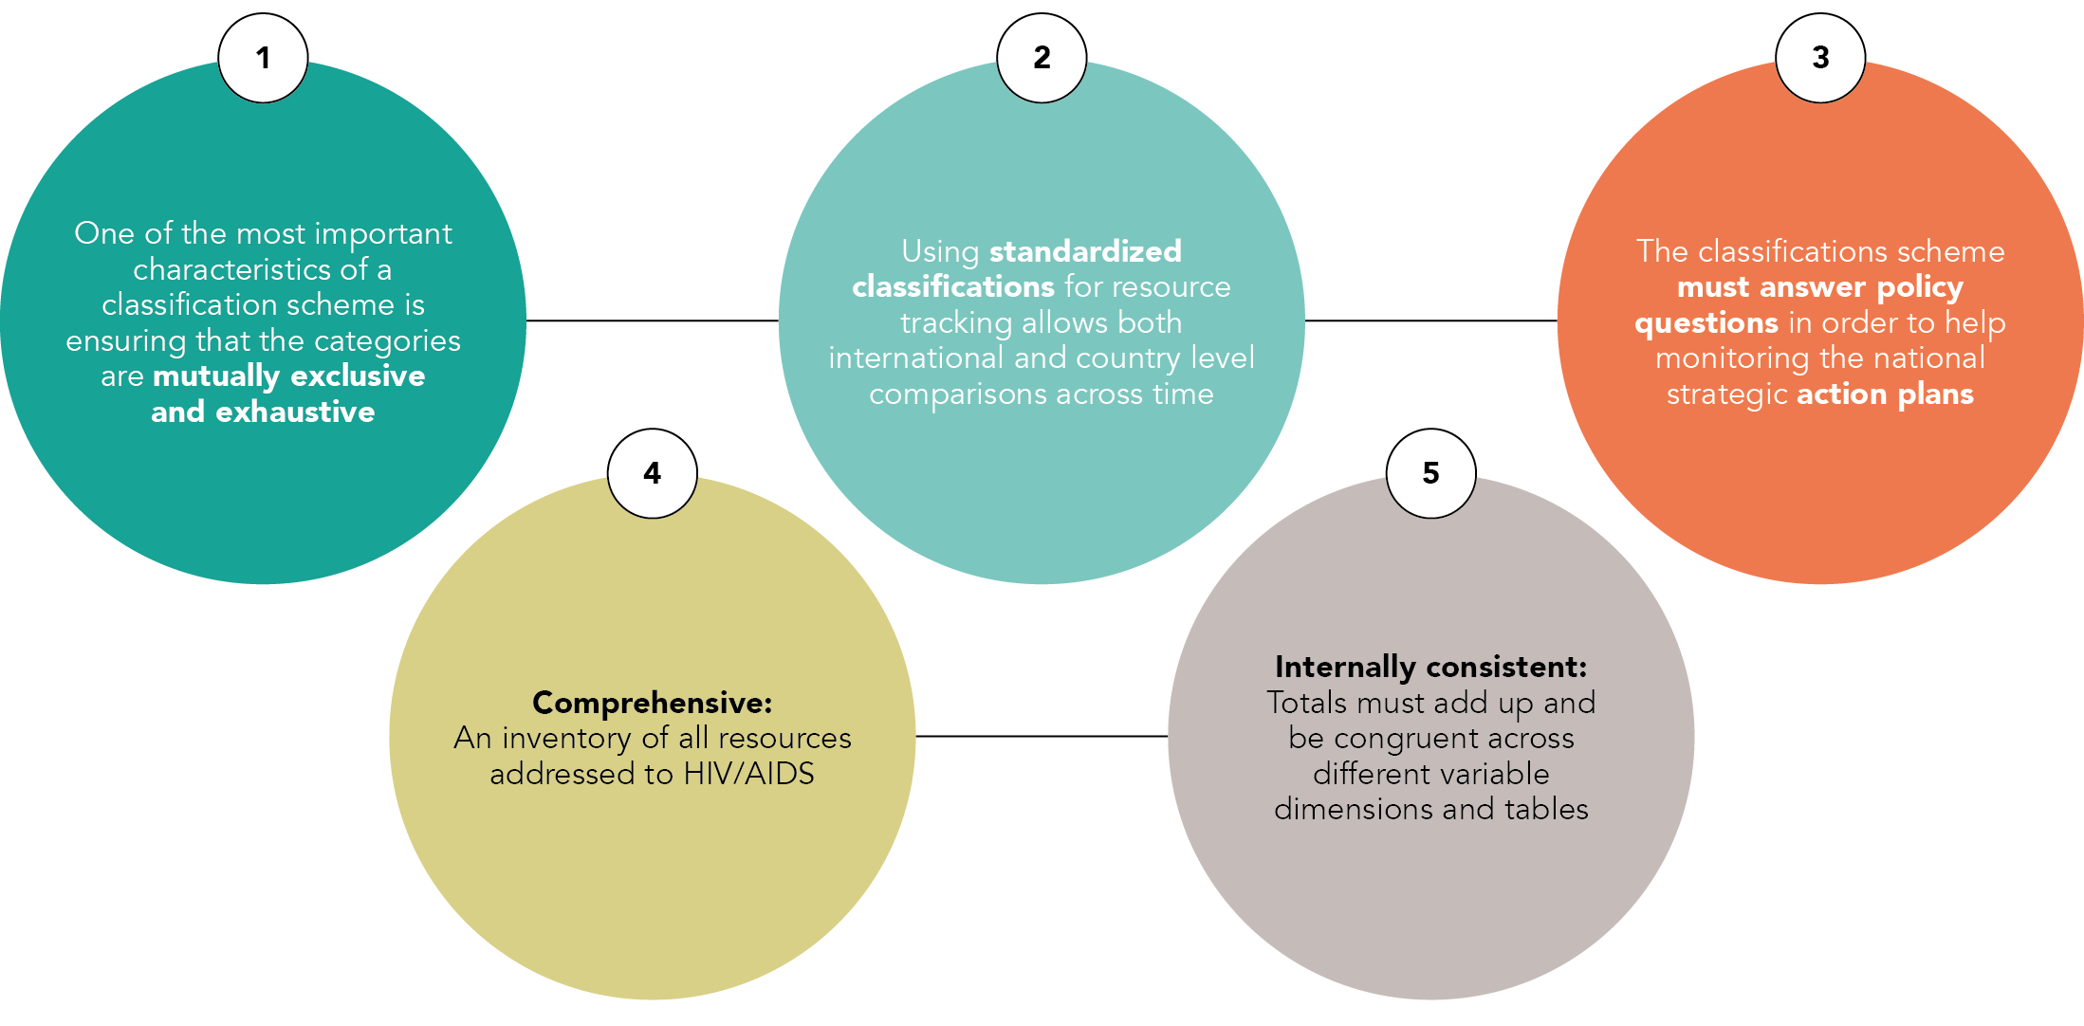
NASA Classifications

Slide 3
The inclusion of the codes “98” and “99” in NASA classification
CATEGORY “98”
CATEGORY “99”
Category “98” represent “Not disaggregated” –
This is to maintain
the mutual exclusiveness attribute
Whenever it is not possible to disaggregate a specific expenditure into its appropriate sub-categories, the expenditure should be reported as “.98.
Each data obtained when tracking goods and services consumed will be entered once, either disaggregated, or not disaggregated by type (“.98”).
Category “99” indicate “ Not else where classified” – This is to assure comprehensiveness of the classification
Whenever the expenditures do not clearly fit a specific sub-category should be listed in the “.99” activities not elsewhere classified.

Slide 4
Example of categories “98” and “99”
-
Categories “.98” are useful, but its use must be reduced to a minimum or zero. The amount of spending coded in “.98” categories refers to the quality of information systems, data reporting and collection process.
Example of 1st digit “.98”: PF.98 Production factor snot disaggregated / Meaning “I have no idea what PF is, not even if it is current or capital, nothing!”
Example of 2nd digit “.98”: ASC.03.98 Care and treatment services not disaggregated
/ Meaning “I know we spent on care and treatment, but I do not know anything more”
Example of 2nd digit “.98”: BP.02.98 “Key populations” not broken down by type / Meaning “I know we spent on targeting key populations, but I do not how much we spent on each”
Example of 5th digit “.98”: ASC.01.01.02.04.98 Other programmatic activities for PWID not disaggregated by type / Meaning “I know we spent on prevention activities targeting PWID but I do not know what type of interventions and how much we spent on each”.
-
-
-
-

Slide 5
Financing Entities (FE) – some examples
FE.01 Public Entities
FE.01.01 Government
FE.01.01.01 Central government
FE.01.01.02 State/provincial government
FE.02 Domestic Private Entities
FE.02.01 Domestic for-profit organizations
FE.02.02 Individuals/Households
FE.02.03 Domestic Not-for-profit organizations (other than social insurance)
FE.02.03.01 Not-for-profit organizations which are Community-led organizations
FE.03 International Entities
FE.03.01 Governments providing bilateral aid
FE.03.01.01 Government of Australia
FE.03.02 Multilateral organizations
FE.03.02.01 Bureau of the Economic and Social Council (ECOSOC)
FE.03.02.02 European Commission
FE.03.03 International not-for-profit organizations and foundations
FE.03.03.01 International HIV/AIDS Alliance

Slide 6
Revenues (REV)
REV.01 Transfers from government domestic revenue including reimbursable loans (allocated to HIV purposes)
  -REV.01.01 Internal transfers and grants
  -REV.01.02 Transfers by government to social health insurance on behalf of specific groups
  -REV.01.03 Subsidies (Transfers from government domestic revenues to for-profit organization financing schemes)
REV.02 Transfers distributed by government from foreign origin
REV.03 Social insurance contributions
  -REV.03.01 Social insurance contributions from employees
  -REV.03.02 Social insurance contributions from employers
REV.04 Compulsory prepayment
(Other, and unspecified, than REV.3)
REV.05 Voluntary prepayment
REV.06 Other domestic revenues
  - REV.06.01 Other revenues from households
  - REV.06.02 Other revenues from corporations
REV.07 Direct foreign transfers
  - REV.7.1 Direct foreign financial transfers
  REV.7.1.1 Direct bilateral financial transfers
  REV.7.1.2 Direct multilateral financial transfers
  - REV.7.2 Direct foreign aid in kind
  REV.7.2.1 Direct foreign aid in goods
  REV.7.2.1.1 Direct bilateral aid in goods
  REV.7.2.1.2 Direct multilateral aid in goods
  REV.7.2.1.3 Other direct foreign aid in goods

Slide 7
Financing Scheme (SCH)
SCH.01 Government schemes and compulsory contributory health care schemes
  SCH.01.01 Government schemes
      SCH.01.01.01 Central government schemes
      SCH.01.01.02 State/regional/local government schemes
  SCH.01.02 Social health insurance schemes
      SCH.01.02.01.01 Private sector employee social health insurance schemes
      SCH.01.02.01.02 Government employee social health insurance schemes
  SCH.01.03 Compulsory Medical Saving Accounts (CMSA)
SCH.02 Voluntary payment schemes
  SCH.2.1 Voluntary insurance schemes
    SCH.2.1.1 Primary/health insurance schemes
        SCH.2.1.1.1 Employer-based insurance (other than enterprises schemes)
        SCH.2.1.1.2 Government-based voluntary insurance
  SCH.2.2 Not-for-profit org schemes
    SCH.2.2.1Not-for-profit organization schemes (excluding SCH.2.2.2)
    SCH.2.2.2 Resident foreign Agencies schemes
SCH.2.3 For-profit enterprise schemes
    SCH.2.3.1 Enterprises (except health care providers) schemes
    SCH.2.3.2 Health care Providers schemes
SCH.03 Household out-of-pocket payment
  SCH.3.1 Out-of-pocket excluding
  cost-sharing
  SCH.3.2 Cost sharing with third-party payers
    SCH.3.2.1 Cost sharing with government schemes & compulsory contributory health insurance schemes
    SCH.3.2.2 Cost sharing with voluntary insurance schemes
    SCH.04. External schemes
    (non-resident)

Slide 8
Financing Agent-Purchaser (FAP)
FAP.01 Public sector
FAP.03 International purchasing organizations
FAP.01.01 Territorial governments
FAP.01.01.01 Central or federal authorities
FAP.01.01.01.01 Ministry of Health (or equivalent sector)
FAP.03.01 Country offices of bilateral agencies
FAP.03.02 Multilateral agencies managing external
resources
FAP.03.02.01 Bureau of the Economic and Social
Council (ECOSOC)
FAP.03.02.02 European Commission
FAP.01.01.02 State/provincial/regional authorities
FAP.01.01.02.01 Ministry of Health (or equivalent sector)
FAP.01.01.02.02 Ministry of Education (or equivalent sector )
FAP.03.03 International not-for-profit organizations
and foundations
FAP.03.03.01 International HIV/AIDS Alliance
FAP.03.03.02 ActionAID
FAP.03.03.03 Aga Khan Foundation
FAP.03.03.04 Association François-Xavier Bagn.
FAP.02 Private sector
FAP.02.01 Private social security
FAP.02.02 Private employer insurance programmes
FAP.02.03 Private insurance For-profit organizations (other than social insurance)
FAP.02.04 Individual/Households
(out-of-pocket payments)
FAP.02.05 Not-for-profit organizations
(other than social insurance)
FAP.02.05.01 Not-for-profit organizations which
are Community-led organizations
FAP.03.04 Projects within International Universities
FAP.03.05 International for-profit organizations

Slide 9
Providers of Services (PS)
PS.01 Public sector providers
PS.01.01 Governmental organizations
PS.01.01.01 Hospitals (public)
PS.01.01.02 Ambulatory care (public)
PS.03 International providers – in country offices
PS.03.01 Bilateral agencies
PS.03.02 Multilateral agencies
PS.03.03 International not-for-profit organizations and foundations
PS.03.04 International research centers and other for-profit international providers
PS.03.98 International providers – in country offices not disaggregated
PS.03.99 Other International providers – in country offices n.e.c.
PS.01 Public sector providers
PS.01.01 Governmental organizations
PS.01.01.01 Hospitals (public)
PS.01.01.02 Ambulatory care (public)
PS.02.02 Domestic For-profit private sector providers
PS.02.02.01 Hospitals (For-profit private)
PS.02.02.02 Ambulatory care (For-profit private)

Slide 10
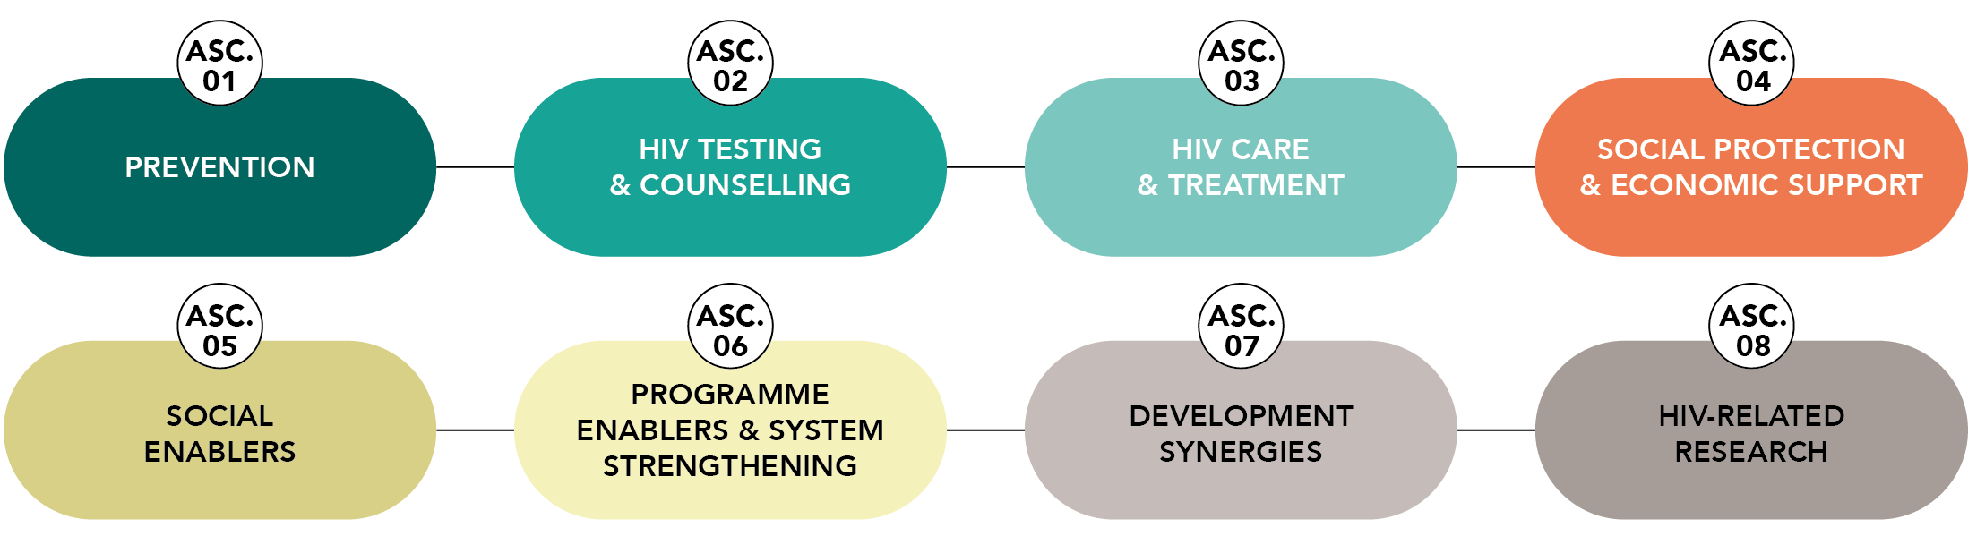
AIDS Spending Categories (ASC)

Slide 11
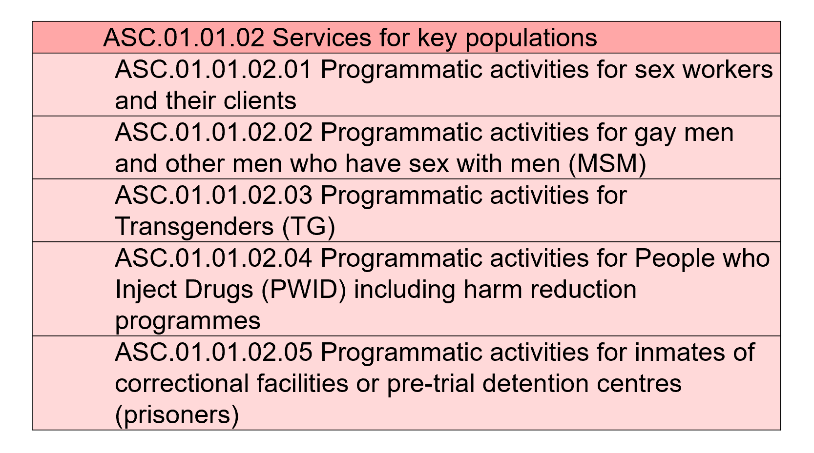
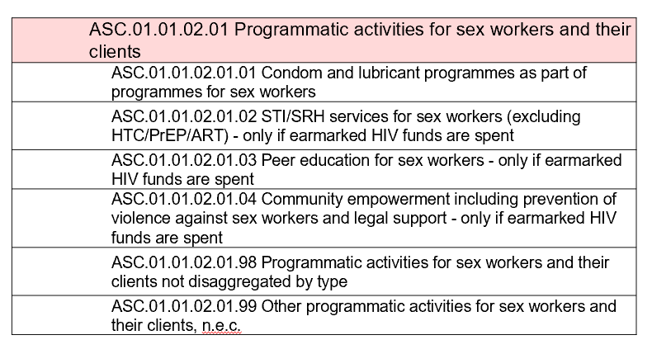
Classification: HIV Prevention
ASC.01 Prevention
ASC.01.01 Five Pillars of Prevention
ASC.01.01.01 Prevention for adolescent girls and young women (AGYW) and their male partners in settings with high HIV prevalence
ASC.01.01.02 Services for key populations
ASC.01.01.03 Condoms (for HIV prevention) for the general population (excluding KPs and AGYW above)
ASC.01.01.04 Voluntary medical male circumcision (VMMC) for HIV prevention
ASC.01.01.05 Pre-Exposure Prophilaxis (PrEP)
ASC.01.02 Other prevention activities
ASC.01.02.01 Prevention of vertical transmission of HIV infection (PMTCT)
ASC.01.02.02 Social and behavioural communication for change (SBCC) for populations other than key populations
ASC.01.02.03 Community mobilization for populations other than key populations
ASC.01.02.04 Programmatic activities for other vulnerable and accessible populations
ASC.01.02.05 Prevention for children and youth (excluding for AGYW in countries with high HIV prevalence)
ASC.01.02.06 Prevention of HIV transmission aimed at people living with HIV and their partners (including sero-discordant couples)
ASC.01.02.07 Prevention and wellness programmes in the workplace
ASC.01.02.08 Microbicides
ASC.01.02.09 Post-exposure prophylaxis
ASC.01.02.10 STI prevention and treatment programmes for populations other than key populations - only if funded from earmarked HIV budgets
ASC.01.02.98 Prevention activities not disaggregated
ASC.01.02.99 Other prevention activities n.e.c.

Slide 12
Classification: HTC
ASC.02 HIV testing and counselling (HTC)
ASC.02.01.01 HIV testing and counselling for sex workers
ASC.02.01.02 HIV testing and counselling for MSM
ASC.02.01.03 HIV testing and counselling for TG
ASC.02.01.04 HIV testing and counselling for PWID
ASC.02.01.05 HIV testing and counselling for inmates of correctional and pre-trial facilities
ASC.02.01.98 HIV testing and counselling (HTC) for key populations (KPs) activities not disaggregated
ASC.02.02 HIV testing and counselling for pregnant women (part of PMTCT programme)
ASC.02.03 Early infant diagnosis (EID) of HIV
ASC.02.04 HIV testing and counselling for adolescent girls and young women (AGYW)
ASC.02.05 HIV testing and counselling for vulnerable and accessible populations (excluding AGYW)
ASC.02.06 Voluntary HIV testing and counselling for general population
ASC.02.07 Provider initiated testing and counselling (PITC)
ASC.02.08 HIV screening in blood banks
ASC.02.09 Mandatory HIV testing (not VCT) (including premarital, job applications, visas etc.) ASC.02.98 HIV testing and counselling activities not disaggregated ASC.02.99 Other HIV counselling and testing activities n.e.c.

Slide 13
Classification: HIV Care and Treatment
ASC.03 HIV Care and Treatment Care
ASC.03.01 Anti-retroviral therapy
ASC.03.02 Adherence and retention on ART - support (including nutrition and transport) and monitoring
ASC.03.03 Specific ART-related laboratory monitoring
ASC.03.04 Co-infections and opportunistic infections: prevention and treatment for PLHIV and KPs
ASC.03.05 Psychological treatment and support services
ASC.03.06 Palliative care
ASC.03.07 Traditional medicine and informal care and treatment services
ASC.03.98 Care and treatment services not disaggregated
ASC.03.99 Care and treatment services n.e.c.
ASC.03.01.01 | ART for adults
ASC.03.01.01.01 | First-line ART – adults
ASC.03.01.01.02 | Second-line ART – adults
ASC.03.01.01.03 | Third-line or salvage ART - adults
ASC.03.01.01.98 | Adult antiretroviral therapy not disaggregated
ASC.03.01.02 | ART for paediatrics
ASC.03.01.02.01 | First-line ART – paediatric
ASC.03.01.02.02 | Second-line ART – paediatric
ASC.03.01.02.03 | Third-line or salvage ART - paediatric
ASC.03.01.02.98 | Paediatric antiretroviral therapy not disaggregated
ASC.03.01.03 | ART for PMTCT (for pregnant women not previously on treatment and newborns)
ASC.03.01.03.01 | ART for PMTCT (for pregnant women not previously on treatment)
ASC.03.01.03.02 | ART for PMTCT (for newborns)
ASC.03.01.03.98 | ART for PMTCT (for pregnant women not previously on treatment and newborns) not disaggregated
ASC.03.01.98 | Antiretroviral therapy not disaggregated neither by age nor by line of treatment nor for PMTCT
ASC.03.01.99 | Other Antiretroviral therapy n.e.c

Slide 14
Other AIDS Spending Categories (ASC)
ASC.06.03 | Strategic information
ASC.06.03.01 | Monitoring and evaluation
ASC.06.03.02 | Operations and implementation science research
ASC.06.03.03 | Serological-surveillance (sero-surveillance)
ASC.06.03.04 | Management information systems
ASC.06.03.05 | HIV drug-resistance surveillance
ASC.06.03.06 | Financial tracking and monitoring
ASC.06.03.98 | Strategic information not disaggregated
ASC.06.03.99 | Other Strategic information n.e.c.
ASC.04 Social protection and economic support (for PLHIV, their families, for KPs and for Orphans and Vulnerable Children)
ASC.04.01 Social protection and economic support for OVC
ASC.04.02 Other social protection and economic support (non-OVC)
ASC.04.98 Social protection activities not disaggregated
ASC.04.99 Social protection activities n.e.c
ASC.05 Social Enablers (excluding direct services for KPs above)
ASC.05.01.01 Stigma and discrimination reduction ASC.05.01.02 Building meaningful engagement for representation in key governance, policy reform and development processes ASC.05.01.02.01 Representation of PLHIV in key processes ASC.05.01.02.02 Representation of youth in key processes
ASC.06 Programme enablers and systems strengthening
ASC.06.01 Strategic planning, coordination and policy development
ASC.06.02 Programme administration and management costs (above service-delivery level)
ASC.06.03 Strategic information
ASC.06.04 Systems Strengthening (excluding Community system strengthening)
ASC.06.05 Community & Not-for-profit organisations system strengthening and community-based activities (excluding direct servcies for KPs above)
ASC.06.06 Human resources for HIV (above-site programmes)
ASC.06.07 Human resources for health (above-site programmes)
ASC.06.98 Programme enablers and systems strengthening not disaggregated
ASC.06.99 Programme enablers and systems strengthening not disaggregated
ASC.06.05 | Community & Not-for-profit organisations system strengthening and community-based activities (excluding direct services for KPs above)
ASC.06.05.01 | Community & Not-for-profit organisational development
ASC.06.05.02 | Community worker education, training and support
ASC.06.05.03 | Resource mobilisation / generation for community & Not-for-profit organisations and financial sustainability activities
ASC.06.05.04 | Recruitment and retention of volunteers
ASC.06.05.05 | Community-led monitoring
ASC.06.05.01 | Community & Not-for-profit organisational development
ASC.06.05.02 | Community worker education, training and support
ASC.06.05.03 | Resource mobilisation / generation for community & Not-for-profit organisations and financial sustainability activities
ASC.06.04 | Systems Strengthening (excluding Community system strengthening)
ASC.06.04.01 | Procurement and supply chain
ASC.06.04.02 | Laboratory system strengthening
ASC.06.04.03 | Institutional & organisational development (health, social, educational etc)
ASC.06.04.04 | Financial and accounting systems strengthening

Slide 15
Other AIDS Spending Categories (ASC)
ASC.07 Development synergies
ASC.07.01 Formative education to build-up an HIV workforce and other trainings not related to any specific activity (e.g. pre-service) using HIV earmarked resources
ASC.07.02 Reducing gender-based violence
ASC.07.02.01 Reducing violence against women and young girls
ASC.07.02.02 Reducing sexual diversity violence
ASC.07.03 Promote HIV-sensitive, cross-sectoral development
ASC.07.04 Capacity building in human rights
ASC.07.98 Development synergies not disaggregated ASC.07.99 Other Development synergies n.e.c.
ASC.08 HIV-related research
ASC.08.01 Biomedical research
ASC.08.02 Clinical research
ASC.08.03 Epidemiological research
ASC.08.04 Socio-behavioural research
ASC.08.05 Economic research
ASC.08.06 Vaccine-related research
ASC.08.98 HIV and AIDS-related research activities not disaggregated by type
ASC.08.99 HIV and AIDS-related research activities n.e.c.

Slide 16
Beneficiary population (BP)
BP.01 | People living with HIV (regardless of having a medical/clinical diagnosis of HIV infection)
BP.01.01 | Adult and young people living with HIV
BP.01.02 | Children living with HIV
BP.01.98 | People living with HIV not disaggregated
BP.02 | Key populations
BP.02.01 | Persons who Inject drug users (PWID) and their sexual partners
BP.02.02 | Sex workers (SW) and their clients
BP.02.02.01 | Female sex workers and their clients
BP.02.02.02 | Transgender sex workers and their clients
BP.03 | Vulnerable, accessible and other target populations
BP.03.01 | Orphans and vulnerable children (OVC)
BP.03.02 | New borns with un-determined HIV status (born to HIV-positive women)
BP.03.03 | Adolescent girls and young women in countries with high HIV prevalence
BP.04 | General population
BP.04.01 | General adult population
BP.04.01.01 | Male adult population
BP.05 | Non applicable (ASC which do not have a specific BP)
BP.98 | Beneficiary Populations not disaggregated
BP.99 | Other Beneficiary Populations n.e.c.

Slide 17
Service delivery modality (SDM)
SDM.01 Facility-based service modalities
SDM.01.01 Health Facility-based: Outpatient
SDM.01.02 Health Facility-based: Inpatient
SDM.01.03 Directly observed treatment (DOT)
SDM.01.04 Non-health facility
SDM.01.98 Facility-based not disaggregated
SDM.01.99 Other facility-based n.e.c.
SDM.02 Home and community-based service modalities
SDM.02.01 Community-based: center
SDM.02.02 Community-based: pick up points (CPUP)
SDM.02.03 Community-based: automated distribution
unit/dispensing machine
SDM.02.04 Community-based: mobile unit
SDM.02.05 Community-based: outreach
SDM.02.06 Community-based: home-based (including door-to-door)
SDM.02.98 Home and community-based not disaggregated
SDM.02.99 Other Home and community-based n.e.c.
SDM.03 Self-service by the client
SDM.04 Community-led activities (non-direct service delivery)
SDM.05 Non applicable (ASC which do not have a specific SDM)
SDM.98 Modalities not disaggregated
SDM.99 Other Modalities n.e.c.

Slide 18
Production factor (PF)
PF.01 Current direct and indirect expenditures
PF.01.01 Personnel costs
PF.01.01.01 Direct service providers personnel costs
PF.01.01.01.01 Labor costs - Direct service providers
PF.01.01.02 Program management personnel costs
PF.01.01.02.01 Labour costs - Program management
PF.01.01.02.02 Fringe Benefits - Program management
PF.01.01.02.05 Pro-bono expert management services (at no charge - estimated value) - Program management
PF.01.01.02.06 Volunteered management services (at no charge - estimated value)
PF.01.02 Operational and programme management current expenditures
PF.01.02.01 Office rental costs
PF.01.02.02 Office utilities costs (electricity, water, heating, etc.)
PF.01.02.03 Travel expenditure
PF.01.02.04 Administrative and programme management costs (excluding PSM)
PF.01.02.05 PSM related expenditure (where not included in the price of the commodities)
PF.01.02.06 Maintenance of medical and laboratory equipment
PF.01.02.07 Unusual wastage of medical products and supplies
PF.01.03 Products and supplies
PF.01.03.01 Pharmaceuticals
PF.01.03.01.01 Antiretrovirals
PF.01.03.01.01.01 Antiretrovirals for treatment (excluding PrEP ARVs) PF.01.03.01.01.02 PrEP anti-retrovirals – oral, ring, injectable
PF.01.03.01.02 Anti-tuberculosis drugs
PF.01.03.01.03 Ophiod substitution therapy (OST) drugs
PF.01.03.02 Medical supplies
PF.01.03.02.01 Syringes and needles
PF.01.03.03 Laboratory reagents and materials
PF.01.03.03.01 HIV tests
PF.01.03.03.02 VL tests
PF.01.03.04 Non-medical supplies
PF.01.03.04.01 Food and nutrients
PF.01.03.04.02 Promotion and information materials
PF.01.04 Contracted external services
PF.01.05 Transportation related to beneficiaries
PF.02 Capital expenditures
PF.02.01 Building
PF.02.01.01 Laboratory and other infrastructure upgrading
PF.02.01.02 Construction and renovation
PF.02.02 Vehicles
PF.02.03 Information technology (hardware and software)
PF.02.04 Laboratory and other medical equipment
PF.02.05 Non medical equipment and furniture

Slide 19
Exercise - hands on NASA classification

Slide 20
Exercise - hands on NASA classification
Find the correct codes for the items in the table –
NASA classification exercises in the annex document

Slide 21
THANK YOU
For more information,
contact UNAIDS Resource Tracking:
Teresa Guthrie
guthriet@unaids.org

