Slide 1

UNAIDS | JANUARY 2019
Resource Tracking FOR COMMUNITY-LED RESPONSE
SUB HEAD HERE
PRESENTER NAME

Slide 2
Module 1:
Introduction to HIV Resource Tracking (RT)
1. Objectives of the module
2. Rationale and purpose of conducting the CLO RT
3. Community-Led Response to HIV
4. Key Concepts and Terminologies
5. Commonalities between NASA and CLO RT

Slide 3
Objective of the module
1. Provide clear protocols for tracking resources to ensure comprehensive data collection and capturing of community-led organisation expenditure of HIV-related funds.
2. To strengthen the capacities of NASA practitioners to implement HIV spending assessments for community-led organizations as part of a full NASA implementation process or as a stand-alone exercise in countries.
This module aims to equip resource-tracking practitioners with the tools and methodologies needed to accurately and effectively track HIV-related resources for community-led organizations. By offering practical guidance, best practices, and standardized procedures,

Slide 4
Rationale and purpose of conducting the RT for the Community- Led-Response (CLR)
In many low- and middle-income countries, reductions in international funding have adversely impacted civil society organizations that serve the most vulnerable populations. As HIV funding shifts, community-led organizations are experiencing financial cutbacks. There is a need for a deeper understanding of resource flows within these organizations and a tailored resource-tracking framework to develop better sustainability strategies.
Community-led organizations play a pivotal role in the fight against HIV by delivering critical services and support to vulnerable and key populations. However, these organizations often face challenges in effectively tracking and managing resources, which can hinder their ability to optimize the use of funds, demonstrate impact, and secure sustained funding.
Effective resource tracking is essential for ensuring transparency, accountability, and the efficient allocation of resources. By providing a structured approach to resource tracking, community-led organizations can enhance their operational efficiency, improve strategic planning, and strengthen their case for continued support from donors and stakeholders.

Slide 5
What are Community-Led Organizations
Community-led organizations (CLOs) are entities for which the majority of governance, leadership, staff, spokespeople, members, and volunteers reflect and represent the experiences, perspectives, and voices of their constituencies and who have transparent mechanisms of accountability to their constituencies.
Community-led responses (CLRs) are actions and strategies that seek to improve the health and human rights of their constituencies. These responses are specifically informed and implemented by and for communities themselves and the organizations, groups, and networks that represent them.
Purposeful Organization
Self-Governing Organization
Working with and for communities
Leadership
Membership
Volunteers
Accountability Transparency
Autonomous
Self-governed

Slide 6
Key Concepts and Definitions
Key Populations – Led Organizations
Resource Tracking
Transaction
These are organizations and networks, are entities for which the majority of governance, leadership, staff, spokespeople, membership and volunteers, reflect the experiences, perspectives and voices of their constituencies and are led by people living with HIV, sex workers, gay men and other men who have sex with men, people who use drugs, and transgender people, AGYW and sero-discordant couples, ex-prisoners and networks of PLHIV
is the process of identifying and quantifying all resources (financial and in-kind) used/consumed in the delivery of HIV services, from the source of funding to the final beneficiaries. It helps us understand how funding, services, and other critical components move through the system to address HIV/AIDS
is the basic unit of financial flow that describes the transfer of resources between various economic agents. This involves tracking the flow of resources (financial/cash contributions and in-kind contributions) from their sources through the agents and service providers, down to the final beneficiaries who receive the goods and services.

Slide 7
KEY Concepts and Definitions
Financial flows – monetary contribution
Financial flows- in-kind contribution
Economic transactions
The cycle of payment in the monetary form. It is a major component of the CLOs revenue, comprised of in-cash donations, grants and subsidies, and income-generation activities.
Refer to the transfer of resources in the form of direct aids in kind or goods, volunteer time rather than monetary assistance. This includes the provision of physical items, such as medical supplies, food, equipment, and other tangible goods, to support the beneficiaries directly
It happens when assets or services are made available to the CLOs for their use:
Assets: meeting halls, vehicles, equipment, etc.
Services: volunteer time and pro bono- services
(note that NASA does not annualize or discount capital investments over their lifespan – we capture their full market value in the year they were donated).

Slide 8
Commonalities between CLOs resource tracking and NASA
While traditional NASA places special emphasis on financing and expenditures, focusing on a framework that prioritizes monetary transactions for goods and services provided and consumed, CLO RT approach covers beyond financial transactions to integrate some aspects of economic transactions.
Both assessments aim to provide a thorough evaluation of resources dedicated to the HIV/AIDS response. CLO spending assessments can be integrated into the full NASA (to be called NASA+) or conducted as independent exercises to monitor CLO contributions
Both assessments identify sustainability challenges and financing gaps to inform policy and strategy. They focus on creating detailed financing flows, from sources to final users.
Both assessments collect HIV resources, including financial and in-kind donations/goods and services converted into monetary terms. The financial and non-financial transactions are summed–up to determine the total resources consumed in the delivery of services.
Zoom-In Approach for CLOs: Acknowledges the growing role of CLOs in prevention, care, and societal enablers. The spending assessment of community-led organizations (CLOs) is a detailed examination of a specific segment within the broader national response.

Slide 9
innovations introduced to the NASA approach
While the approach and methodology for conducting NASA and CLO resource tracking are identical, CLO resource tracking incorporates the economic valuation aspect, which was not traditionally part of NASA.
The significant addition to NASA for the CLR aspects is the economic transfers that require valuation, such as
Volunteer time
Refers to the unpaid hours contributed by individuals to support an organization or cause. In resource tracking, volunteer time is quantified and valued to recognize the significant economic contributions made by volunteers, even though no financial transactions occur.
Pro bono services
Refers to professional services provided voluntarily and without payment. These services are typically offered by skilled professionals, such as lawyers, doctors, accountants, or consultants, to support CLOs who cannot afford to pay for such expertise.
Donations and free use of properties
Refers to the provision of goods, services, or facilities without charge to support an organization or cause. This includes tangible items like food, clothing, equipment, or supplies, as well as the rent-free use of buildings, office space, or land.

Slide 10

Module 2:
Framework for Resource Tracking
Implementation phases
1. Planning
2. Context analysis –CLOs mapping

Slide 11
Implementation phases
Please note that the CLO spending assessment can either be incorporated into a comprehensive NASA process (NASA+) or be conducted as an independent study (Stand-alone exercise)
Planning and material development
Context analysis - CLO landscape
Data collection, cleaning
Analysis and reporting writing

Slide 12
Planning
Planning the study involves a decision-making process influenced by the context, stakeholders, and the quality and completeness of directories and data sources. This section addresses three topics for determining the scope and boundaries of a CLOs HIV Spending Assessment.
Raising awareness and partners mobilisation
Build an alliance of stakeholders and organizations to support the project.
Defining the Purpose
Determine the specific aims of the CLO spending assessment.
Defining the Scope
Decide on the study period (suggest one year for the first study to build skills and confidence).
Ensure participation from CLOs, government offices, and international partners.
Form a steering committee from these partners to guide key decisions
If integrating into a full NASA study
or a standalone CLO RT.
Consider the geographical and organizational coverage, including urban and rural areas, large networks, and small independent CLO?

Slide 13
Planning ----continues
Identification of potential CLOs
by consulting potential data sources, registries including other networks and organizations that are involved in the national response.
Formal letters seeking access to data
The HIV coordinating Entity (NAC) is responsible for the Study introduction letter (drafting and signing).
Recruitment of research assistants
Identify and train potential data collectors
Some criteria should be set for the selection of data collectors, including familiarity with the HIV landscape in the country, Good skill in Excel and comfortable with numbers. (Bachelor in economics, public health, accounting or Finance)
Develop a database with names and contact details of potential CLOs (from NGO, CBOs, KP organisations ) based on the definition of CLO (confirmation of their selection via a decision tree (see following slides)
Letters to be distributed to all the potential sources of data (including all HIV financing entities and agents)

Slide 14
Context analysis &
CLO IDENTIFICATION & SELECTION
Countries have diverse civil society and community-based organizations involved in the HIV response to varying degrees. However, not all of these organizations fulfill the criteria for being classified as CLOs. This section outlines the process of using decision trees to identify and select CLOs, and subsequently inviting them to participate in the assessment.
Data sources
Gather a comprehensive list of organizations involved in the national HIV response. This list should include names, addresses, and other contact information. Some countries have registries and directories of private non-profit organizations.
Utilize existing registries and directories of private non-profit organizations, such as those maintained by National HIV/AIDS Commissions, Country Coordinating Mechanisms, PEPFAR implementing partners, and Global Fund principal recipient
Access public administration databases for non-profit organization registration details, ensuring to obtain the most complete and up-to-date information
The snowball technique would assist to identify and locate additional potential CLOs from other organisations or networks, rather than relying on the first available source.

Slide 15
Context analysis & CLO IDENTIFICATION
This mapping process ensures a systematic and thorough identification of organizations that truly represent and serve their communities, aligning with the goals of the assessment.
Preliminary Filtering and formal contact
STEP 1. Review the developed list of community-based organizations to exclude organizations that do not meet the criteria for CLO, such as NGOs, foundations, faith-based and other organizations not run by community members. Focus on organizations run by members of key and vulnerable population groups
STEP 2. With the support of national authorities and or national networks of organizations, the steering committee should formally contact the shortlisted non-profit organizations.
STEP 3. Distribute a questionnaire based on decision trees to assess their eligibility as CLOs. This questionnaire should be distributed to all the potential CLOs alongside the introduction letter to access their data.

Slide 16
CLO IDENTIFICATION – Decision trees
The first decision tree checks the organization's purpose, registration requirements, eligibility for grants, ability to hire staff, provide services, and maintain records.
The second decision tree assesses the organization's autonomy, self-governance, and legal status regarding property, revenue, liabilities, and accountability.
The third decision tree ensures the organization is run for and by the community, requiring clear participation of community members in planning, direction, implementation, evaluation, and as beneficiaries of CLO programs and activities.
Final Selection: Based on the results from the decision trees, finalize the list of organizations that qualify as CLOs. Ensure these organizations are properly documented and prepared for participation in the assessment.

Slide 17
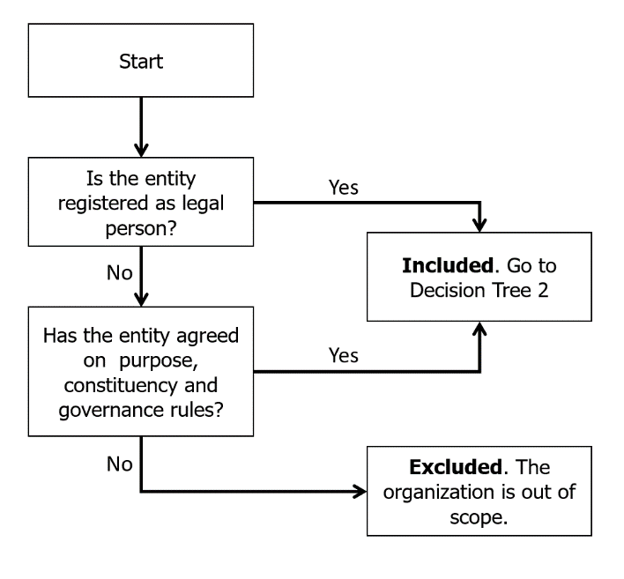
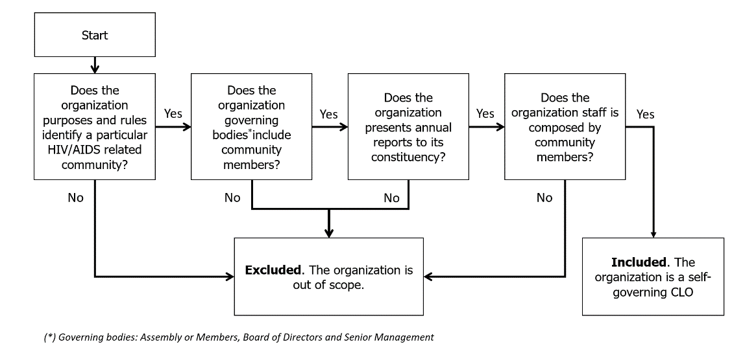
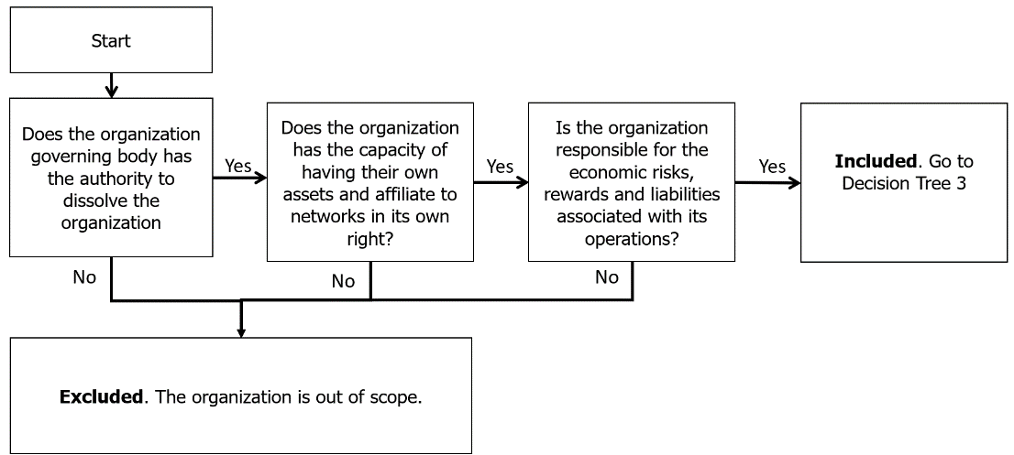
CLO IDENTIFICATION –Decision trees
1. The first decision tree
2. The second decision tree
3. The third decision tree
4. Final Selection

Slide 18
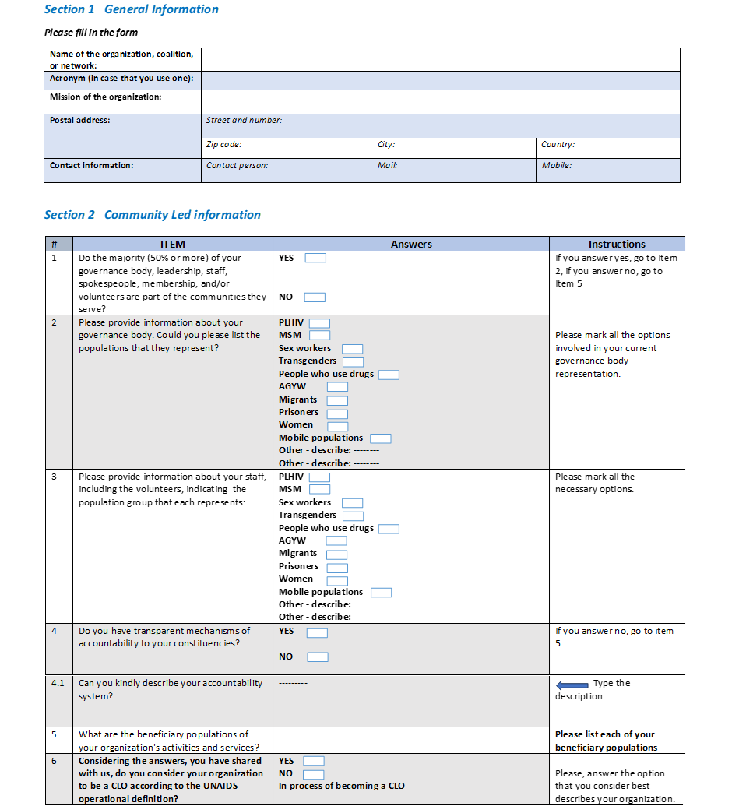
CLO self–identification form
The tool will be provided in Word and PDF formats. It can also be provided through the Google online form.
Once a CLO has been confirmed as being community-led, they can be approached for a meeting with them to collect their data.

Slide 19
Module 3:
data collection and management
1. Data Collection Techniques
2. Tools for Data Collection
3. Data Entry and Cleaning

Slide 20
Data collection approach
The RT for CLO will primarily adopt a bottom-up approach to data collection, focusing on granularity and detailed level. Instead of collecting data from higher levels (Top-down approach), it involves collecting data from individual sources, such as specific projects, programs, or activities within the CLO’s response. Data collectors will interview respondents or will assist them to fill in the form, prompting for further details to allow the collection of granular data.
Preference for Face-to-Face Interviews: Face-to-face interviews are preferred due to their effectiveness in ensuring data accuracy and completeness. They allow for real-time verification and ensure that all pertinent information is captured accurately.
Combination Approach: Depending on respondent availability, a combination of
face-to-face and virtual interviews may be employed to optimize data collection efforts.

Slide 21
Data collection tools
Two data collection tools were developed with distinct objectives for CLO resource tracking
The first tool is a user-friendly and printable version of the workbook (Tool A), designed to collect non-financial transactions, such as volunteer time, pro-bono services, and donations (including rent-free use of space and in-kind services). This tool is tailored for community-led organizations and includes various tables covering key aspects such as the organization's profile, beneficiaries, intervention, and revenue sources (like grants, fundraising, or household contributions).
Do not make assumptions when completing the forms but find the spending evidence and add up all the received non-cash donations, in volume and also in monetary valuation.
The second tool is a customized tool (Tool B) designed to collect financial transactions, allowing the mapping of all NASA vectors based on the DCT format. The DCT will be used to consolidate and recreate financial transactions for import into RTT.

Slide 22
In-kind donations and other non-financial data collection
STEP 1. Discuss and customize the data collection tool with the NASA team. This should be part of the training, to ensure that data collectors understand the tool and data requirements.
STEP 2. Distribute the tool to all eligible CLOs in advance of the interview appointment to prepare the data accordingly. Given that a self-administered tool might not yield high-quality or detailed data, it is essential for data collectors to conduct face-to-face or virtual interviews.
STEP 3. Data collection. To make this process a success, the national authorities and national networks of KP have to support the NASA team in securing appointments with CLOs, noting that in some countries KP organizations operate underground and cannot expose their identity or location without fully trusting the researchers.
STEP 4. Data collectors' deployment in the field. During the interviews, data collectors should assist respondents in accurately completing the data collection tool to ensure the information gathered is both comprehensive and accurate. Remember to request for the CLO annual reports to corroborate with the information provided in the data collection tools.

Slide 23
In-kind donations and other non-financial data
1. Donated goods received by the organization. The assets are grouped into wide categories: buildings, equipment, furniture, vehicles, supplies (medicine, food, other supplies), and other goods. Use the receipt or estimated market value for the goods.
No of items | Program/activity and beneficiary | Donor Type and name (Public, international, private, etc) | Asset Description (Computer, bicycle, food parcels, test kits, vehicles, supplies) | Estimated value of each item | Year
2. Volunteers' contribution - Please describe the volunteers' contribution to the organization, programs, the number of hours of voluntary work per day, and the number of working days a year. Example, 10 volunteers working 4 hours a day = 40 hours/day, every Saturday = 52 days/year
No. of volunteers | Program/activity | Volunteer Tasks / Duties | Hours Volunteer /day | Days/year | Estimated Volunteer Cost / Value? Using min. wage?
3. Annual-Base Free Use of Property. Please provide details about the property that has been donated for free-use, particularly if it has been used regularly and continuously throughout the year. Please categorize the properties by type and purpose (if possible, describe their size, capacity, or any distinctive features) and provide an estimate of the market value for annual rental rates at the lowest price, along with the source of this estimate.
Property Type | Program/activity benefitting from the use of property | Donor Type and name (public, private/household or international partner) | Estimated annual rental value for such a space
4. Event-Based Use of Property. Please provide details about property donated for one-time or short-term free use. Please include an estimate of the market rental rate at the lowest price for the duration of use, and specify the source of this estimate. Classify the properties by type and intended use.
Property type/use | Program/activity benefitting from the use of property | Donor Type and name (public, private/household or international partner) | Once-time or short time? (quantity x by frequency = total time used | Estimated rental rate of the property

Slide 24
Financial data collection
Similar to the traditional NASA, this tool is designed to capture the complete flow of resources, from the origin/FE to the final beneficiaries BP.
The NASA practitioner and/ RT team will lead and ensure rigorous quality control measures to ensure the correct application of the tools and the quality of the data collected.
This data collection tool will be applied for primary data collection. Researchers are required to conduct face-to-face, or virtual interviews and assist respondents to complete the data collection tool correctly.
Please note that some CLOs are sub-recipients of the main FEs (such as Government, GF, PEPFAR, and UN agencies). Therefore, the team must avoid double counting when collecting data on direct financial transfers or in-kind donations from CLOs.
Sometimes CLOs receive funds or in-kind donations from FAP but are unaware of the primary financing entity. In such cases, the FAP should be contacted to provide clarity on the source of the funding.

Slide 25
EXAMPLE OF data collection TOOL that captured all the required elements

Slide 26
Module 4:
Data consolidation AND Analysis

Slide 27
Assumptions and estimates: Valuation of non-monetary flows
This stage consists of estimation, valuation, and distribution of expenditures, with criteria established and applied consistently across the different CLOs. The non-financial include the following:
Volunteer time
In-kind donations
Pro-bono services
Free or subsidized office space/events venues
These need to be quantified and given a monetary value

Slide 28
Assumptions and estimates: Volunteer time
Use cost analysis to estimate the value of volunteer time.
This can involve determining the equivalent monetary value of the hours contributed by volunteers by assigning a standard hourly rate based on the type of work performed.
The minimum wage could also be applied to estimate the value of volunteers’ time. This is a low rate usually applied for menial work and so may underestimate the contribution of volunteers’ time.
Both approaches help quantify the financial impact and contribution of volunteer efforts within the organization. The number of volunteers directly involved in HIV services could then be scaled up to get a CLO estimate of human resources costs.
Please note that some CLOs may not have records of volunteer hours. Therefore, this data might need to be collected through manager recall. Given the potential for recall bias, the data collectors should provide guidance to CLOs on how to minimize these biases.
For example, the data collectors could suggest that managers use historical event calendars, meeting logs, or project timelines to help jog their memory and provide more accurate estimates of volunteer hours. Additionally, the NASA / RT team might recommend cross-referencing with other staff members or volunteers to corroborate the information. By using these methods, CLOs can provide more reliable data on volunteer contributions.

Slide 29
Assumptions and estimates: In-kind donations
Utilize cost analysis to estimate the value of in-kind donations.
This involves assigning a monetary value to the goods and services donated based on their market rates. By doing so, you can accurately quantify the financial impact and contribution of these in-kind donations to the organization.
When donors provide information on the value of in-kind donation, the real value should be captured as primary data ---No need for estimation.
For example, if a company donates office furniture, you would determine the current market price of similar furniture to estimate its value. Similarly, if a software company provides free access to its software, you would use the subscription cost to estimate the value of this in-kind donation.
If a local grocery store donates food items for an event, you would add up the market prices of all the donated food items to determine the total value of the donation.
This allows for a clearer understanding of the true value of the resources available to the organization and helps in reporting for resource-tracking purposes.

Slide 30
Assumptions and estimates: Pro-bono services
Use cost analysis to estimate the value of pro bono services.
This involves assigning a monetary value to the professional services provided free of charge by comparing them to standard market rates.
If a professional donates their time and expertise, such as legal advice or accounting services, you would use the standard hourly rate for those services to calculate the total contribution.
For example, if a lawyer donates 10 hours of legal services, and the standard hourly rate for legal services is $200, the value of the pro bono services would be $2,000.
Similarly, if a graphic designer creates a marketing brochure and the market rate for such a service is $1,000, you would use this figure to estimate the value of the contribution.
By calculating these values, you can quantify the financial impact and contribution of the pro bono services to your organization, aiding in more accurate financial reporting and resource tracking.

Slide 31
Assumptions and estimates: Free or subsidized office space/events venues
Use cost analysis to estimate the free or subsidized office space/events venues
This involves determining the market rental rate for similar spaces and comparing it to what your organization could have paid if charged. “Consider the difference between the cost of office space in a commercial setting, and the lower cost if within a government owned premise”
For example, if a business provides your organization with free office space, you would find out the market rate for renting a comparable office in the same area. If the market rate is $2,000 per month and you use the space for 12 months, the value of the donation would be $24,000.
Similarly, if an event venue is provided at a subsidized rate, calculate the difference between the market rate and the amount paid. If the market rate for the venue is $5,000 per event, but you pay only $1,000, the subsidized amount is $4,000. If you hold four events in a year, the total value of the subsidy is $16,000.
By applying this method, you can accurately quantify the financial benefit of the free or subsidized office space or event venues, which is valuable for financial reporting and resource tracking.

Slide 32
Data entry and consolidation
This stage involves integrating and balancing the spending assessment by combining primary data and estimates. During this process, all collected data, including detailed records and estimates from various CLOs, are entered into DCT. This ensures that all financial information is accurately captured and organized according to NASA methodology.
Next, the data will be triangulated to ensure that there are no double countings, discrepancies or missing entries. For example, if an organization reports receiving $10,000 in donations but shows expenditures of $12,000, there is a need to investigate and reconcile the difference.
DCT will help in recreating transactions by linking the different economic agents with their intervention and beneficiary population.
Finally, consolidated data are reviewed to identify any potential errors or inconsistencies. Suppose an estimate for the value of volunteer time appears unusually high. In that case, it may be necessary to re-evaluate the daily / hourly rates used or check for data entry errors.

Slide 33
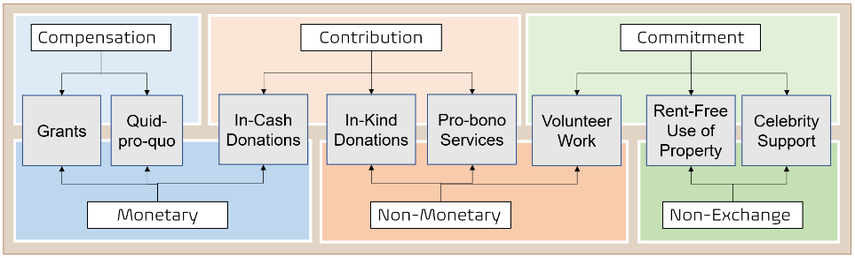
Data consolidation
Reconstructing transactions
Different sets of data will be collected using two distinct tools, however, the non-financial costs will be estimated based on the most costing method to put a monetary value to each item that was involved in the HIV response.
Once the non-monetary / non-exchange flows have been valuated, each transaction needs to be traced back to its origins (financing entity FE, REV, SCH)
SCH
The non-financial items/services/ time must be attributed to the services that are provided by the CLO, the CLO manager has to explain how the items were used, or for what services.
By identifying the different vectors, the transactions get reconstructed and the total for each FE and PS is reconciled accordingly.

Slide 34
Non-financial transaction mapping
It is important to note that these non-financial transactions are identified by the combination of the following vectors.

Slide 35
Non-financial transaction mapping

Slide 36
DATA MANAGEMENT, ANALYSIS & PRESENTATION
There are two options to consider when analyzing & presenting the CLO-RT.
The integrated exercise (NASA+) involves a comprehensive data entry and analysis that encompasses both financial and economic transactions. The objective of this exercise is to produce a full NASA study that includes an in-depth analysis of the contributions made by community-led organizations (CLOs) in comparison to other organizations involved in the national HIV response.
CLO RT stand-alone exercise: Focused Assessment of Community-Led Organizations. The exercise centers on gathering data directly from CLOs. The primary goal is to assess the financial and non-financial resources of CLOs.
Both approaches ensure a thorough understanding of the financial dynamics and the significant contributions of CLOs. Providing a detailed examination of their financial impact and role within the broader context of HIV response efforts.

Slide 37
The integrated exercise
Combined NASA and CLO data for analysis and presentation
It is suggested that the CLO non-financial transactions be kept in a separate RTT file, to avoid their inclusion in the GAM 8.3 matrix. The generation of the GAM 8.3 matrix should omit all non-financial transactions, hence
Create different DCTs and RTT projects
  DCT (1) and RTT project (1) for financial transactions and
  DCT (2) and RTT project (2) for the economic transactions/ estimated non-financial resources.
Differentiating direct spending and estimated economic resources in the DCT and RTT:
When entering the data in DCT ensure that each transaction is labeled under the correct “type of data” variable.
Two distinct variables are recommended to separate direct from estimated figures (resources): Type of Data: Non-Financial
Source of Data: Estimations

Slide 38
The integrated exercise
Combined NASA and CLO data for analysis and presentation…..continue
The RT team must cross-verify/ triangulate data from various sources to avoid double counting. This process includes deciding which source to use when the same data are collected from two different sources:
There are two distinct datasets to be created and combined:
1. The full NASA RTT dataset: Capture all the financial transactions in one DCT and import them in RTT project “1” to generate the RTT datasets for financial transactions (this refers to the traditional NASA).
2. The CLO RTT dataset (the economic transactions/ estimated non-financial resources). Capture all the no- financial transactions in one DCT and import them in a different RTT project “2” to generate the RTT datasets for Non-financial transactions (this refers to the economic transactions)

Slide 39
The integrated exercise
Combined NASA and CLO data for analysis and presentation…..continue
For combining the analysis, the RT team will manually manipulate data in Excel. The primary dataset is the Full NASA database exported from RTT, to which you will add (paste in) the CLO transactions. In other words, the CLO database will be pasted/added to the full NASA database. Combining the two datasets into one will allow us to show the overall picture of HIV spending
Be cautious to avoid double counting while combining the two datasets. The RT team must incorporate only CLO data that were not previously recorded in the traditional NASA database. Specifically, this pertains to non-financial data and economic transactions.
For result presentation: the RT team can manually extract the type of data they want to present by filtering the type of data variable. There are two approaches to this:
To present an overall picture (financial + economic resources): Incorporate the CLO non-financial data in the NASA dataset to show the overall spending.
To present the overall CLO spending: Extract the financial CLO transactions from the NASA dataset and incorporate it into the CLO non-financial dataset to show the CLO overall spending (financials and non-financial transactions).
The country will determine whether to present a total picture, including the total NASA spending and the estimated economic resources from CLOs. Or present the two results separately.

Slide 40
CLO RT stand-alone exercise
Conducting a stand-alone exercise is an option, but there are instances when its results will integrate with the full NASA study
The CLO financial and non-financial data in one DCT and analyzed in one RTT project.
The stand-alone CLO RT allows us to show the total picture of CLO HIV spending, including direct/actual spending from different FEs + the non-financial /economic transaction from estimations.
Data collection will use both top-down and bottom-up approaches. To prevent double counting, the RT team must cross-verify/ triangulate data from various sources. This process includes deciding which source to use when the same data are collected from two different sources.
Differentiating direct spending and estimated resources in the DCT: Two distinct variables are recommended to separate direct from estimated figures (resources):
Type of Data: Non-Financial
Source of Data: Estimations.
The RTT outputs will combine both direct spending and estimated resources and show the total picture of CLO spending.
However, for results presentation, the RT team can manually extract the type of data they want to present by filtering the type of data variable.

Slide 41
Potential challenges with CLO data entry and consolidation
The questionnaires include tables to detail the amounts spent on various types of services and the corresponding beneficiary populations. However, not all organizations have the necessary records to accurately break down expenditures by each beneficiary type. In such situations, CLO should provide guidance on how to proportionally distribute the spending among the beneficiaries (BPs).
Additionally, there are instances where funds are earmarked for specific populations, but the allocation across different programs is not documented. In these cases, the CLO should also offer guidance on how to proportionally allocate the spending by intervention (ASC).
Even though registered CLOs are required by law to keep records and prepare annual financial statements, some CLOs are under-resourced and lack the organizational tools, capacity, and financial literacy expertise to accurately report their organization's finances.
CLOs may struggle with inadequate documentation and reporting systems. They might find it challenging to itemize all donated goods and their quantities according to their sources. Without proper valuation of these donations, it becomes difficult to provide accurate estimations of their worth. Team discussions with the CLO will assist in this process.

Slide 42
Potential challenges with CLO data entry and consolidation
For instance, a CLO may receive various in-kind donations such as office supplies, food items, or equipment from multiple donors. If the organization lacks a systematic approach to track these donations, they might not be able to specify how many items came from each donor. This can lead to significant challenges when trying to estimate the total value of the donations per FE.
Additionally, small or unfunded CLOs that operate from the founder's home may struggle to accurately estimate the cost of using the property for free. However, without proper valuation methods, managers may either undervalue the benefit, missing out on important financial insights or overvalue it, which could lead to inflated expense reports.
It is crucial to translate all economic costs into financial terms. NASA / RT team should assist CLO in choosing the approach that provides the most reasonable estimates. To address this, managers can research local rental rates for similar properties, By doing so, they can derive a more accurate and fair market value for the space being used.
This approach ensures that all economic costs are properly reflected in the financial records, providing a clearer picture of the organization's true expenses and resources.
Overall, accurate cost estimation and appropriate valuation methods are essential for ensuring the comprehensive resource tracking of CLOs.

Slide 43
Module 5:
CLO Resources Tacking analysis
This section will present potential analysis that can be done with this assessment

Slide 44
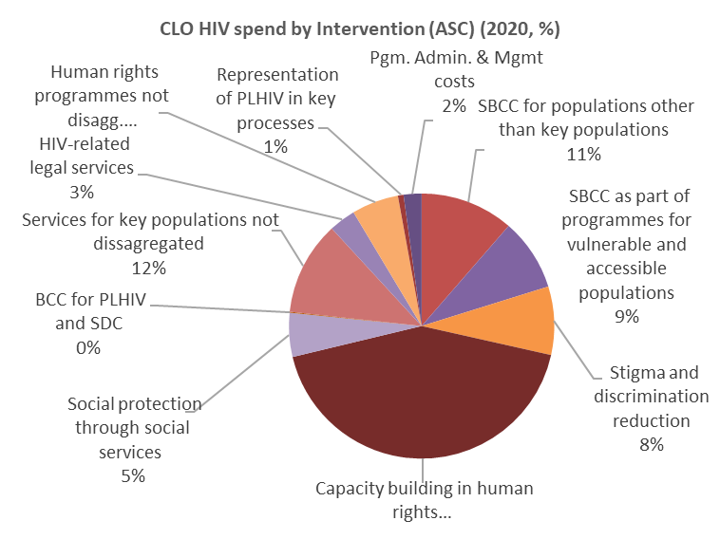
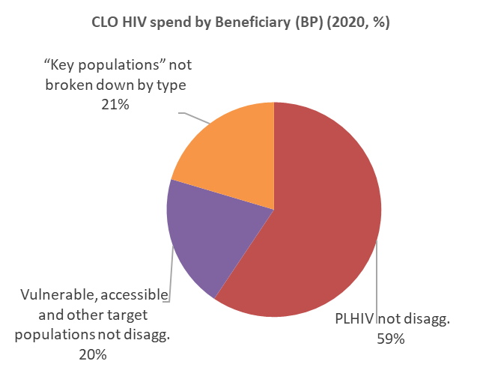
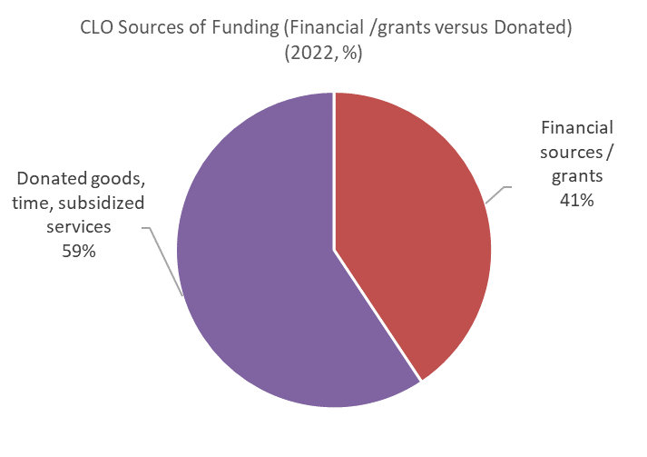
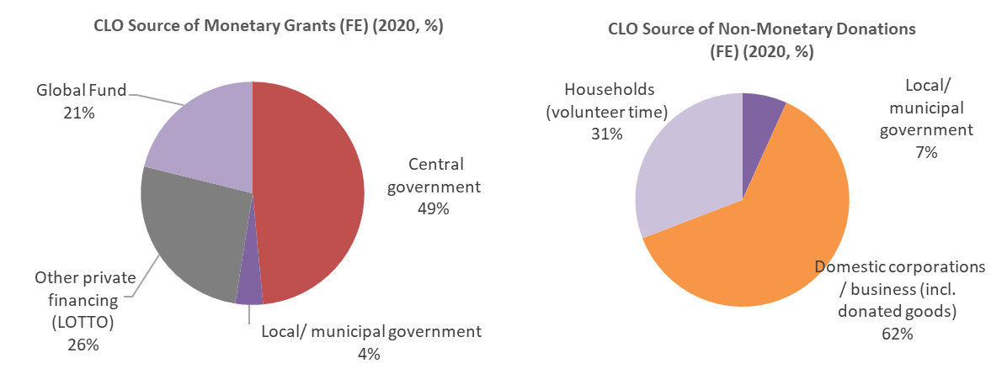
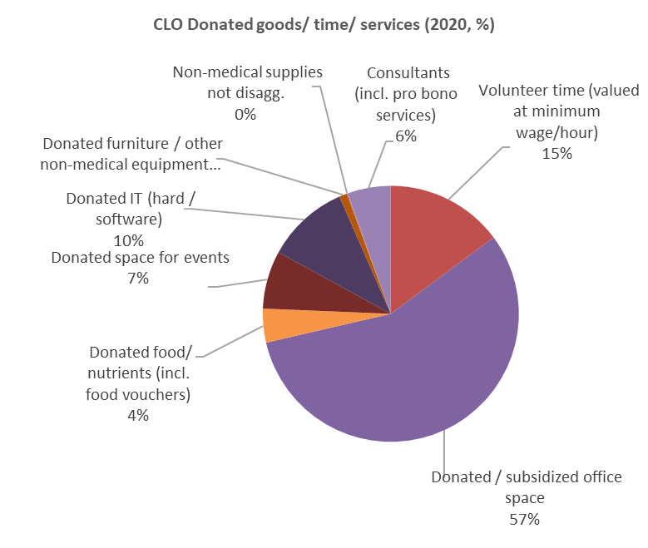
Basic graphs for CLO data analysis

Slide 45
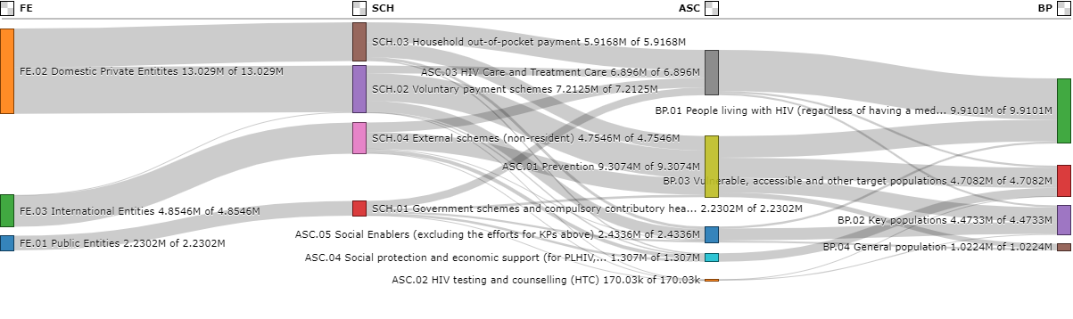
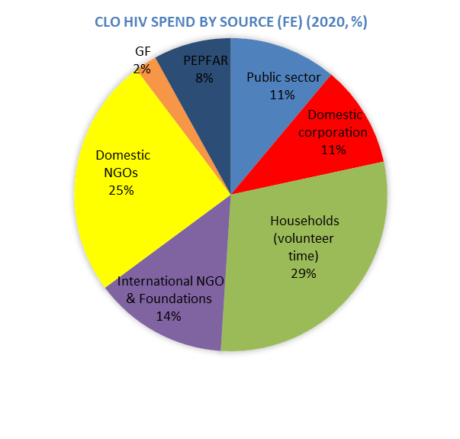
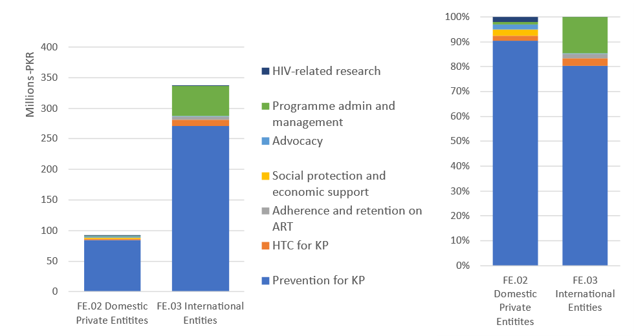
Basic graphs for CLO data analysis

Slide 46
Integrating the data into a full Nasa Report
The features and qualities of the NASA report necessitate that the resource tracking of Community-led responses meets certain minimum requirements for integration into the final NASA estimation, analysis, and report.
The minimum requirements include recreation of complete transactions, and the use of sound estimation methods,
In the initial attempt to conduct resource tracking of Community-led responses, the CLO analysis could be carried out independently of the traditional NASA data. Subsequently, the findings from this analysis would be documented and included in the appendix section of the overall report, ensuring transparency and providing supplementary insights alongside the main NASA data analysis.
However, in-kind donations should be included as part of the traditional NASA, the NASA / RT team should ensure that data are triangulated to avoid double counting.

Slide 47
KEY POINTERS
CLOs offer a variety of services to ensure that PLHIV and key populations from different backgrounds can access HIV and OI treatment, prevention and testing, and harm reduction as well as human rights support and advocacy.
Allocate adequate time to the preparation for these studies – awareness raising, mapping & identification of CLOs, training, and tools.
Mapping (identification and updating contacts) of CLOs must be done in advance of the commencement of the RT.
Provide the NASA team with an overview of CLO RT, its utility, and data requirements.
Consider a progressive approach that starts with NASAs “catching the bigger CLO fish” first and progressively expands coverage of assessments.

Slide 48
KEY POINTERS cont….
Interestingly, the NASA classifications have been updated to better capture the CLO response and funding.
RT is a tedious process that requires attention to small details, and most importantly, strong costing or financing experience is required.
This project shows the effort to enhance NASA’s ability to track and reflect the CLR, so that CLO RT can be embedded in routine NASA or a deeper dive into the CLO world with standalone exercises to provide a wealth of in-depth insights (but which could not be scaled up to national level).

Slide 49

THANK YOU
For more information, contact UNAIDS Resource Tracking:
Teresa Guthrie
guthriet@unaids.org

