Slide 1

Training & Workshop Series - Adaptable slide deck to conduct costing or budgeting exercises with the community-led response - Stakeholder Engagement
Guidelines Cover

Slide 2
How to use this file
This file is a template organized around five key engagement and training moments for your costing or budgeting exercise.
Each section contains slides you can adapt.
Slides are kept simple for use in meetings with stakeholders.
The notes section provides facilitator guidance, instructions and tips.
To view notes in PowerPoint click the “Notes” button at the bottom of the window.
Facilitator and teams should adapt and expand the slides with their own information and materials.
Notes:
This section will contain notes for the facilitator(s)

Slide 3
File content
Session | Slides | Objectives
Introductory meeting with stakeholders | Slides 4-21 | Present purpose, scope, methods, and timeline of the exercise; agree on roles/ responsibilities; introduce MOU and confidentiality agreement.
Team orientation on data collection | Slides 22-81 | Provide orientation on basic health economics; introduce tools; co-develop and revise tools with CLO members; agree on workplan and timeline.
Review of preliminary results and analysis | Slides 82-112 | Cover basic analysis concepts and methods; review early findings; validate/refine allocation factors; identify and address data gaps.
Validation of results | Slides 113-124 | Present total and unit costs; check plausibility; agree on adjustments; decide on format for presenting results.
Dissemination meeting | Slides 124-148 | Share final results; discuss implications for planning & advocacy; agree on next steps for applying findings.

Slide 4
Introductory meeting with stakeholders - Presenter Name(s) - Date & Location
Insert relevant LOGOS here
Insert relevant LOGOS here

Slide 5
Welcome & introductions

Slide 6
Agenda
Start | End | Description
Insert time | Insert time | Opening remarks
Insert time | Insert time | Introductions
Insert time | Insert time | Overview of the costing/budgeting exercise
Insert time | Insert time | Approach and methodology
Insert time | Insert time | Roles and responsibility
Insert time | Insert time | Review of draft agreements

Slide 7
Opening remarks
We will begin with opening remarks from key partners to set the stage for this exercise.
Notes:
Notes for facilitator:
Invite short remarks (2–3 minutes each) from:
Host organization (e.g., CLO or Ministry of Health representative)
Partner agencies (e.g., UNAIDS, donors, technical partners)
Keep remarks brief and focused on the importance of the exercise and shared goals.

Slide 8
Introductions
Let’s take a moment to introduce ourselves.
Please share your name, organization, role, one expectation from today’s meeting.
Notes:
Notes for facilitator:
Go around the room (or online participants) and invite each person to introduce themselves.
Suggest a concise format: Name, organization, role, and expectations from this meeting.
Write down all expectations on a flip chart, board, or shared screen where everyone can see them.
At the end of the meeting, revisit the list:
Check whether expectations were met.
Identify any points that need to be followed up later.
Optionally, if the group is large, consider doing quick round-table introductions instead of everyone speaking individually.

Slide 9
Overview of the exercise

Slide 10
Budgeting vs. costing
Cost Analysis | Budgeting
Retrospective and/or current | Prospective
Based on observed costs and results | Based on anticipated/modelled costs and results
In a full analysis, includes value of capital goods that are used for implementation | Excludes already purchased capital costs
Capital costs annualized (spread over years of useful life) | Full capital costs included in year of purchase
In an economic analysis, includes in-kind contributions | Typically excludes in-kind contributions
Principally top-down methodology: total financial expenditures allocated to inputs and interventions | Bottom-up methodology = price x quantity
Notes:
Notes for facilitator:
Use this slide to highlight the key differences between budgeting and cost analysis.
Emphasize that:
Budgeting is forward-looking (prospective), based on anticipated or modeled costs and results, often guided by protocols or expectations, not necessarily reality, and generally excludes in-kind contributions.
Cost analysis is backward-looking (retrospective or current), based on observed expenditures and results, and in full economic analysis includes capital costs and in-kind contributions.
Methodologically, budgeting often uses a bottom-up (price × quantity) approach, while cost analysis often uses a top-down allocation of expenditures across inputs, and interventions.
Clarify that both approaches are valuable but serve different purposes: budgeting is for planning future activities, cost analysis is for understanding actual resource use.
Refer to Chapters 3 & 4 of the Guidelines for further details.

Slide 11
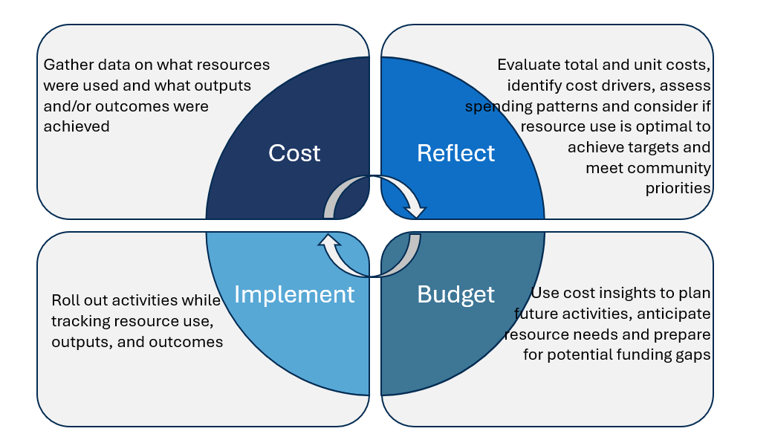
Budgeting and costing learning cycle
Notes:
Notes for facilitator:
This figure shows the budgeting and costing learning cycle: a continuous process rather than one-off activities
Start with “Cost”: gather data on what resources were used and what outputs or outcomes were achieved.
Move to “Reflect”: analyze total and unit costs, identify cost drivers, look at spending patterns, and assess whether resources were used effectively to meet community priorities.
Then “Budget”: use those insights to plan the next round of activities, anticipate future resource needs, and prepare for possible funding gaps.
Finally, “Implement”: roll out the planned activities, while tracking resource use, outputs, and outcomes.
Emphasize that this is a cycle: once implementation happens, the next round of costing and reflection begins again.
The goal is to create a habit of continuous learning and improvement, where communities and stakeholders use costing and budgeting evidence to strengthen planning, advocacy, and sustainability.

Slide 12
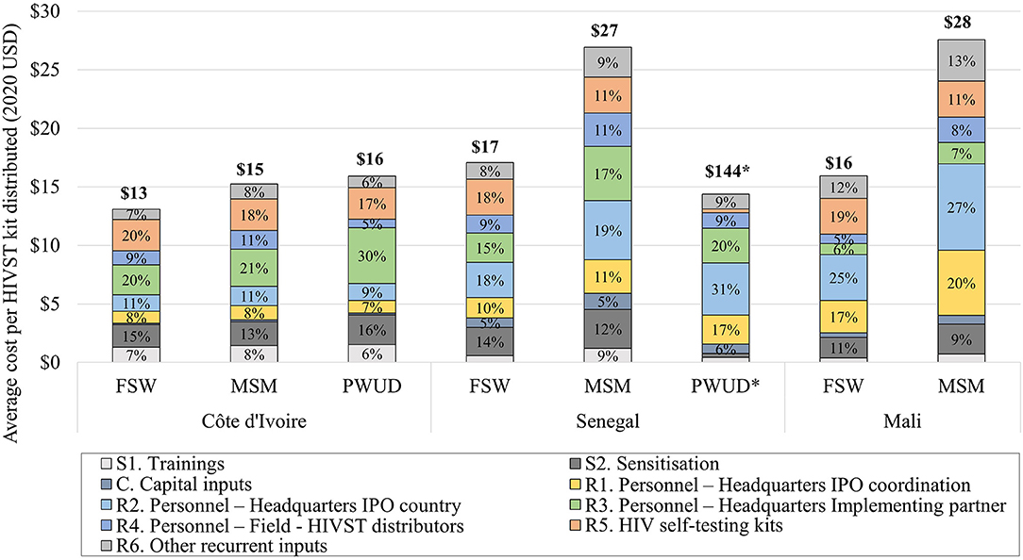
Typical results from a cost analysis
Source: Costs and Scale-Up Costs of Integrating HIV Self-Testing Into Civil Society Organisation-Led Programmes for Key Populations in Côte d'Ivoire, Senegal, and Mali
Marc d’Elbee, et al. Frontiers, Public Health, 2021
Notes:
Notes for facilitator:
This figure presents results from a cost analysis of HIV self-testing distribution led by civil society organizations in Côte d’Ivoire, Senegal, and Mali.
Each bar represents the average cost per HIVST kit distributed to a specific key population group. For example, in Côte d’Ivoire, the average cost was $13 per kit for female sex workers, compared to $17 in Senegal and $16 in Mali.
The different colors in the bars represent categories of costs (cost inputs), such as trainings, sensitization, personnel, self-test kits, and other recurrent inputs.
Across all three countries, the largest share of costs came from personnel, followed by the cost of the HIVST kits themselves.
This type of analysis highlights the unit cost range of the intervention across different populations and settings.
Encourage participants to reflect:
What do these results tell us about the main cost drivers?
Why might unit costs differ between countries or population groups?

Slide 13
Added value of a costing exercise
Provides a comprehensive financial picture, capturing all costs: both financial and in-kind, direct and central-level costs.
Helps identify the full costs of services, beyond donor-driven budgets that may dictate activities.
Supports evidence-informed budgeting.
In economic costings, values community in-kind contributions, making visible what is often overlooked
Informs funding allocation and negotiations.
Improves understanding of cost variations across organizations, sites, and populations.
Notes:
Notes for facilitator:
Comprehensive financial picture: A costing exercise goes beyond the budget lines to capture all resources used, financial, economic, direct, and central. This helps us see the full picture of what it really takes to deliver an intervention.
Full costs of services: Donor budgets often prescribe activities, but they may not reflect the actual resources needed. Costing shows what services may actually cost, which can be different from what was budgeted.
Recognizing community in-kind contributions: Many community-led responses rely heavily on volunteers, donated space, or other non-financial contributions. Costing makes these visible and valued, showing their importance alongside paid inputs, and potentially supporting advocacy for increased and more sustainable funding.
Evidence-informed budgeting: With data on costs, decision-makers can prepare more accurate, grounded budgets and projections. Also costing feeds into national strategies and helps align community-led work with broader health system and HIV planning.
Funding allocation and negotiation: Reliable cost data strengthens the position of CLOs and partners when discussing how resources should be distributed to support sustainable community work.
Understanding variations: Costs can differ across organizations, sites, or populations. Costing helps us understand why, whether it’s scale, context, or type of service, and use that insight for planning and efficiency.

Slide 14
Intervention(s) included in this exercise
Complete this slide to describe the intervention(s) included in the costing or budgeting exercise:
Intervention: [insert text]
Objective(s): [insert text]
Setting: [insert text]
Context: [insert text]
Population(s) served: [insert text]
Implementing CLO: [insert text]
Partner(s): [insert text]
Output or outcome indicators: [insert text]
Notes:
Notes for facilitator:
The first step in any costing or budgeting exercise is to define the intervention(s) to be included. This slide provides a template for capturing those definitions.
Refer participants to Chapter 5.1 of the Guidelines and the Intervention Definition Tool (Appendix 4), which provide detailed guidance.
Encourage other participant(s) to present this slide and its contents

Slide 15
Defining exercise purpose and scope
Complete this slide to describe the purpose and scope of the exercise.
Purpose: [insert text]
Perspective: [insert text]
Time horizon: [insert text]
Types of costs: [financial or economic, best practice vs. observed practice, full or incremental]
Levels of inputs: [above-intervention, intervention or participant costs, capital and/or recurrent]
Types of outputs: [insert text]
Notes:
Notes for facilitator:
Refer to Chapter 5.1.2 and the Scope Framework tool (Box 5.3) for full guidance.
Stress that being explicit about purpose and scope is critical:
It keeps decisions consistent throughout the exercise.
It ensures stakeholders understand what will and will not be included in the estimates.
It helps avoid misinterpretation of results later.
Encourage the team to discuss each element in the table (purpose, perspective, time horizon, cost types, input levels, outputs).
Define and explain terms as you go along:
Purpose: Why is this exercise being done? (e.g. monitor, assess efficiency, inform funding proposal, short/long-term planning)
Perspective: Whose costs/resources are included? (e.g. one CLO, multiple CLOs, government, donors). Be detailed.
Time horizon: What time period is covered?
Types of costs: Financial only, or also economic (in-kind, donated)? Best practice vs. observed practice? Full vs. incremental?
Levels of inputs: Which inputs are covered? (above-intervention, intervention, participant; capital vs. recurrent)
Types of outputs: How will outputs be measured? (site, activity, participant)

Slide 16





Exercise timeline
Planning
Data collection & cleaning
Data analysis
Validation
Dissemination
[Insert date]
[Insert date]
Team orientation on data collection
Validation workshop
Introductory meeting with stakeholders
Review of preliminary analysis
Dissemination meeting
[Insert date]
[Insert date]
[Insert date]
Notes:
Notes for facilitator:
This slide is a template: please adapt it to your context/exercise
Enter dates for each milestone
Remind participants: this is a living plan and can be updated as the exercise progresses.

Slide 17
Participatory approach
To strengthen your understanding and capacity to use this exercise’s results for monitoring, planning, resource mobilization, and advocacy
To enable you to conduct your own exercise, now and in the future
Improve and validate data collection and analysis through collaboration
Notes:
Notes for facilitator:
Emphasize that this exercise is not only about producing cost results, but about building skills and ownership among stakeholders.
The participatory approach ensures that:
Organizations can directly use the results for planning and advocacy.
Teams gain the capacity to repeat costing or budgeting exercises independently in the future.
Data collection and analysis are more accurate and relevant, because they are informed and validated by those closest to the interventions.
Stress that everyone here plays an active role in shaping both the process and the outcomes.

Slide 18
Roles and responsibilities
Complete this table and discuss details with participants to validate.
Task | Responsible | Accountable | Consulted | Informed
Exercise coordination | [Insert text] | [Insert text] | [Insert text] | [Insert text]
Data collection | [Insert text] | [Insert text] | [Insert text] | [Insert text]
Data entry & cleaning | [Insert text] | [Insert text] | [Insert text] | [Insert text]
Analysis | [Insert text] | [Insert text] | [Insert text] | [Insert text]
Validation of results | [Insert text] | [Insert text] | [Insert text] | [Insert text]
Dissemination | [Insert text] | [Insert text] | [Insert text] | [Insert text]
Notes:
Notes for facilitator:
Prepare a draft of this table in advance, filling in likely individuals, organizations, or stakeholders for each task.
During the meeting, present the draft and discuss with participants to validate and adjust roles as needed to reflect consensus.
Clarify the RACI roles:
Responsible (R): person/organization doing the work
Accountable (A): person who signs off or has ultimate ownership
Consulted (C): those who provide input and expertise
Informed (I): those who need to be kept up to date
Keep the table high-level at first with main tasks and roles.
Revisit and refine this table over time, adding more detail (rows, tasks, responsibilities) as the exercise progresses.
Encourage open discussion to make sure everyone agrees on “who does what” and that there are no overlaps or gaps.

Slide 19
Ethics and Safeguards
Every exercise must consider how to protect participants, ensure confidentiality, and handle sensitive data responsibly. Use this template to identify measures that will be applied in this exercise.
Area | Measures to be taken (to be adapted)
Ethical approval | [Is formal approval required? If yes, from which body?]
Informed consent | [Will staff and providers be interviewed or surveyed? How will they be informed?]
Confidentiality | [How will sensitive financial data be safeguarded? Will output data be anonymized or aggregated?]
Data handling & storage | [Where will data be stored? Who has access? How long will it be retained?]
Compensation | [Will participating CLOs or individuals be compensated? How will this be done fairly and transparently?]
Notes:
Notes for facilitator:
Prepare in advance: Draft proposed measures in each category
During the meeting, present these drafts and discuss with participants to validate or adapt them.
Refer to Chapter 6.2 of the Guidelines for detailed guidance.
Key points to emphasize:
Formal ethical approval may not always be required, but ethical safeguards are always essential.
Informed consent should be clear, voluntary, and respectful.
CLO clients and beneficiaries should at no point be interviewed.
Confidentiality: stress anonymization, limited access, and secure storage.
Compensation should be modest, appropriate, and transparent to avoid unintended consequences.
Encourage stakeholders to raise concerns, this is about building trust and transparency before data collection starts.

Slide 20
MOU & Confidentiality agreement
If relevant, review and adapt the template Memorandum of Understanding and Confidentiality Agreement available in the guidelines Appendix.
Notes:
Notes for facilitator:
If an MOU and confidentiality agreement are needed for your exercise, prepare draft documents in advance.
This step is conditional:
Required if the exercise is externally led, to safeguard CLOs and participants.
Optional if led internally by the CLO, but still good practice to set expectations.
Refer to appendix for templates
Share the draft (printed or projected) and review together.
Encourage participants to discuss, edit, and confirm understanding.
Ensure all individuals handling data sign the Confidentiality Agreement before data collection.

Slide 21
Closing & reflections
Notes:
Notes for facilitator:
Bring back the list of expectations captured during introductions (flip chart, board, or projected notes).
Read through each expectation one by one, and check with participants whether it was addressed.
Acknowledge any expectations not yet met, agree on how and when they will be followed up.
Thank participants for their contributions, and confirm next steps (e.g., timeline, responsibilities, upcoming meetings).
Close on a positive note, emphasizing that this is the start of a collaborative process.

Slide 22
Team orientation on data collection - Presenter Name(s) - Date & Location
Insert relevant LOGOS here
Insert relevant LOGOS here

Slide 23
Welcome & introductions

Slide 24
Agenda
Start | End | Description
Insert time | Insert time | Welcome & introductions
Insert time | Insert time | Foundations of costing & budgeting
Insert time | Insert time | From concepts to practice: defining and mapping resources
Insert time | Insert time | Costing methodology (part 1)
Insert time | Insert time | Costing methodology (part 2)
Insert time | Insert time | Data mapping & planning
Notes:
Notes for facilitator:
Set expectations clearly:
This is a training and workshop, not just a general meeting.
Participants will be actively working through exercises, not only listening to presentations.
Flexibility:
The slides and agenda can be adapted to fit the needs of the group.
Facilitators are encouraged to adjust the timing, add examples, or adapt exercises based on context.
Duration:
Based on experience, this full training typically requires two full days.
Schedule sufficient time for discussions and exercises.
Plan regular breaks to maintain focus and energy.
Tone setting:
Emphasize that the workshop is hands-on and participatory.
Encourage participants to ask questions, challenge assumptions, and share their own examples.

Slide 25
Opening remarks
We will begin with opening remarks from key partners to set the stage for this exercise.
Notes:
Notes for facilitator:
Invite short remarks (2–3 minutes each) from:
Host organization (e.g., CLO or Ministry of Health representative)
Partner agencies (e.g., UNAIDS, donors, technical partners)
Keep remarks brief and focused on the importance of the exercise and shared goals.

Slide 26
Introductions
Let’s take a moment to introduce ourselves.
Please share your name, organization, role, one expectation from today’s meeting.
Notes:
Notes for facilitator:
Go around the room (or online participants) and invite each person to introduce themselves.
Suggest a concise format: Name, organization, role, and expectations from this meeting.
If this is the same group as the previous stakeholder meeting, introductions can be skipped to save time.
Regardless, invite all participants to share their expectations for this training session.
Write down all expectations on a flip chart, board, or shared screen where everyone can see them.
At the end of the meeting, revisit the list:
Check whether expectations were met.
Identify any points that need to be followed up later.
Optionally, if the group is large, consider doing quick round-table introductions instead of everyone speaking individually.

Slide 27
Foundations of costing and budgeting
Notes:
The following slides cover the content of Chapter 3 of the guidelines.

Slide 28
Budgeting vs. costing
Cost Analysis | Budgeting
Retrospective and/or current | Prospective
Based on observed costs and results | Based on anticipated/modelled costs and results
In a full analysis, includes value of capital goods that are used for implementation | Excludes already purchased capital costs
Capital costs annualized (spread over years of useful life) | Full capital costs included in year of purchase
In an economic analysis, includes in-kind contributions | Typically excludes in-kind contributions
Principally top-down methodology: total financial expenditures allocated to inputs and interventions | Bottom-up methodology = price x quantity
Notes:
Notes for facilitator:
This slide repeats content from the earlier stakeholder meeting. If today’s participants are the same group, you can skip quickly or summarize briefly. If there are new participants, take a few extra minutes to go over it.
Use this slide to highlight the key differences between budgeting and cost analysis.
Emphasize that:
Budgeting is forward-looking (prospective), based on anticipated or modeled costs and results, often guided by protocols or expectations, not necessarily reality, and generally excludes in-kind contributions.
Cost analysis is backward-looking (retrospective or current), based on observed expenditures and results, and in full economic analysis includes capital costs and in-kind contributions.
Methodologically, budgeting often uses a bottom-up (price × quantity) approach, while cost analysis often uses a top-down allocation of expenditures across inputs, and interventions.
Clarify that both approaches are valuable but serve different purposes: budgeting is for planning future activities, cost analysis is for understanding actual resource use.
Refer to Chapters 3 & 4 of the Guidelines for further details.

Slide 29
Budgeting and costing learning cycle
Notes:
Notes for facilitator:
This slide repeats content from the earlier stakeholder meeting. If today’s participants are the same group, you can skip quickly or summarize briefly. If there are new participants, take a few extra minutes to go over it.
This figure shows the budgeting and costing learning cycle: a continuous process rather than one-off activities
Start with “Cost”: gather data on what resources were used and what outputs or outcomes were achieved.
Move to “Reflect”: analyze total and unit costs, identify cost drivers, look at spending patterns, and assess whether resources were used effectively to meet community priorities.
Then “Budget”: use those insights to plan the next round of activities, anticipate future resource needs, and prepare for possible funding gaps.
Finally, “Implement”: roll out the planned activities, while tracking resource use, outputs, and outcomes.
Emphasize that this is a cycle: once implementation happens, the next round of costing and reflection begins again.
The goal is to create a habit of continuous learning and improvement, where communities and stakeholders use costing and budgeting evidence to strengthen planning, advocacy, and sustainability.

Slide 30
Fundamental concepts for defining scope
To define the scope of a costing or budgeting exercise, we must first agree on some fundamental concepts in health economics:
Perspective: whose costs are included?
Time horizon: over what period are costs observed or projected?
Types of costs: financial vs. economic, best practice vs. real world, full vs. incremental.
Inputs: types (capital vs. recurrent) and levels (above-intervention, intervention, participant).
These concepts help set the boundaries of the exercise and ensure clarity and consistency.
Notes:
Notes for facilitator:
Introduce this section as the foundation for the rest of the training: before collecting or analyzing any data, we must define the scope.
Clarify that these concepts are standard in health economics
Emphasize that participants will go through each concept one by one, with examples and short exercises to deepen understanding.
Position it as a practical step: defining these boundaries now avoids confusion later when interpreting or comparing results.

Slide 31

Perspective
The perspective is the point of view from which costs are estimated and determines which costs will be included and excluded in the exercise.
You can choose one of the following perspectives:
The payer, i.e. the cost to the party financing the intervention, e.g. the cost to donors.
The service provider, i.e. the cost to the party providing the service, e.g. the cost to the community organisation.
The user, i.e. the cost to the person receiving the intervention, i.e. the user or beneficiary of the care. This includes both direct costs (cost of transport to a clinic) and indirect costs (loss of income due to time off work).
Society, i.e. the cost of an intervention for service providers and users, to understand the costs to society as a whole.
Notes:
Notes for facilitator:
Refer to Chapter 3.3 of the Guidelines for further details.
Explain that the perspective determines whose costs are being counted, and therefore, which resources are included or excluded.
Walk through the four perspectives:
Payer: costs to the funder or donor financing the intervention.
Service provider: costs to the organization delivering the service (e.g. a CLO).
User: costs to the person receiving services (direct and indirect, like transport, fee for the service, or lost wages).
Society: a combined view, capturing all costs (provider and user costs)
Use the image (6 vs 9) to emphasize that perspective matters: the same situation can look very different depending on whose view and whose costs is considered.
Prompt discussion:
Which perspective is most relevant for this current exercise? What would change if we shifted perspectives?

Slide 32
Perspective: exercise
Scenario:
A community-led organisation working for sex workers identified an increased number of STI symptoms among its members and approached the Global Fund for funding to include self-testing for syphilis. The peer distributors work in groups and distribute syphilis self-tests in bars every Thursday evening. They then carry out individual follow-up with customers who test positive, accompanying them to an appropriate health clinic for STI treatment.
Questions :
What costs do you need to consider if you take the point of view of the payer? the provider? the user/beneficiary? society? What types of costs might this include?
Notes:
Notes for facilitator:
Refer back to Chapter 3.3 of the Guidelines for conceptual guidance.
This is a practical exercise to apply the idea of perspective to a real scenario.
Ask a participant to read the scenario aloud and clarify any details if needed.
Guide discussion by asking:
From the payer’s perspective (Global Fund): Which costs would matter? (e.g., test kits, stipends, distribution materials).
From the provider’s perspective (CLO): What costs would they face? (e.g., staff/peer educator time, transport, supervision, training, office overheads).
From the user’s perspective (sex workers): What costs would they incur? (e.g., time, transport to clinic, lost earnings, stigma-related risks).
From society’s perspective: How do we combine provider and user costs? What additional costs/benefits might appear? (e.g., reduced STI transmission, improved health outcomes, reduced burden on health system).
Encourage participants to list examples under each perspective, and compare how different the cost picture looks depending on whose view is taken.
Close by emphasizing: Perspective is not about finding the “right” one, it’s about being clear which one you choose and how it affects the results.

Slide 33
Time horizon
The time horizon is the length of time over which costs are observed (in costing) or projected (in budgeting).
For costing, typical choice is to select a period of 1 year, to capture variatiosn in activity and spending.
Considerations:
Seasonal variation: uptake or costs may fluctuate
Start-up vs. routine implementation: different cost structures over time
Funding cycles: may constrain time horizon
Short and long horizon: detail vs. uncertainty
Unexpected disruptions: stock-outs, strikes, policy changes, pandemics
Notes:
Notes for facilitator:
Introduce the concept: The time horizon is the length of time over which we observe or project costs. It’s a critical choice because it defines the scope of the analysis.
Highlight the default: A typical choice is 1 year, which usually captures seasonal and programmatic variations. But this can change depending on the purpose of the costing or budgeting exercise.
Walk through the considerations:
Seasonal variation: Costs and outputs may fluctuate by season (e.g. outreach harder during rainy season, demand higher at year-end).
Start-up vs. implementation: Costs often look very different in the first few months compared to steady-state delivery.
Funding cycles: Donor or government planning horizons may define what is feasible (e.g. Global Fund 3-year cycles).
Short vs. long horizons: Short horizons give more detail but may miss the bigger picture. Longer horizons provide trends but come with more uncertainty.
Unexpected disruptions: Remind participants that real-world shocks (stock-outs, strikes, political unrest, pandemics) can significantly distort results if not considered.

Slide 34


Financial and economic costs
Type | Financial costs | Economic costs
Definition | Cost of paid resources | Value of resources used, paid for or not paid for
Examples | staff, consultancy fees, rent, utilities, supplies, hall hire, etc. | staff, rent, supplies, rental of premises, etc. AND donation of volunteer time, donation of furniture, staff paid by other institutions, subsidised medical supplies, etc....
Objective | Used to help forecast, manage and track actual expenses that need to be paid. | Used to understand and estimate the total cost of an intervention, including donations.
Notes:
Notes for facilitator:
Explain the difference clearly:
Financial costs = actual paid expenses (e.g., salaries, rent, utilities, supplies).
Economic costs = total value of all resources used, whether paid or not (e.g., volunteer time, donated items, staff time covered by other organizations).
Stress that economic costs provide the full picture of what it takes to deliver an intervention, while financial costs are narrower and reflect only what is actually paid for.
Emphasize why this matters for community-led responses: many rely heavily on in-kind or unpaid contributions. If these are excluded, the “full” cost is underestimated.
Key takeaway: Financial costs are for managing budgets. Economic costs are for recognizing the full value of all contributions—including community efforts.

Slide 35
Financial and economic costs: exercise
What information do you need to estimate the economic cost of the following examples?
A peer distributor uses his own motorbike to go to a hot spot to distribute condoms.
3 minutes of radio to advertise your drop-in center
Free one-hour legal service provided by a para-legal
Time contributed by a volunteer mediator
Notes:
Notes for facilitator:
This is a participatory exercise: ask participants to brainstorm in pairs or small groups, then share back.
For each example, what information would you need to assign an economic value?
Peer distributor’s motorbike: fuel cost, kilometers travelled, the replacement value of the motorbike.
Radio airtime: usual commercial rate for 3 minutes of radio advertising. If airtime is subsidized, economic cost should reflect the true market value.
Legal service: hourly professional fee for a para-legal in that context.
Volunteer mediator: the amount time contributed, and value of their time.
How should their time be valued?
Minimum wage?
Replacement cost? (ex: salary for a typical mediator position in the public sector)
Discussion prompt:
How might excluding in-kind or unpaid contributions affect cost estimates? How might that affect funding negotiations or sustainability planning?

Slide 36


Best practice and real world costs
Type | Best practice costs | Real world costs
Definition | Costs estimated based on how procedures should function. | Costs estimated based on how procedures are implemented.
Examples | Cost of distributing preexposure prophylaxis estimated based on treatment protocol, including total staff time and users expected treatment duration (ex: 6 months) | Cost of distributing preexposure prophylaxis estimated based on real implementation, including stock-out periods and users’ shorter periods of treatment.
Purpose | Used to help determine how much an intervention should cost when implemented according to expectations. | Used to help foresee, manage, and track actual costs of the intervention.
Risks | Overestimation of resources as it does not consider real world constraints. | Underestimation of resources as it is based on an inefficient and poor-quality intervention.
Feasibility | Less resource intensive | More resource intensive as it requires measuring how resources are used in reality
Notes:
Notes for facilitator:
This slide introduces the difference between best practice costs and real world costs.
Best practice costs are based on how procedures should function if everything goes according to plan or protocol. For example, costing PrEP distribution assuming all staff follow guidelines, no stock-outs, and users stay on treatment for the full expected duration.
Real world costs, by contrast, are based on how interventions are actually implemented. This means including disruptions like staff absences, stock-outs, or shorter treatment durations.
Each approach has a purpose:
Best practice costs help us understand what an intervention should cost under ideal conditions, and they can be useful for planning or advocacy.
Real world costs help us understand actual resource use and track what’s happening in practice.
There are risks to both:
Best practice may overestimate resources because it ignores inefficiencies or constraints.
Real world may underestimate resources because it reflects inefficiencies or disruptions that ideally should not happen.
Neither approach is “better” in all cases — the choice depends on the purpose of your costing exercise.

Slide 37


Full and incremental costs
Type | Full costs | Incremental costs
Definition | Cost of all resources required to deliver an intervention | Cost of additional resources needed if you add the intervention to existing services
Examples | Includes shared costs, for example central costs or overheads, i.e. costs above the intervention level. | Only takes into account the additional resources required Only suitable for a specific activity, not a major programme
Objective | Used to help forecast, manage and track actual expenses that need to be paid. | Used to estimate the cost of adding a new intervention to a set of existing programmes.
Notes:
Notes for facilitator:
Refer back to Chapter 3.3 of the Guidelines for conceptual guidance.
Explain that this slide distinguishes between:
Full costs: the cost of all resources required to deliver an intervention, including central/overhead and indirect costs.
Incremental costs: the cost of additional resources needed if you add the intervention to existing services.
Clarify: Incremental costs are not the same as full costs, they only capture what’s “extra” on top of what already exists.
Discussion prompts:
When might you use full costs vs. incremental costs?
Full costs → good for long-term planning, sustainability, and advocacy.
Incremental costs → useful for short-term funding proposals or when scaling up existing activities.
Reinforce: both are valid, but you need to be explicit and transparent about which approach you are using, since results will differ.
Key takeaway: full costs help show the real cost of sustaining interventions. Incremental costs show the additional resources needed to expand or add activities.

Slide 38
Full and incremental costs: exercise
Examples of incremental analysis:
Want to know the cost of adding a new service
Want to know the cost of opening a drop-in center for 1 extra hour
Want to know the cost of opening another office in another region
Any other examples?
Notes:
Notes for facilitator:
Read through the examples aloud (new service, extra clinic hour, new office).
Ask participants: “Can you think of similar examples from your own organization or context?”
Encourage brainstorming: e.g.
Adding an extra peer educator to a project.
Expanding services to include PrEP distribution alongside HIV testing.
Running an additional community event each quarter.
Extending a hotline by one more day a week.
Takeaway: Incremental costs are practical for short-term decisions (like pilots, expansions, or donor proposals), but they don’t replace the need for full costs when thinking about sustainability and long-term planning.

Slide 39
Cost inputs
Supplies & Equipment
Personnel
Intervention output
Vehicles & Buildings
What are inputs?
Resources needed for successful intervention
Think of them as “ingredients” in a recipe
Why are they important?
Contribute to the overall costs of the program
Essential for the intervention to work effectively
Considerations in costing or budgeting:
Purpose, audience and feasibility influence which costs are included
Some costs might be excluded for practical reasons
HIV tests & promo materials & chairs
Staff & peer volunteers
Number of tested peers
Tent canopy and car
Notes:
Notes for facilitator:
Introduce inputs as the resources required to deliver an intervention. These can be thought of as the “ingredients” in a recipe, you need the right combination to get the desired result.
Explain the diagram:
On the left: examples of general inputs such as personnel, supplies, vehicles, buildings.
On the right: specific to an HIV testing intervention: peer volunteers, HIV test kits, promo materials, tents, vehicles. These inputs flow into the intervention and produce an output, e.g. number of peers tested.
Discussion prompts for participants:
Key message to underline:
Inputs need to be systematically identified and measured, because what gets included (or excluded) directly shapes the results of the costing or budgeting exercise.
In the next slides, you’ll explore different types and levels of inputs, and how choices about inclusion/exclusion affect results.

Slide 40
Types of cost inputs
 | Definition
Capital | Items that last more than a year. They are expensive (more than $100) and have a long lifespan . In calculating costs, the cost of inputs is annualised (i.e. spread over several years).
Recurring | Items that must be paid for or purchased regularly. Also, equipment under $100, e.g. stapler.
Notes:
Notes for facilitator:
Explain that inputs can be grouped into capital and recurring costs.
Capital costs: last more than a year, usually higher value. In costings, these are annualized, ie spread over their useful life.
For example, if a vehicle costs $20,000 and is expected to last 10 years, the annual cost in the costing analysis is $2,000. This prevents one large purchase from distorting the results for a single year.
In budgeting: The full purchase price ($20,000) must appear in the year it is bought, because budgeting is about tracking actual money spent and needed for cash flow
Recurring costs: items purchased regularly (e.g. fuel, supplies, staff salaries). These also include small equipment under $100 that is used up or replaced quickly.

Slide 41
Types of cost inputs
 | Inputs | Examples
Capital | Building | Room hire, office rent, renovations
 | Vehicles | Cars, motorbikes, bicycles, vans
 | Equipment | Laboratory furniture, technology and equipment
Recurring | Staff | Salaries, benefits, per diems, honoraria
 | Medical supplies and consumables | Test kits, medicines, lab kits, gloves, etc...
 | Non-medical supplies and consumables | T-shirts, pens, notebooks, general supplies
 | Operation and maintenance of vehicles and transport | Fuel, repairs, transport fares
 | Building operation and maintenance | Electricity, gas, water, waste management
 | Staff training | ALL costs associated with staff training
 | Communications costs | Internet, telecommunications, credit top-ups
 | Other recurring costs | Bank charges, subscriptions, refreshments
Notes:
Notes for facilitator:
Walk participants through the table row by row.
Emphasize the difference between capital inputs (buildings, vehicles, equipment) and recurring inputs (things that need to be paid for regularly like staff, consumables, utilities).

Slide 42
Types of cost inputs: exercise
 | Inputs
Capital | Building
 | Vehicles
 | Equipment
Transport reimbursement to visit health facility site
June 2025 staff salary
Economic value of volunteer monitor’s time
Bank charges
Rent of venue to hold enumerator training
Office rent
Monthly bill for electricity
Perdiem & transport for field staff supervision
Recurring | Staff
 | Medical supplies and consumables
 | Non-medical supplies and consumables
 | Operation and maintenance of vehicles and transport
 | Building operation and maintenance
 | Staff training
 | Communications costs
 | Other recurring costs
Notes:
Notes for facilitator:
This is a classification exercise. Ask participants to place each example into the correct input category.
Emphasize that while some items are straightforward, others can be tricky and need careful judgment:
Rent: goes under building (capital input), but because it is paid monthly, it should not be annualized like capital purchases (e.g. buying a building).
Per diem & transport: actually represent two different inputs. Per diem belongs under staff/personnel, while transport should be under operation of vehicles & transport. Financial reports often lump these together, so cost analysts must disaggregate them to get accurate results.
Highlight that this is a common challenge when using financial data for costing: items are often aggregated in ways that don’t map neatly to input categories.

Slide 43
Levels of cost inputs
Costs can be measured at different levels:
Above-service level (also called central level). This includes costs not directly tied to an intervention, like management, administration, monitoring and evaluation, procurement.
Intervention level. Involves costs directly associated with providing interventions. Can be stratified by site, capturing the costs of an intervention at each site where it is implemented.
Participant level. Represents cost incurred by the users or participants of an intervention.
Notes:
Notes for facilitator:
Explain that inputs can be grouped not only by type (capital vs. recurrent) but also by level. This helps clarify where in the system the costs occur.
The three key levels to highlight are:
Above-intervention (central costs): resources that support multiple interventions, such as management, administration, finance, or monitoring and evaluation. These are sometimes referred to as overhead or shared costs.
Intervention-level costs: inputs directly linked to delivering a specific activity or service, such as staff time for peer outreach, test kits, or training sessions.
Participant-level costs: resources provided or incurred at the individual user level, such as transport stipends, refreshments at a session, or the time of participants themselves.
Stress that all levels contribute to total cost.

Slide 44
From concepts to practice: defining and mapping resources
Notes:
Skip or adapt, if doing a budgeting exercise.

Slide 45
Preparing for the exercise
Defining the intervention(s)
Defining the scope of the exercise
Process mapping
Central resource mapping
Notes:
Notes for facilitator:
This is the first step in preparing for costing/budgeting.
At the end of the training, this work will feed into a detailed data collection plan.

Slide 46
Intervention(s) included in this exercise
Complete this slide to describe the intervention(s) included in the costing or budgeting exercise:
Intervention: [insert text]
Objective(s): [insert text]
Setting: [insert text]
Context: [insert text]
Population(s) served: [insert text]
Implementing CLO: [insert text]
Partner(s): [insert text]
Output or outcome indicators: [insert text]
Notes:
Notes for facilitator:
This slide was already introduced in the stakeholder meeting when the exercise was first framed.
Just use it to remind everyone of the intervention(s) that will be costed or budgeted.

Slide 47
Defining exercise purpose and scope
Complete this slide to describe the purpose and scope of the exercise.
Purpose: [insert text]
Perspective: [insert text]
Time horizon: [insert text]
Types of costs: [financial or economic, best practice vs. observed practice, full or incremental]
Types & Levels of inputs: [above-intervention, intervention or participant costs, capital and/or recurrent]
Notes:
Notes for facilitator:
This slide was already introduced in the stakeholder meeting when the exercise was first framed.
Now, participants should have a stronger grasp of the concepts: perspective, time horizon, types of costs, levels of inputs, etc... The purpose here is to validate and finalize the scope of the costing/budgeting exercise.
Go through each element one by one (Purpose, Perspective, Time horizon, Types of costs, Levels of inputs, Types of outputs).
Discussion prompts:
Purpose: Does the purpose we agreed earlier still feel relevant? Is there anything to refine or add?
Perspective: Do participants agree this is the right point of view? Should other perspectives be considered (payer, provider?) Who specifically would the provider perspective include?
Time horizon: Is the chosen period realistic, considering seasonality, funding cycles, or unexpected disruptions?
Types of costs: Are we capturing the right approach, financial/economic, best practice/observed, full/incremental?
Levels of inputs: Are all levels covered—central, intervention, participant? Should capital vs recurrent be treated differently?
Encourage participants to discuss and suggest changes. The facilitator should capture proposed edits on the slide or in notes so the agreed scope is clearly documented.
Wrap up:
Emphasize that validating scope here is critical, because it sets the boundaries for data collection and analysis.
Clarify that once scope is confirmed, it ensures the costing/budgeting exercise is transparent, credible, and aligned with participants’ priorities.

Slide 48
Identifying direct resources: process mapping
Purpose: Identify how interventions are delivered and what resources are used or required.
Step-by-step documentation of intervention delivery
Captures who, where, and what resources are involved
Ensures all inputs (staff time, space, supplies, equipment) are identified
Provides first draft for data collection planning, but to be validated later with observations
Helps understand variation across sites or delivery models
Notes:
Notes for facilitator:
Explain that this is the first step in identifying direct resources. Validation will come later (through observation, role-play, or follow-up discussions).
Clarify that the aim is to document the delivery process, not to perfect it now. Encourage participants to be practical and draw on their knowledge.
Highlight that each intervention (e.g. ART refill, peer support, CLM visit) may look different depending on where and how it is delivered.
Use probing questions:
What happens first?
Where does it happen?
Who is involved?
What is used (supplies, space, equipment)?
Emphasize: This first attempt doesn’t need to be perfect, but it will guide what data we need to capture and where we need to validate later.

Slide 49
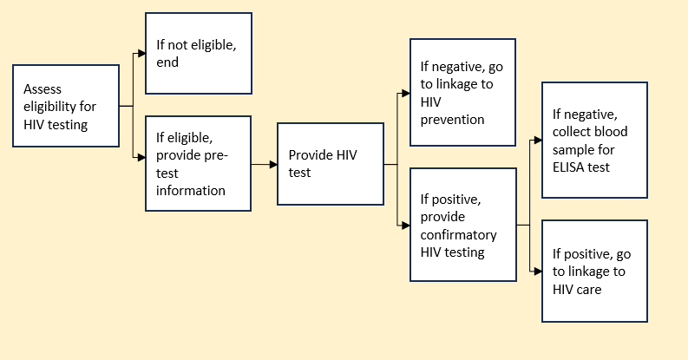
Process mapping: exercise
Notes:
Notes for facilitator:
Present an example of the process mapping exercise.
Participants can either do it using a step by step flow diagram, visually documenting all the steps involved from start to finish. Prompt participants to identify alternative steps across different outcomes, if applicable.

Slide 50
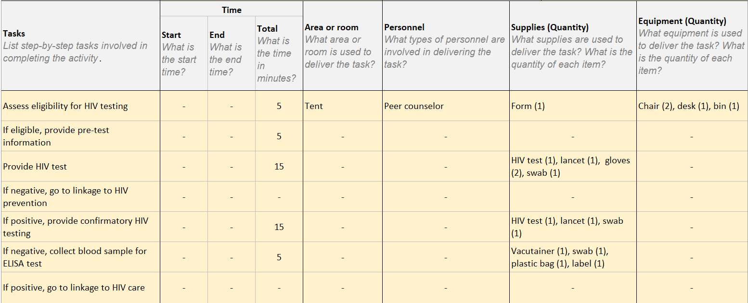
Process mapping: exercise
Notes:
Notes for facilitator:
Present an example of the process mapping exercise.
Ultimately, this table needs to be completed with:
Start and end times.
Location or space used.
Staff roles and time spent.
Supplies and equipment used.
This should later on be validated with observation, but for now, key resources used for direct intervention implementation should be identified.
Be sure to collect this information from the CLO(s) at the end of the exercise

Slide 51
Identifying above-intervention inputs: central resource mapping
Purpose: Identify cross-cutting resources that enable all interventions and that will need to be included in the costing/budgeting later
Identify staff, office rent, utilities, security, shared services (cleaning, waste disposal), shared equipment, vehicles, compliance costs (taxes, registration, audit fees), donated or seconded resources (free office space, staff paid by other stakeholders), organizational events (planning retreats).
Focus on big-ticket items with the greatest impact on total costs
No need to quantify or assign costs yet, just identify these central resources that will need to be included in the exercise.
Notes:
Notes for facilitator:
Explain that this is the first step in identifying direct resources. Validation will come later (through observation, role-play, or follow-up discussions).
Clarify that the aim is to document the delivery process, not to perfect it now. Encourage participants to be practical and draw on their knowledge.
Highlight that each intervention (e.g. ART refill, peer support, CLM visit) may look different depending on where and how it is delivered.
Use probing questions:
What happens first?
Where does it happen?
Who is involved?
What is used (supplies, space, equipment)?
Emphasize: This first attempt doesn’t need to be perfect, but it will guide what data we need to capture and where we need to validate later.

Slide 52
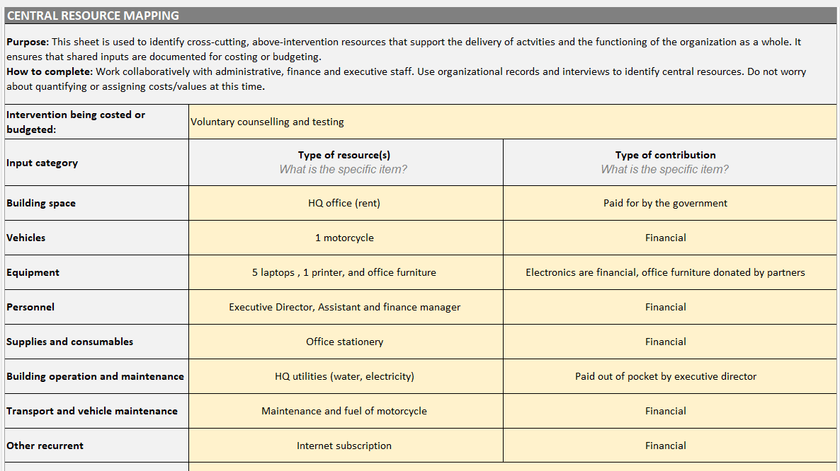
Central resource mapping: exercise
Notes:
Notes for facilitator:
Explain that unlike process mapping (focused on direct service delivery), this step identifies cross-cutting, above-intervention resources that enable the organization to function.
Emphasize these costs are often overlooked but are essential (e.g., admin staff, rent, utilities).
Ask participants: What central resources does your CLO rely on that support all interventions?
Encourage them to think beyond what is in budgets or expense reports (e.g., seconded staff, donated office space, volunteer admin support).
Clarify that at this stage, they are only listing inputs, not assigning costs.
Remind them to focus on big-ticket items that could significantly affect total costs.
Stress the importance of including shared services (IT, cleaning, compliance costs, audits, registrations).
Emphasize: this is a first exercise; the team will do further work later on by reviewing organizational records (budgets, org charts, asset registries) and interviewing central staff to validate and complete the list.

Slide 53
Costing methodology
Notes:
Skip or adapt, if doing a budgeting exercise.

Slide 54
Methodological approach
Total financial accounts and expenses
Sites, operations, populations
Inputs
Descending
(top to bottom)
Ascending
(bottom to top)
Take the total costs of the programme and disaggregate them downwards to obtain the unit costs.
Costs are then allocated to input types, input levels, and interventions.
Measure and evaluate all the resources (inputs) used in an intervention and aggregate them to obtain total costs and average unit costs.
Notes:
Notes for facilitator:
Explain that there are two main ways to calculate costs:
Top-down (descending): Start with total financial expenditures (e.g., from accounts or budgets) and disaggregate them downwards to inputs, interventions, and unit costs.
Bottom-up (ascending): Start with all the resources (inputs) used at the intervention level, add them up, and then calculate the total and unit costs.
Link to participants’ experience:
Emphasize that most people are already familiar with bottom-up, because it is very similar to how budgeting is usually done (adding up expected resources line by line).
For a costing:
Clarify that you are using will be a combined approach:
The top-down approach is the principal method, because you are working from real expenditures in financial records.
The bottom-up approach will complement it, especially to fill data gaps (for example, where in-kind contributions are not captured in financial accounts).
Why this matters:
Combining both approaches helps ensure the results are as complete and realistic as possible.
It allows you to cross-check between what was actually spent (financial records) and what resources were really used (inputs).

Slide 55
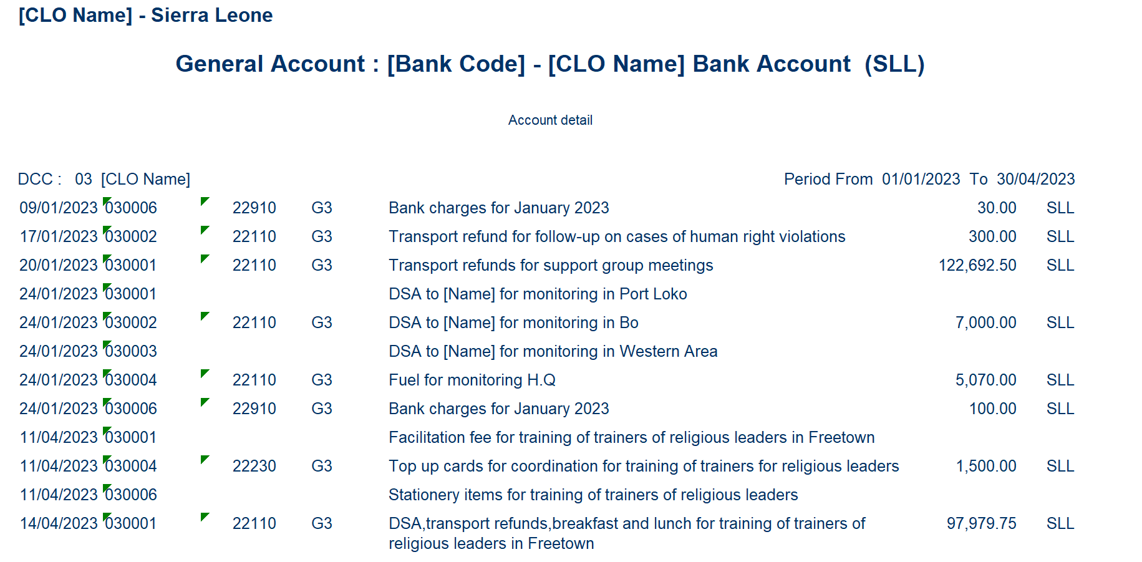
Starting with financial expenditures
Notes:
Notes for facilitator:
Replace this example screenshot with a real extract from the CLO’s accounts, making sure to:
Remove any sensitive or personal information (e.g., staff names, account numbers).
Keep only the expense details needed to illustrate the method.
Emphasize the key point:
We work with real expenditures, not projected budgets, not donor financial reports, not high-level summaries.
This means going down to the most detailed, disaggregated line items available, what you see in bank account details, QuickBooks, or other accounting systems.
Why this matters:
Using line-by-line transactions ensures accuracy and completeness.
It avoids missing costs that might be hidden in aggregate categories.
It allows us to map each expenditure to the correct input type, intervention, and ultimately to unit costs.
This is the foundation of the top-down approach.

Slide 56
Starting with financial expenditures
Input
Intervention
Site
Input
Intervention
Site
Input
Intervention
Site
Notes:
Notes for facilitator:
This slide shows how we move from raw expenditures to categorised costs.
Each expense line should ideally capture the what, why, and where:
What = the input type (e.g., food, fuel, per diem, top-ups).
Why = the intervention it supports (e.g., peer educator training, community meeting, sensitisation).
Where = the site/location (e.g., Makeni, Bo, Bombali).- this is only really necessary if you’re doing a site-level analysis.
Walk participants through the examples:
Breakfast and lunch for peer educators training, Makeni →
Input = catering (supplies and consumables)
Intervention = peer educator training
Site = Makeni
Payment for match official edutainment in Bo →
Input = honorarium/service cost
Intervention = edutainment event
Site = Bo
Support for fuel, top up, pregnant & lactating meeting and HW meeting, Bombali →
Input = fuel + communication + meeting costs (needs disaggregation)
Intervention = support meetings for pregnant/lactating women and health workers
Site = Bombali
Key message: Accounting records often don’t cleanly separate inputs. For example:
“Fuel, top up, and meeting costs” are bundled together.
In costing, we must disaggregate them into their proper categories.

Slide 57
Allocation of costs to interventions: exercise
Costs:
Stipend for community-led monitor
Payment for field use for edutainment event
Facilitation fee for training on HIV self-testing
Top-up cards for peer-navigators
Interventions:
HIV self-testing
Edutainment
Community-led monitoring
PrEP distribution
Notes:
Notes for facilitator:
This slide is about practicing direct allocation of costs to specific interventions.
On the left you see examples of costs, and on the right you see the interventions.
Instructions to participants:
For each cost item, decide which intervention it belongs to.
Stipend for community-led monitor → Community-led monitoring
Payment for field use for edutainment event → Edutainment
Facilitation fee for training on HIV self-testing → HIV self-testing
Add other examples relevant to the CLO(s) and other stakeholders
These are largely straightforward examples where you can assign 100% of the cost to one intervention.
Now for the tricky one:
Top-up cards for peer navigators.
Here, it’s not clear: peer navigators may support multiple interventions (e.g., HIV self-testing, PrEP distribution, community-led monitoring).
This shows why in real costing exercises, not all costs can be directly allocated.
Prompt to participants:
Ask: If peer navigators support multiple interventions, how could we decide to split this cost?
Encourage them to suggest allocation bases such as:
% of peer navigators’ time spent on each activity (time-use data),
Number of clients reached in each intervention,
Or another fair method they use in their organisations.

Slide 58
Allocation of costs to interventions
Examples of shared costs:
Rent for the drop-in center
Transport costs for the purchase of ARV drugs and screening kits
Community outreach for condom distribution, HIV testing, and PrEP initiation
Value of the bench for patients in the waiting room
Examples of central costs:
Director's salary
Management office rent
Fuel for the monitoring & evaluation manager's motorbike
Training of administrative staff on accounting regulations
→ Using Allocation Factors to allocate shared and central costs
Notes:
Notes for facilitator:
In practice, many expenditures are shared across interventions or are central costs that support the entire organisation.
Examples:
Office rent or utilities (support all activities, not just one).
Administrator salaries or finance staff (support multiple interventions).
Vehicles or equipment used by different projects at different times.
These costs are essential : without them, interventions can’t function, but they’re not easy to attribute to a single activity.
This is where allocation factors come in:
We need a rule or basis for dividing up shared costs fairly across interventions.
Allocation factors could be based on:
Number of staff per intervention,
Time spent (from timesheets or activity logs),
Proportion of direct costs,
Or other relevant measures.
The key is transparency: making clear what rule you chose and why.
Transition to next part:
In the coming slides/exercises, we’ll explore what allocation factors are and the tools that can be used to measure these

Slide 59
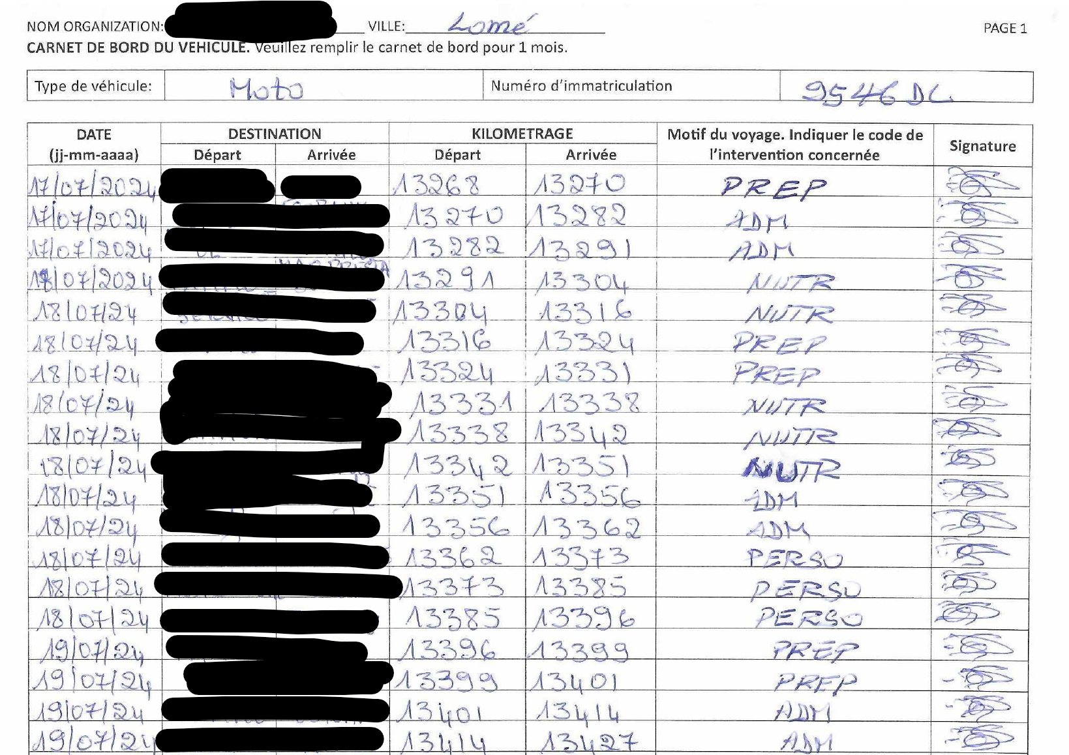
Tool to allocate vehicle costs
Types of costs:
Recurring: Fuel, Repairs/Maintenance, Oil, Tyres, etc...
Capital: Annual value of your vehicles (motorbike, car, etc.)
Logbooks:
 | PrEP | ADMIN | NUTR | TOTAL
Distance | 22 | 58 | 45 | 125 kms
% | 18% | 46% | 36% | 100%
Notes:
Notes for facilitator:
Vehicles are a common shared resource in community-led organisations, and their costs need to be allocated across interventions.
Explain the types of costs:
Recurring costs: fuel, oil, tyres, maintenance, and repairs. These happen regularly.
Capital costs: the value of the vehicle itself (motorbike, car, van). In costing, these are annualised, meaning the purchase value is spread over the useful life of the vehicle so it doesn’t distort one year’s costs.
Introduce logbooks:
Logbooks are a practical way to track how vehicles are used.
Each trip records: the date, destination, kilometres travelled, and the intervention it was used for.
This allows us to calculate how much of total vehicle use went to each intervention.
Walk through the example (right-hand side):
Total distance: 125 km.
Of that:
22 km for PrEP = 18%
58 km for Admin = 46%
45 km for Nutrition = 36%
So if fuel or annualised vehicle costs were $1,000, we would allocate:
$180 to PrEP,
$460 to Admin,
$360 to Nutrition.
Key message:
Without logbooks, organisations may have to guess or make arbitrary allocations.
With logbooks, the allocation is evidence-based and transparent.

Slide 60
Tool to allocate vehicle costs
Discussion:
Do(es) your CLO(s) use any type of vehicles for central administration, service delivery or interventions?
Do(es) your CLO(s) current track vehicle use this way? Are the activities and interventions and kilometers clearly detailed?
If not, is this something that could realistically be implemented in your CLO(s) over a representative period? (1-3 months?)
What changes or adaptations would you need to make to this logbook to suit your context?
Notes:
Notes for facilitator:
Transition from the previous slide: We just saw how logbooks can be used to allocate vehicle costs fairly across interventions. Now let’s think about how this applies to your organisations.
Walk through each question:
Do you use vehicles? → Ask participants to share what kinds of vehicles are used in their CLO (motorbikes, cars, shared vans, etc.) and whether they’re used for service delivery, outreach, administration, or a mix.
Do you currently track usage? → Probe how detailed records are: do they just track fuel bills, or do they have records of trips linked to interventions?
Could a logbook system be implemented? → Emphasize this doesn’t have to be permanent — even 1–3 months of tracking can give a useful picture of allocation. Ask if they think it’s realistic in their context.
What changes would be needed? → Encourage them to suggest practical adaptations: simpler formats, adding columns, making it digital, or assigning responsibility to a specific staff member.
Key message: Tracking vehicle use doesn’t have to be burdensome, but it creates transparency and allows CLOs to show funders exactly how shared resources like vehicles are used across multiple interventions.

Slide 61
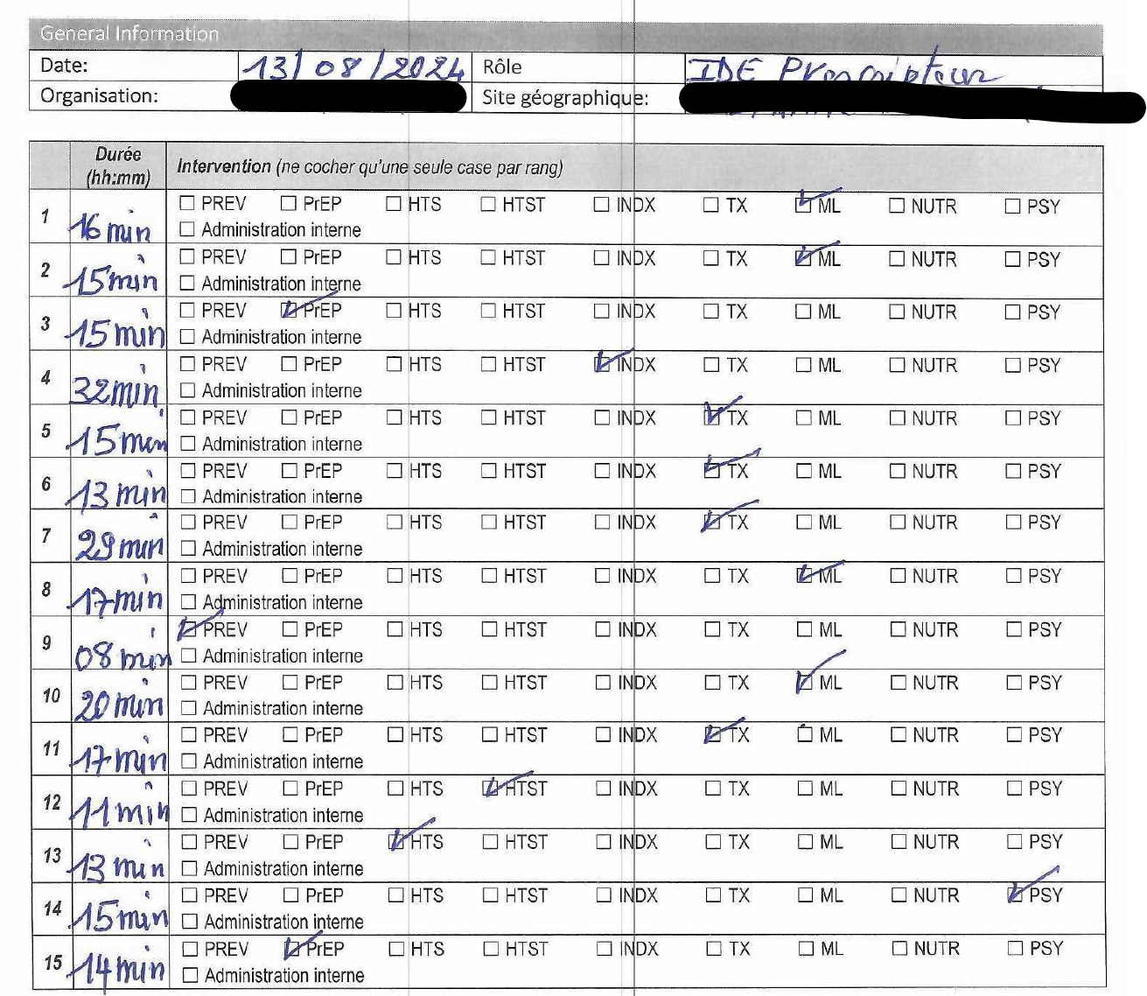
Tool to allocate personnel costs
Types of costs:
Salary of direct services staff
Compensation, benefits, fringe benefits, per diems, incentives, fees, etc...
Time sheets:
 | PREV | PREP | INDX | TX | ML
% time of this personnel member | 2% | 26% | 2% | 58% | 12%
Notes:
Notes for facilitator:
Explain the types of personnel costs:
Salaries of direct service staff (e.g., nurses, peer navigators).
Benefits, per diems, incentives, or stipends.
Introduce time sheets as a tool:
Staff record their activities daily or weekly.
Activities are linked to specific interventions (e.g., HIV self-testing, PrEP distribution, CLM).
The percentages show how their total time is distributed across interventions.
Emphasize that this allows costs to be allocated proportionally, rather than assuming 100% of a salary belongs to one intervention.
While a CLO may already charge a fixed % of staff time to a specific project or funder, in costing exercises we use the observed data: the total salary and the real split of time across interventions
Key message: Personnel costs are often the largest share of budgets, so allocating them accurately is essential for credible costing.

Slide 62
Tool to allocate personnel costs
Discussion:
Which staff members should complete a time sheet?
Should the time sheet be completed retrospectively (looking back) or prospectively (in real time)?
How long should the time sheet cover to be representative?
How can the tool be adapted to fit your CLO’s context?
Notes:
Notes for facilitator:
Emphasize that not every staff member needs to complete this. Only those with time spread across different interventions (e.g., peer navigators, field staff, program officers).
Discuss retrospective vs. prospective use:
Retrospective may be easier (staff reflect on a past week/month), but risks recall bias.
Prospective (daily/weekly recording) is more accurate, but requires discipline.
Highlight that this activity can be strenuous, it’s not realistic to do continuously. Instead, agree on a representative period (e.g., 1-2 weeks,) to capture typical activities.
Ask participants: What time period would work in your organization to be representative without overburdening staff?
Adaptation: Explore ways to simplify the tool (e.g., fewer intervention categories, weekly instead of daily logs, start time and end time or total time spent)

Slide 63
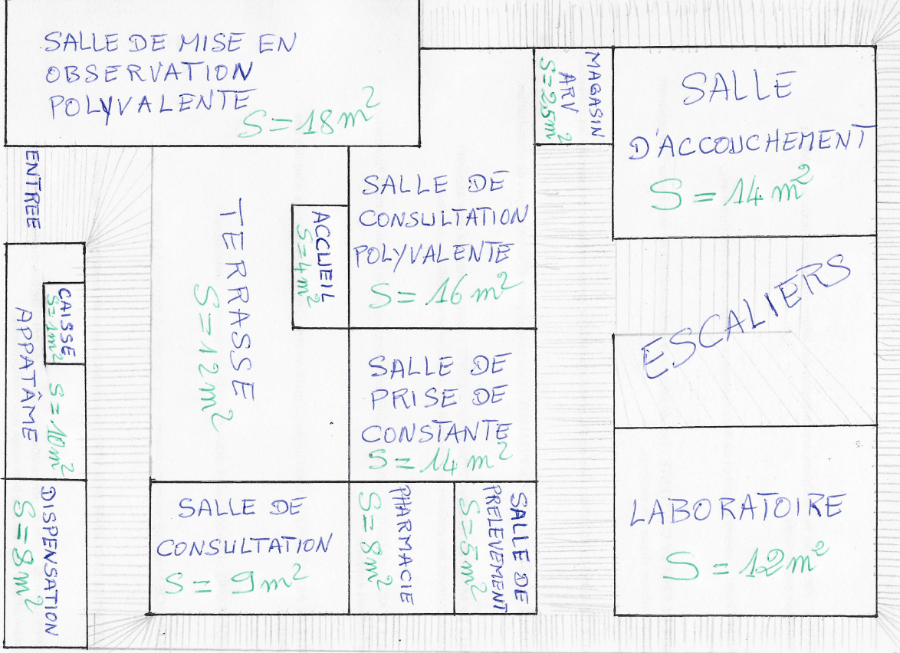
Tool to allocate building costs
Types of costs:
Building rent
The cost of electricity, water, etc...
Building plans:
The % of each room/space
Notes:
Notes for facilitator:
This tool helps allocate building-related costs (rent, utilities, maintenance) to different interventions.
The method is useful only if certain areas are clearly dedicated to specific activities, interventions, or personnel.
Example: A room used entirely to stock PrEP medications can be allocated fully to PrEP.
Example: An office used exclusively by the CLM project manager can be allocated to CLM.
But you can encourage participants to think creatively:
For spaces serving multiple interventions (e.g., a supply room with test kits, ART, and PrEP), costs could be allocated based on stock quantities or usage patterns.
For shared offices (e.g., a manager who works across several projects), their office space could be allocated using the same proportions as their timesheet.
Emphasize practicality: this level of detail may become complicated. It’s most useful where space is clearly linked to one activity or team. Where spaces are very mixed-use, other allocation methods (e.g., staff time, number of clients served) may be more feasible.

Slide 64
Equipment inventory
Discussion:
Would it make sense in your CLO to use the % of space allocate building costs?
Do building plans already exist that show the division of space?
If not, could you create a simple map or drawing to represent how rooms/spaces are used?
Notes:
Notes for facilitator:
Additional questions to pose to participants:
Which spaces are clearly dedicated to one intervention or activity, and which are shared?
What other methods would they want to use to allocate shared building costs?
Reinforce that the goal is not perfection, but to have a reasonable and transparent method to allocate costs fairly.

Slide 65
Tool to allocate supplies costs
Types of costs:
The cost of each medical input (gloves, alcohol, screening kits, ARVs, PrEP, etc.)
Quantity = # consumed per month + # losses
Unit price = purchase price of the input + insurance costs + agents' costs
80% Site 1
20% Site 2
Notes:
Notes for facilitator:
Explain that supplies (e.g., gloves, HIV test kits, ARVs, PrEP commodities) are usually consumed directly by interventions, so it’s important to know not only the purchase price but also how much is used and where.
Point out that the unit cost should include:
Purchase price of the input
Insurance costs (if relevant)
Other costs (like shipping, handling, clearing fees)
Highlight how M&E data is extremely useful here:
For example, if Site 1 reached 80% of clients and Site 2 reached 20%, then we can allocate 80% of the supplies costs to Site 1 and 20% to Site 2.
This ensures the allocation reflects real service delivery data, not guesses.
Emphasize: This is a practical way to use existing program monitoring data to make cost allocation more accurate and credible.
No discussion exercise is needed here, this slide is mainly to show participants how to link costing with routine program data they already collect.

Slide 66
Questions?

Slide 67
Costing methodology (continued)

Slide 68
Missing information in financial accounts
Even with detailed financial data, some important costs may be missing:
Items purchased by other stakeholders:
e.g. HIV test kits supplied by the ministry of health
Equipment purchased outside the costing period
e.g. Vehicles, laptops, or furniture bought in earlier years but still in use.
Services and goods supplied in-kind
e.g. Volunteer time, free space used for implementation, donated supplies,
subsidized utilities.
Notes:
Notes for facilitator:
Start by reminding participants: Up to now, we’ve looked at expenditures from CLO financial accounts. But these don’t always tell the full story.
Explain each category:
Other funders’ items: If commodities are procured by partners, CLO accounts won’t show them.
Equipment purchased earlier: A motorbike bought two years ago won’t appear in this year’s accounts, but it is still a costed input — so we annualize its value.
In-kind contributions: Volunteer peer educators’ time, donated venues for events, or a free billboard space for awareness campaigns. These may not appear in financials but are real resources used.
Highlight: This is why we distinguish between financial and economic costs, financial shows what CLOs actually spent; economic includes everything used, whether paid for or not.
Encourage participants to share examples from their CLOs where real resources may be missing from financial accounts.

Slide 69
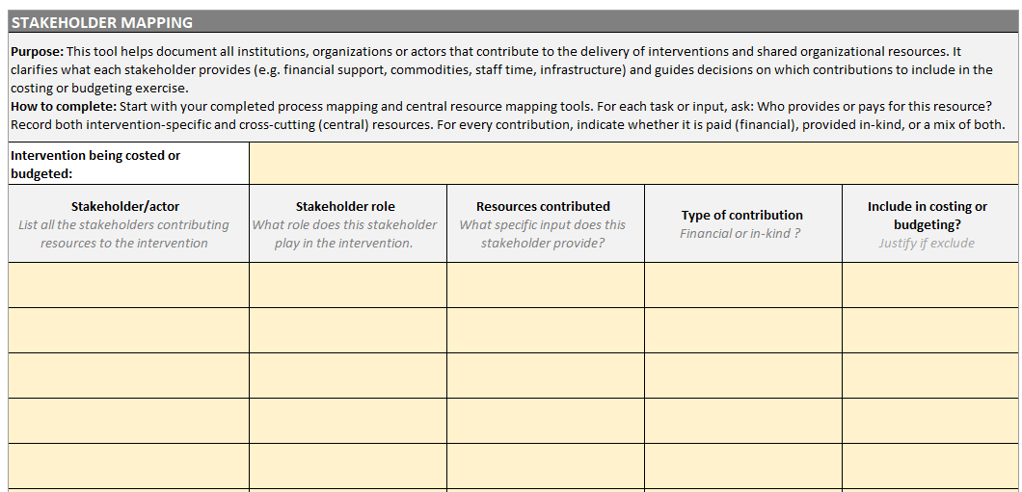
Stakeholder mapping
Notes:
Notes for facilitator:
This tool helps you document all the stakeholders that contribute resources to an intervention or to the organization as a whole.
Stakeholders can include donors, government agencies, partner NGOs, community groups.
It makes visible who provides what, whether it’s funding, commodities, staff time, infrastructure
How it works:
For each intervention being costed or budgeted, you record:
The stakeholder/actor (e.g., Ministry of Health, Global Fund, local CLO).
Their role in delivering the intervention (e.g., provide commodities, supervise staff, mobilize community).
The resources contributed (be as specific as possible: HIVST kits, staff salaries, meeting space, data systems).
The type of contribution – is it financial (cash, paid for directly) or in-kind (volunteer time, donated goods, office space)? Sometimes it’s a mix.
Whether to include it in costing or budgeting. Remember this has to match with the exercise scope you agreed on!
This mapping is important because financial accounts don’t always tell the whole story. Many CLOs rely on external stakeholders for donated items, shared staff, or free infrastructure. Without stakeholder mapping, these resources are invisible in the costing exercise.

Slide 70
Stakeholder mapping: exercise
Exercise:
Who are the key stakeholders providing resources to your intervention(s)?
What specific role and resources do they contribute?
Are these contributions financial, in-kind, or both?
Should they be included in your costing/budgeting exercise? Why or why not?
Do the inclusions/exclusions match the perspective and scope you agreed on earlier?
Use the table to complete this together.
Notes:
Notes for facilitator:
How to run the exercise:
Set up the task:
Tell participants this tool is best completed in real time as a group exercise.
They should map out all stakeholders who provide resources to their intervention or organization.
Remind them that this includes not just funders, but also government, community groups, partner NGOs.
Complete the table together:
List each stakeholder.
Note their role (e.g., providing staff, commodities, infrastructure, data systems).
Record the specific resources contributed.
Decide the type of contribution (financial, in-kind, or mix).
Discuss whether to include it in the costing or budgeting exercise, checking back to the perspective and scope you defined earlier.
Facilitation tips:
Encourage them to think beyond what shows up in the books (e.g., donated ARVs, free use of community halls).
Use probing questions like: “Is this resource visible in your accounts?” “If not, does it still matter for a full picture of resources?”
Emphasize that it’s okay to exclude some contributions, but it’s critical to be transparent and justify why.

Slide 71
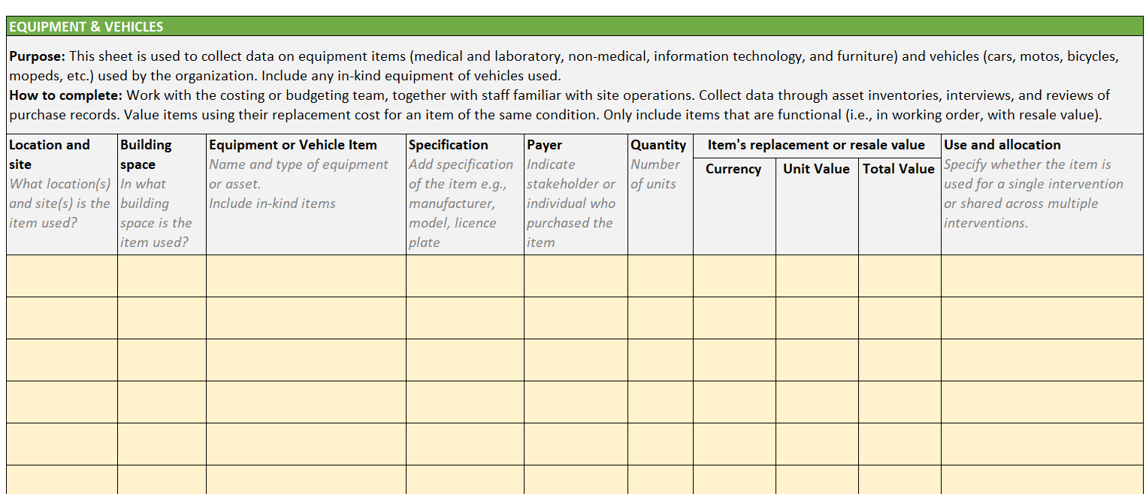
Equipment inventory
Notes:
Notes for facilitator:
Purpose of the tool:
Explain that this tool is designed to capture all equipment and vehicles used by the organization, including medical, laboratory, IT, non-medical, furniture and vehicles.
Highlight: it’s not just about what the CLO bought, but what the CLO uses.
Stress that equipment is valued using its replacement cost, not the original purchase price, because what matters is the current value of resources being used.

Slide 72
Equipment inventory
Discussion:
Does your organization already have an equipment or asset inventory?
Does it include all the information shown here?
Is it updated regularly?
What would need to change to make this tool usable in your CLO?
Notes:
Notes for facilitator:
Does your organization already have an equipment or asset inventory?
Some may have it under finance, others under administration.
They might call it an "asset register" or “inventory list.”
Does it include all the information shown here?
Many inventories miss key fields like payer, allocation, or current replacement value.
Is it updated regularly?
Often, inventories are created once for audits or donor requirements, but not consistently updated.
Ask participants: How up to date is yours? What’s missing?
What would need to change to make this tool usable in your CLO?
Could fields be added?
Who would update it?
Key message to stress:
An updated equipment inventory is critical for economic costing, since older purchases and donated items won’t appear in annual accounts.
Encourage participants to see this not as “extra work” but as a tool that helps CLOs demonstrate the full value of the resources they manage.

Slide 73
In-kind goods and services: exercise
Exercise:
On a flip chart, board or paper, list all in-kind goods and services that support the interventions.
Focus on big-ticket contributions essential for service delivery.
Think about what you listed in process mapping, central resource mapping and stakeholder mapping.
Examples:
Volunteers or interns
Borrowed office space, meeting spaces for peer groups, agricultural or football fields lent from communities
Donated commodities and supplies
Clarifications:
Do not include routine personal expenses (e.g. staff commuting to work)
Do not include out-of-pocket costs later reimbursed
Notes:
Notes for facilitator:
Introduce the exercise: explain that in-kind contributions are goods and services that support interventions but are not paid for by the organization.
Emphasize: these are important to capture because they show the true economic cost of community-led interventions.
Instruct participants to:
Write down all in-kind contributions they can think of (on paper, board, or flip chart).
Focus on big-ticket items (e.g. volunteer time, donated office space, vehicles)
Remind them what to exclude:
Normal personal costs (e.g. commuting to work).
Out-of-pocket expenses if they are reimbursed.
Encourage participants to draw from earlier exercises but make sure to add anything missing that has not yet been identified.
Process mapping (direct delivery resources).
Central resource mapping (shared organizational inputs).
Stakeholder mapping (partners who provide in-kind support).
Stress that this is a first step—a brainstorm. Later, these items will need to be reviewed, measured, and valued.

Slide 74
Recap

Slide 75
Recap of training so far
We have covered:
Basic concepts in health economics
Defining and mapping resources needed for the exercise
Reviewing the costing/budgeting methodology to be applied
Discussing and adapting tools for allocating shared and central resources
Identifying resources that need to be captured using a bottom-up approach.
Final steps in this workshop:
Data mapping and planning: organize what data is needed, where it will be found, and how to collect it
Logistical and administrative steps: review what arrangements are needed to ensure smooth data collection
Notes:
Notes for facilitator:
Introduce the slide as a recap: Let’s pause for a moment and review what we’ve achieved so far in this training.
Walk through the list point by point:
Basic health economics concepts: making sure everyone understands the building blocks.
Defining and mapping resources: ensuring clarity on what inputs are needed.
Methodology: confirming how the costing/budgeting will be carried out.
Tools for shared and central resources: adapting them to the CLO’s context.
Bottom-up resources: identifying which ones need detailed capture.
Emphasize progress made: We’ve laid the foundation by making sure the concepts, resources, and tools are clear.
Transition to next steps: Now, we’ll shift focus to the practical side: mapping and planning the actual data collection, and reviewing the logistical and administrative steps needed to carry this out smoothly.

Slide 76
Data mapping & planning

Slide 77
Recap of training so far
We have covered:
Basic concepts in health economics
Defining and mapping resources needed for the exercise
Reviewing the costing/budgeting methodology to be applied
Discussing and adapting tools for allocating shared and central resources
Identifying resources that need to be captured using a bottom-up approach.
Final steps in this workshop:
Data mapping and planning: organize what data is needed, where it will be found, and how to collect it
Logistical and administrative steps: review what arrangements are needed to ensure smooth data collection
Notes:
Notes for facilitator:
Introduce the slide as a recap: Let’s pause for a moment and review what we’ve achieved so far in this training.
Walk through the list point by point:
Basic health economics concepts: making sure everyone understands the building blocks.
Defining and mapping resources: ensuring clarity on what inputs are needed.
Methodology: confirming how the costing/budgeting will be carried out.
Tools for shared and central resources: adapting them to the CLO’s context.
Bottom-up resources: identifying which ones need detailed capture.
Emphasize progress made: We’ve laid the foundation by making sure the concepts, resources, and tools are clear.
Transition to next steps: Now, we’ll shift focus to the practical side: mapping and planning the actual data collection, and reviewing the logistical and administrative steps needed to carry this out smoothly.

Slide 78
Data mapping
Purpose: Summarize what data is available and what will need to be collected
Exercise:
Bring together the results from your process mapping, central resource mapping and stakeholder mapping
Compile all inputs into a single view
Identify existing data sources and gaps
Focus on three elements for each input:
Quantity- what data source will indicate how much is used?
Price- what data source will indicate the value?
Allocation factor- what data source will indicate its share of use for the intervention being costed or budgeted?
Notes:
Notes for facilitator:
Refer to Chapter 5.1.6 and Appendix 4 (Data Mapping Tool).
Explain: This step pulls everything together. We now look at all the inputs identified earlier and map the data we need to capture their costs.
Key points to cover:
Use the inputs identified in process mapping (direct), central mapping (shared), and stakeholder mapping (contributors).
For each input, identify whether it is financial or in-kind.
Ask: Do we already have reliable data for quantity, price, and allocation factor?
Map where the data will come from: invoices, payroll, registries, monitoring systems, or primary data collection (example: allocation factor tools)
Outputs/outcomes must also be mapped to data sources (e.g. programme records, M&E databases).
Encourage participants to color-code in the tool:
One color for available data sources (desk review).
Another color for new/field data collection required
Stress: This is the bridge between identifying inputs and planning your data collection. It ensures you know exactly what needs to be collected, by whom, and how.

Slide 79
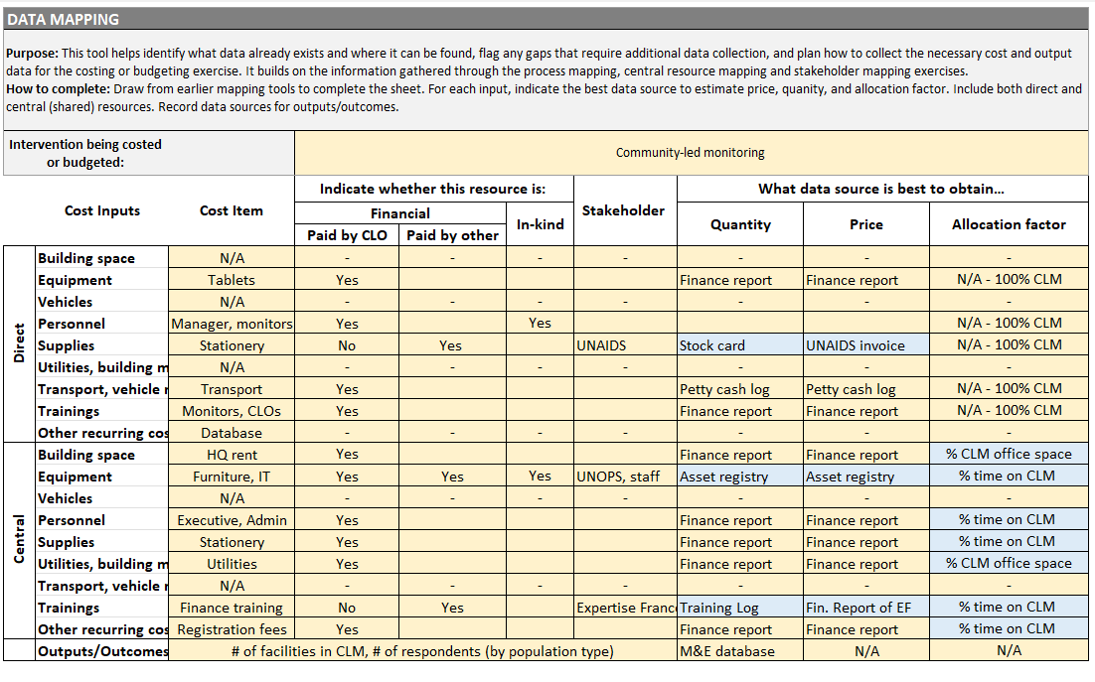
Data mapping
Notes:
Notes for facilitator:
Refer to Chapter 5.1.6 and Appendix 4 (Data Mapping Tool).
Share the data mapping tool for participants to complete

Slide 80
Data collection plan
Exercise:
Builds on data mapping tool
Assign roles and responsibilities
Set target dates for each data item
Include steps for verification and validation
This tool will become the roadmap for data collection and analysis
Notes:
Notes for facilitator:
Refer to Chapter 6.3.2 and Box 6.4 (Workplan tool).
Explain: Now that we know what data we need and where it comes from, the next step is to organize how it will be collected. This means deciding who will do what, and by when.
Key points to emphasize:
Use the Data Mapping tool as the foundation. For each input, add:
Who will collect the data
When it should be collected
Who will verify the data and by when
Timelines will vary depending on the exercise: a single budgeting exercise may take a few weeks, while a full economic costing across CLOs may take months.
Stress that this plan is iterative:
Data collection and analysis often happen in parallel.
It’s normal to discover gaps and go back to adjust the plan.
Encourage naming a dedicated coordinator: costing/budgeting can be too demanding to manage alongside routine responsibilities.
Discussion prompt: Who in your team should lead coordination? How do we ensure responsibilities are realistic and clear?

Slide 81
Closing & reflections
Notes:
Notes for facilitator:
Bring back the list of expectations captured during introductions (flip chart, board, or projected notes).
Read through each expectation one by one, and check with participants whether it was addressed.
Acknowledge any expectations not yet met, agree on how and when they will be followed up.
Thank participants for their contributions, and confirm next steps (e.g., timeline, responsibilities, upcoming meetings).

Slide 82
Review of preliminary results and analysis - Presenter Name(s) - Date & Location
Insert relevant LOGOS here
Insert relevant LOGOS here

Slide 83
Welcome & introductions

Slide 84
Agenda
Start | End | Description
Insert time | Insert time | Opening remarks
Insert time | Insert time | Introductions
Insert time | Insert time | Overview of the costing/budgeting exercise
Insert time | Insert time | Approach and methodology
Insert time | Insert time | Roles and responsibility
Insert time | Insert time | Review of draft agreements

Slide 85
Opening remarks
We will begin with opening remarks from key partners to set the stage for this exercise.
Notes:
Notes for facilitator:
Invite short remarks (2–3 minutes each) from:
Host organization (e.g., CLO or Ministry of Health representative)
Partner agencies (e.g., UNAIDS, donors, technical partners)
Keep remarks brief and focused on the importance of the exercise and shared goals.

Slide 86
Introductions
Let’s take a moment to introduce ourselves.
Please share your name, organization, role, one expectation from today’s meeting.
Notes:
Notes for facilitator:
This should be the same group as the previous data collection training, so introductions can be skipped to save time.
Regardless, invite all participants to share their expectations for this training session.
Write down all expectations on a flip chart, board, or shared screen where everyone can see them.
At the end of the meeting, revisit the list:
Check whether expectations were met.
Identify any points that need to be followed up later.
Optionally, if the group is large, consider doing quick round-table introductions instead of everyone speaking individually.

Slide 87
Study progress update

Slide 88
Review of progress & data gaps
Facilitator: Insert/update data mapping tool here. Use green to show what is complete and red what is pending or missing.
Notes:
Notes for facilitator:
Purpose:
Provide transparency on where the exercise stands.
Motivate stakeholders to close remaining gaps.
How to present:
Share the updated Data Mapping Tool on screen.
Highlight completed items (green) and outstanding ones (red).
Keep the update brief — the real focus is the discussion.
Discussion:
Invite participants to react: Does this look complete and accurate?
Ask directly: What is still missing?
Push for action: Can we fill this gap today? If not, ask Who can take this on, and by what date?
Record all commitments visibly (on flip chart, whiteboard, or shared doc).
Key message:
This is not just reporting back, it’s a working session to unblock issues, accelerate completion, and secure clear commitments.

Slide 89
Recap of key lessons from last workshop
Notes:
Notes for facilitator:
Bring back 4–6 key concepts from the last workshop (e.g., perspective, time horizon, types of costs, process mapping, central resources).
Display them as prompts (not full definitions).
Ask participants to explain these concepts in their own words.
If there are new participants, ask the returning participant to explain one or two concepts to their partner.

Slide 90
Budgeting vs. costing
Notes:
Notes for facilitator:
Prompt participants: what are the key differences between budgeting and costing?

Slide 91
Budgeting vs. costing
Cost Analysis | Budgeting
Retrospective and/or current | Prospective
Based on observed costs and results | Based on anticipated/modelled costs and results
In a full analysis, includes value of capital goods that are used for implementation | Excludes already purchased capital costs
Capital costs annualized (spread over years of useful life) | Full capital costs included in year of purchase
In an economic analysis, includes in-kind contributions | Typically excludes in-kind contributions
Principally top-down methodology: total financial expenditures allocated to inputs and interventions | Bottom-up methodology = price x quantity
Notes:
Notes for facilitator:
Use this slide to review possible answer

Slide 92
Perspective
Notes:
Notes for facilitator:
Prompt participants:
What is a perspective in health economics?
What perspectives can be used in costing?

Slide 93
Perspective
The perspective is the point of view from which costs are estimated and determines which costs will be included and excluded in the exercise.
You can choose one of the following perspectives:
The payer, i.e. the cost to the party financing the intervention, e.g. the cost to donors.
The service provider, i.e. the cost to the party providing the service, e.g. the cost to the community organisation.
The user, i.e. the cost to the person receiving the intervention, i.e. the user or beneficiary of the care. This includes both direct costs (cost of transport to a clinic) and indirect costs (loss of income due to time off work).
Society, i.e. the cost of an intervention for service providers and users, to understand the costs to society as a whole.
Notes:
Notes for facilitator:
Use this slide to review possible answer

Slide 94
Time horizon
Notes:
Notes for facilitator:
Prompt participants:
What is a time horizon in health economics?
What are important considerations when choosing one?

Slide 95
Time horizon
The time horizon is the length of time over which costs are observed (in costing) or projected (in budgeting).
For costing, typical choice is to select a period of 1 year, to capture variatiosn in activity and spending.
Considerations:
Seasonal variation: uptake or costs may fluctuate
Start-up vs. routine implementation: different cost structures over time
Funding cycles: may constrain time horizon
Short and long horizon: detail vs. uncertainty
Unexpected disruptions: stock-outs, strikes, policy changes, pandemics
Notes:
Notes for facilitator:
Use this slide to review possible answer

Slide 96
Financial and economic costs
Notes:
Notes for facilitator:
Prompt participants:
What is the difference between financial and economic costs?
What is the value of doing one versus the other?

Slide 97
Financial and economic costs
Type | Financial costs | Economic costs
Definition | Cost of paid resources | Value of resources used, paid for or not paid for
Examples | staff, consultancy fees, rent, utilities, supplies, hall hire, etc. | staff, rent, supplies, rental of premises, etc. AND donation of volunteer time, donation of furniture, staff paid by other institutions, subsidised medical supplies, etc....
Objective | Used to help forecast, manage and track actual expenses that need to be paid. | Used to understand and estimate the total cost of an intervention, including donations.
Notes:
Notes for facilitator:
Use this slide to review possible answer

Slide 98
Types of cost inputs
 | Definition
Capital
Recurring
Notes:
Notes for facilitator:
Prompt participants:
What is the difference between capital and recurrent costs?
What are examples of capital inputs and recurrent inputs?

Slide 99
Types of cost inputs
 | Definition
Capital | Items that last more than a year. They are expensive (more than $100) and have a long lifespan . In calculating costs, the cost of inputs is annualised (i.e. spread over several years).
Recurring | Items that must be paid for or purchased regularly. Also, equipment under $100, e.g. stapler.
Notes:
Notes for facilitator:
Use this slide to review possible answer

Slide 100
Review of preliminary results
Notes:
Notes for facilitator:
Bring back 4–6 key concepts from the last workshop (e.g., perspective, time horizon, types of costs, process mapping, central resources).
Display them as prompts (not full definitions).
Ask participants to explain these concepts in their own words.
If there are new participants, ask the returning participant to explain one or two concepts to their partner.

Slide 101
Reminder
Top-down approach:
Step 1. Collect all financial expenditures
Step 2. Allocate to cost inputs
Step 3. Allocate to intervention(s)
Step 4. Complete financial data with any other remaining resources
Notes:
Notes for facilitator:
Remind that you went through these steps in the last data collection workshop. The remainder of this workshop will be to go through preliminary results from each step.

Slide 102
Step 1. Collect all financial expenditures
Exercise:
Go to the Cost Data sheet of the workbook
Review the financial expenditure that has been collected and entered into that sheet:
Check all data within the time horizon are included
Confirm all financial data sources are well labeled
Confirm all financial systems (by funder, project or site) are represented
Identify any missing or incomplete expenditures
Notes:
Notes for facilitator:
This is an interactive placeholder slide: participants should actively review the workbook together.
Ask participants to open their costing/budgeting workbook and look at the cost data sheet where the collected financial expenditures should be all entered.
Key checks to guide them:
Are all expenditures for the full time horizon included? (No missing months, quarters, or periods).
If the CLO uses multiple financial systems (e.g., per funder, project, or site), confirm that all have been integrated.
Check whether dates match correctly with the costing period defined earlier.
Ensure there are no large gaps or missing chunks of expenditures that could bias results.
Encourage participants to flag discrepancies and note what still needs to be added.
Wrap-up message: This first step is about making sure the financial backbone of the exercise is complete. We can only build accurate results if all the underlying expenditure data are here.

Slide 103
Step 2. Allocate costs to cost inputs
Exercise:
Go to column Q: cost input
Filter by each cost input category
Check if the costs are correctly categorized?
Flag any cost categorization you disagree with.
Identify any input categories with no costs allocated
Does this mean something is missing from the collected data?
Notes:
Notes for facilitator:
Walk participants through the filtering function in Excel (in case they are less familiar).
Do the first category together as a group, then move on systematically.
Encourage discussion: sometimes categorizations can be subjective — the group should agree on what is most appropriate.
Pay special attention to “empty” categories (no costs allocated). Probe whether this reflects reality, or whether costs are missing from financial records.
Outcome: a list of flagged issues to be revisited, and greater confidence in the categorization.

Slide 104
Step 2. Allocate costs to cost inputs
Exercise:
Check entries in the workbook for vehicles and equipment.
Look for duplicates: are any items appearing both in financial records and in the equipment inventory?
Verify allocation: are items categorized correctly under capital with useful life years (Column R)?
Refer to the Parameters Sheet: review the # of useful life years assigned to capital goods.
Discuss: do participants agree with these assumptions? Would alternative life years be more appropriate?
Notes:
Notes for facilitator:
Remind participants: vehicles and equipment are capital costs, not recurrent. Their costs should be spread (annualized) across their useful life in costings.
Walk through an example: e.g., a motorbike bought for $1,000 with 5 years useful life → $200/year.
Ask participants:
Do we see any duplicates (same motorbike both in financials and inventory)? If yes, flag and resolve.
Are all capital items correctly allocated in Column R?
In the Parameters Sheet, does the assumed useful life (e.g., 5 years for vehicles, 3 years for laptops) match participants’ experience?
Emphasize: these assumptions can impact the results, so this is an important step to validate.
Record any changes agreed by participants to update later.

Slide 105
Step 3. Allocate costs to intervention(s)
Exercise:
Present preliminary results from allocation tools (e.g., vehicle logbooks, time sheets, building plans).
Review results with participants:
Do the allocation results reflect reality?
Are all vehicles, equipment, and staff included?
Are there gaps (e.g., missing logbooks, incomplete timesheets)?
Validate: is this an accurate representation of how resources are used across interventions?
Notes:
Notes for facilitator:
Remind participants: allocation ensures that shared or central resources (like vehicles, staff, or buildings) are fairly distributed across interventions.
Start with one example (e.g., vehicle logbook):
Show # of kiometers and % of kilometers used per intervention.
Ask: Does this match your experience of how this vehicle is used?
Check completeness: Are all vehicle logbooks available and completed? If not, which are missing?
Repeat the same validation for:
Personnel costs (using timesheets).
Buildings (using floor space or usage allocation).
Supplies (using M&E data or other allocation factor)
Push for consensus: If something doesn’t look right, how should it be adjusted?
Document any changes agreed.

Slide 106
Step 3. Allocate vehicle costs to intervention(s)
Present results from vehicle logbooks
Vehicle 1 | Intervention 1 | Intervention 2 | Intervention 3 | Intervention 4 | Total
# of kilometers | ## | ## | ## | ## | ##
% of kilometers | % | % | % | % | 100%
Notes:
Notes for facilitator:
Adapt this template as needed

Slide 107
Step 3. Allocate personnel costs to intervention(s)
Present results from vehicle logbooks
Personnel 1 | Intervention 1 | Intervention 2 | Intervention 3 | Intervention 4 | Total
# of hours | ## | ## | ## | ## | ##
% of hours | % | % | % | % | 100%
Notes:
Notes for facilitator:
Adapt this template as needed

Slide 108
Step 3. Allocate building costs to intervention(s)
Present results from vehicle logbooks
Building 1 | Intervention 1 | Intervention 2 | Intervention 3 | Intervention 4 | Total
# of square meters | ## | ## | ## | ## | ##
% of square meters | % | % | % | % | 100%
Notes:
Notes for facilitator:
Adapt this template as needed

Slide 109
Step 3. Allocate supply costs to intervention(s)
Present results from vehicle logbooks
M&E | Intervention 1 | Intervention 2 | Intervention 3 | Intervention 4 | Total
# of persons reached | ## | ## | ## | ## | ##
% of persons reached | % | % | % | % | 100%
Notes:
Notes for facilitator:
Adapt this template as needed

Slide 110
Step 4. Valuing volunteer contributions using minimum wage
 | Number of volunteers | Average hours per month | Value per hour | Total value per month
Peer educators | [X] | [Y] | [Z] | [X] * [Y*Z]
Peer navigators | [X] | [Y] | [Z] | [X] * [Y*Z]
Community-led monitors | [X] | [Y] | [Z] | [X] * [Y*Z]
[insert other] | [X] | [Y] | [Z] | [X] * [Y*Z]
[insert other] | [X] | [Y] | [Z] | [X] * [Y*Z]
[insert other] | [X] | [Y] | [Z] | [X] * [Y*Z]
Notes:
Notes for facilitator:
Refer participants to Chapter 4, Box 4.4: this explains how to conduct the exercise step by step.
Remind: financial records may show stipends, but these do not always reflect the full value of contributions.
Three steps to check with participants:
Quantifying volunteers
How many were active during the costing period?
Refer to registries, activity logs, or rosters.
Measuring time worked
Estimate hours using timesheets, logs, or recall.
Cross-check: does the average per person seem realistic?
Valuing time contributed
Show at least two different valuation methods (e.g., minimum wage vs. replacement cost).
Highlight that some volunteers are partially paid: stipends may cover transport but not reflect the real opportunity cost of their time.
For partially paid volunteers:
Stipend appears in financial costs.
Add a separate line in economic costing for the additional value of their time, beyond stipends.
Discussion prompts:
Do the quantities and hours look correct?
Which valuation method makes the most sense in this context?
How would the choice of method affect advocacy and funding?
Are we comfortable with how partially paid volunteers are represented — both the stipend in financial costs and the additional value in economic costs?
Wrap-up message: The goal is to ensure that unpaid or underpaid contributions are recognized and valued fairly in the results.

Slide 111
Step 4. Valuing volunteer contributions using other replacement value
 | Number of volunteers | Average hours per month | Value per hour | Total value per month
Peer educators | [X] | [Y] | [Z] | [X] * [Y*Z]
Peer navigators | [X] | [Y] | [Z] | [X] * [Y*Z]
Community-led monitors | [X] | [Y] | [Z] | [X] * [Y*Z]
[insert other] | [X] | [Y] | [Z] | [X] * [Y*Z]
[insert other] | [X] | [Y] | [Z] | [X] * [Y*Z]
[insert other] | [X] | [Y] | [Z] | [X] * [Y*Z]
Notes:
Notes for facilitator:
Refer participants to Chapter 4, Box 4.4: this explains how to conduct the exercise step by step.
Remind: financial records may show stipends, but these do not always reflect the full value of contributions.
Three steps to check with participants:
Quantifying volunteers
How many were active during the costing period?
Refer to registries, activity logs, or rosters.
Measuring time worked
Estimate hours using timesheets, logs, or recall.
Cross-check: does the average per person seem realistic?
Valuing time contributed
Show at least two different valuation methods (e.g., minimum wage vs. replacement cost).
Highlight that some volunteers are partially paid: stipends may cover transport but not reflect the real opportunity cost of their time.
For partially paid volunteers:
Stipend appears in financial costs.
Add a separate line in economic costing for the additional value of their time, beyond stipends.
Discussion prompts:
Do the quantities and hours look correct?
Which valuation method makes the most sense in this context?
How would the choice of method affect advocacy and funding?
Are we comfortable with how partially paid volunteers are represented — both the stipend in financial costs and the additional value in economic costs?
Wrap-up message: The goal is to ensure that unpaid or underpaid contributions are recognized and valued fairly in the results.

Slide 112
Closing & reflections
Notes:
Notes for facilitator:
Bring back the list of expectations captured during introductions (flip chart, board, or projected notes).
Read through each expectation one by one, and check with participants whether it was addressed.
Acknowledge any expectations not yet met, agree on how and when they will be followed up.
Thank participants for their contributions, and confirm next steps (e.g., timeline, responsibilities, upcoming meetings).

Slide 113
Validation of results - Presenter Name(s) - Date & Location
Insert relevant LOGOS here
Insert relevant LOGOS here

Slide 114
Welcome & introductions

Slide 115
Agenda
Start | End | Description
Insert time | Insert time | Opening and framing
Insert time | Insert time | Review of preliminary results
Insert time | Insert time | Agreement on final outputs and presentation approach

Slide 116
Objectives
Review and validate costing/budgeting results
Agree on any adjustments needed
Decide how results should be presented to wider stakeholders
Notes:
Notes for facilitator:
Emphasize this is a working session, not a formal presentation. Everyone’s input is expected.
Stress that this is about collaborative validation. The goal is to ensure the results reflect reality and are trusted by everyone before moving to final presentation.

Slide 117
Review of preliminary results

Slide 118
Preliminary results: total costs
Insert a bar chart or stacked column chart showing the total costs of the intervention(s) costed or budgeted.
Be sure the graph is labelled in either USD or Local Currency Unit (LCU) and the year of the costs are also specified.
Leave blank space for notes/comments
Notes:
Notes for facilitator:
This slide is a placeholder for discussion. Insert draft total costs here.
Refer to Chapter 9.1 of the Guidelines and Box 9.1 for suggestions on how to develop this graphic.
Remind participants: this is not final, the purpose is to validate results together.
As discussion unfolds, take notes of suggested corrections or adjustments.
Discussion prompts for participants:
Do these totals look plausible based on your knowledge of the intervention?
Compare these figures with past costings or past budgets:
Are the totals broadly consistent?
If there are differences, what might explain them?
Does anything appear to be missing from the analysis?
Have the costs and contributions from all relevant stakeholders been considered and included?
Are there any paid or unpaid costs from partners that should be reflected in this result?
Prompts on presentation of results:
Are you comfortable with how this result is shown in the graphic?
Do you have suggestions for improving the way it is presented?
Would you prefer to see these totals presented differently at the dissemination meeting?

Slide 119
Preliminary results: cost by input category
Insert a stacked column chart showing the percentage distribution of costs by input category (e.g., personnel, supplies, equipment, transport, etc).
Be sure the graph is labelled in either USD or Local Currency Unit (LCU) and the year of the costs are also specified.
Leave blank space for notes/comments
Notes:
Notes for facilitator:
This slide is a placeholder for discussion. Insert a draft stacked bar chart (or similar) showing the distribution of costs by input category (e.g., personnel, supplies, transport, equipment, central costs).
Refer to Chapter 9.2 of the Guidelines and Box 9.3 for suggestions on how to develop this graphic.
Remind participants: this is not final, the purpose is to validate results together.
As discussion unfolds, take notes of suggested corrections or adjustments.
Discussion prompts for participants:
Do the proportions across categories (e.g., personnel vs. supplies vs. transport) look plausible for this intervention?
Are there any surprising patterns (e.g., unusually high/low shares for a given input)?
Compare these results to past costings or budgets:
Are input shares broadly consistent?
If not, what explains differences? (e.g., changes in delivery model, scale, context)
Are all expected input categories captured? Has anything been left out?
Prompts on presentation of results:
Are you comfortable with how this result is shown in the graphic?
Do you have suggestions for improving the way it is presented?
Would you prefer to see cost inputs presented differently at the dissemination meeting?

Slide 120
Preliminary results: central vs. direct costs
Insert a stacked column chart showing the percentage distribution of costs between central (above-intervention) and direct intervention costs.
Be sure the graph is labelled in either USD or Local Currency Unit (LCU) and the year of the costs are also specified.
Leave blank space for notes/comments
Notes:
Notes for facilitator:
This slide is a placeholder for discussion. Insert a draft stacked bar or side-by-side chart showing the split between central (above-intervention) costs and direct intervention costs.
Refer to Chapter 9.3 of the Guidelines and Box 9.5 for suggestions on how to develop this graphic.
Remind participants: this is not final, the purpose is to validate results together.
As discussion unfolds, take notes of suggested corrections or adjustments.
Discussion prompts for participants:
Does the balance between central and direct costs look plausible for this CLO and intervention?
Are central functions (e.g., management, coordination, administration) adequately represented?
Compare with past costings or budgets:
Is the share of central vs. direct costs consistent with prior experience?
If not, what might explain the differences?
For budgeting: are central costs realistically included in forward-looking plans, or are they at risk of being overlooked?
Prompts on presentation of results:
Are you comfortable with how this result is shown in the graphic?
Do you have suggestions for improving the way it is presented?
Would you prefer to see central vs. direct costs presented differently at the dissemination meeting?

Slide 121
Preliminary results: unit costs
Insert a stacked column chart showing the percentage distribution of costs between central (above-intervention) and direct intervention costs.
Be sure the graph is labelled in either USD or Local Currency Unit (LCU) and the year of the costs are also specified.
Leave blank space for notes/comments
Notes:
Notes for facilitator:
This slide is a placeholder for discussion. Insert draft charts showing unit costs (e.g., cost per person reached, cost per person tested, cost per person supported in ART adherence).
Refer to Chapter 9.4 of the Guidelines and Box 9.6 for suggestions on how to develop this graphic.
Remind participants: this is not final, the purpose is to validate results together.
As discussion unfolds, take notes of suggested corrections or adjustments.
Discussion prompts for participants:
Compare with past or other costings or budgets (dividing total budget with total targets):
Are the unit costs broadly consistent?
If there are differences, what might explain them (e.g., changes in population reached, scale, or delivery model)?
Are outputs (the denominators used to calculate unit costs) defined clearly and consistently?
If comparing multiple sites, populations or models, are there any outliers (sites, populations, or delivery models that are much higher or lower)? What explains them?
Framing tip:
Stress that unit costs are especially sensitive to how outputs are defined and the completeness of data. Encourage participants to question whether the outputs used here reflect reality.
Remind the group: higher or lower unit costs are not automatically good or bad, they must be interpreted in light of context, equity, and sustainability.
Prompts on presentation of results:
Are you comfortable with how this result is shown in the graphic?
Do you have suggestions for improving the way it is presented?
Would you prefer to see these unit costs presented differently at the dissemination meeting?

Slide 122
Preliminary results: financial vs. economic
Insert a stacked column chart showing the percentage distribution of costs between central (above-intervention) and direct intervention costs.
Be sure the graph is labelled in either USD or Local Currency Unit (LCU) and the year of the costs are also specified.
Leave blank space for notes/comments
Notes:
Notes for facilitator:
This slide is a placeholder for discussion. Insert a chart comparing financial and economic unit costs (side-by-side or overlaid).
Refer to Chapter 9.5 of the Guidelines and Box 9.8 for suggestions on how to develop this graphic.
Remind participants: this is not final, the purpose is to validate results together.
As discussion unfolds, take notes of suggested corrections or adjustments.
Discussion prompts for participants:
Does the gap between financial and economic unit costs look plausible?
Are all relevant unpaid and in-kind contributions reflected (e.g., volunteer time, donated venues, out-of-pocket expenses by staff)? Consider:
Quantities- have the quantity of hours, resources, or contributions been properly measured?
Valuation – has an appropriate method been used to assign value to these contributions?
Refer to Chapter 4, Box 4.3 exercise on valuing volunteer time.
Check whether the chose valuation is reasonable, whether alternative methods would give very different results, and if so, whether that matters to interpretation.
Compare with past or other costings or budgets:
Were these contributions similarly accounted for before?
If not, what’s different this time?
Do results suggest that the intervention is relying heavily on unpaid inputs? If so, what are the implications for sustainability?
Should some of these contributions be built into future budgets to ensure fair compensation and reduce risks to community-led organizations?
Encourage participants to discuss how best to frame these findings for external audiences (e.g., funders, government).
Prompts on presentation of results:
Are you comfortable with how this result is shown in the graphic?
Do you have suggestions for improving the way it is presented?
Would you prefer to see these results presented differently at the dissemination meeting?

Slide 123
Next steps
Use this slide to capture decisions in real time during the session.
Agreements:
[Insert adjustments agreed to totals/inputs/unit costs]
[Insert clarifications on unpaid or in-kind contributions]
[Insert consensus on how results will be presented externally]
Next steps:
[Insert actions to refine data or analysis]
[Insert responsibilities (who will be responsible for what)]
[Insert timeline for finalizing results and preparing dissemination materials].
Notes:
Notes for facilitator:
Use this slide as a live record of what the group has agreed. Either type directly during the session or take notes and update before sharing back.
Encourage participants to confirm each agreement out loud before moving on, this ensures clarity and ownership.
Summarize clearly who does what next and by when, so everyone leaves with a shared understanding.
Close by thanking participants for their input and reinforcing that these validated results will form the basis for the final dissemination meeting.

Slide 124
Dissemination meeting - Presenter Name(s) - Date & Location
Insert relevant LOGOS here
Insert relevant LOGOS here

Slide 125
Welcome & introductions

Slide 126
Agenda
Start | End | Description
Insert time | Insert time | Opening remarks
Insert time | Insert time | Introductions
Insert time | Insert time | Review of objectives & methodology
Insert time | Insert time | [Costing or Budgeting] results
Insert time | Insert time | Discussion
Insert time | Insert time | Closing remarks

Slide 127
Opening remarks
We will begin with opening remarks from key partners to set the stage for this exercise.
Notes:
Notes for facilitator:
Invite short remarks (2–3 minutes each) from:
Host organization (e.g., CLO or Ministry of Health representative)
Partner agencies (e.g., UNAIDS, donors, technical partners)
Keep remarks brief and focused on the importance of the exercise and shared goals.

Slide 128
Review of objectives & methodology

Slide 129
Intervention(s) included in this exercise
Complete this slide to describe the intervention(s) that were costed or budgeted:
Intervention: [insert text]
Objective(s): [insert text]
Setting: [insert text]
Context: [insert text]
Population(s) served: [insert text]
Implementing CLO: [insert text]
Partner(s): [insert text]
Output or outcome indicators: [insert text]
Notes:
Notes for facilitator:
This slide revisits the definition of the intervention(s) included in the exercise.
You may reuse the slide presented at the introductory stakeholder meeting, but make sure it reflects any updates or changes since then (e.g., scope adjustments, refined definitions, or added interventions).
Encourage another participant (not the facilitator) to present this slide; ideally someone directly involved in the exercise, to build shared ownership of the results.
Refer again to Chapter 5.1 of the Guidelines and the Intervention Definition Tool (Appendix 4) for background on why defining interventions is an essential starting point.

Slide 130
Exercise purpose and scope
Complete this slide to describe the purpose and scope of the exercise.
Purpose: [insert text]
Perspective: [insert text]
Time horizon: [insert text]
Types of costs: [financial or economic, best practice vs. observed practice, full or incremental]
Levels of inputs: [above-intervention, intervention or participant costs, capital and/or recurrent]
Types of outputs: [insert text]
Notes:
Notes for facilitator:
This slide revisits the purpose and scope of the exercise.
You may reuse the version presented at the introductory stakeholder meeting, but check whether any elements have changed (e.g., perspective, time horizon, or outputs). Update the slide accordingly.
Encourage a participant involved in the study to present this slide, to reinforce shared ownership of the process.
Remind participants that being explicit about purpose and scope is critical because:
It keeps decisions consistent throughout the exercise.
It clarifies what is and is not included in the estimates.
It helps avoid misinterpretation of results.
If useful, refer back to Chapter 5.1.2 of the Guidelines and the Scope Framework tool (Box 5.3) for further detail.

Slide 131
Exercise timeline
Planning
Data collection & cleaning
Data analysis
Validation
Dissemination
[Insert date]
[Insert date]
Team orientation on data collection
Validation workshop
Introductory meeting with stakeholders
Review of preliminary analysis
Dissemination meeting
[Insert date]
[Insert date]
[Insert date]
Notes:
Notes for facilitator:
Use this slide to present the timeline of the exercise as it actually happened, with updated dates and milestones.
You can adapt the same template used at the start, but revise it to reflect real progress (e.g. when data collection, analysis, and validation actually took place).
This is also a chance to show how the process unfolded, highlighting any adjustments or delays and how they were managed.

Slide 132
Data collected & analysed
Data collected:
Financial data [specify sources: expenditures, staff salaries, procurement records…]
Economic data [ specify in-kind contributions, volunteer time]
Outputs [enter indicators]
Use of resources [enter allocation factor tools: timesheets, vehicle logbooks]
Data analysis:
Cleaning and validation of data sets
Allocation of shared costs to intervention(s)
Calculation of total costs
Estimation of unit costs
Notes:
Notes for facilitator:
Present an overview of the types of data collected (financial, economic, outputs), noting where they came from (data sources).
Then explain how the data were analysed: cleaned, validated, allocation factors applied, costs summarized, and unit costs calculated.
This process ensures the results are transparent and replicable.

Slide 133
Data sources & tools
Insert screenshots or pictures of completed tools and other data sources used in this exercise
Notes:
Notes for facilitator:
Showcase the tools and data sources used in the exercise. For example:
Excel workbooks, financial ledgers, output registers, completed vehicle logbooks, timesheets, etc.

Slide 134
Allocation factors
Describe which allocation factors were used for shared central inputs
Cost Input | Allocation factor used | Basis or data source
Buildings | [Insert text] | [Insert text]
Vehicles | [Insert text] | [Insert text]
Equipment | [Insert text] | [Insert text]
Personnel | E.g: 63% on intervention | Based on staff timesheets
Supplies | [Insert text] | [Insert text]
Building operations & maintenance | [Insert text] | [Insert text]
Transport, vehicle operations and maintenance | [Insert text] | [Insert text]
Trainings | [Insert text] | [Insert text]
Other recurrent | [Insert text] | [Insert text]
Notes:
Notes for facilitator:
Explain that allocation factors are essential when costs (like staff time, rent, transport) are shared across multiple interventions.
Be transparent about the factors chosen and the reasoning behind them.
Emphasize that there is no single correct allocation factor, what matters is that they are reasonable, documented, and agreed upon during validation meetings
Presenting allocation factors builds credibility and trust in the results, since stakeholders can see how shared inputs were handled.
For additional details on allocation factors and sources, see Chapter 7.3 of the guidelines.

Slide 135
Results

Slide 136
Total costs of intervention(s)
Insert a bar chart or stacked column chart showing the total costs of the intervention(s) costed or budgeted.
Be sure the graph is labelled in either USD or Local Currency Unit (LCU) and the year of the costs are also specified.
Notes:
Notes for facilitator:
Refer to Chapter 9.1 of the Guidelines and Box 9.1 for suggestions on how to develop this graphic.
Support the audience in interpreting these totals
If this is a costing exercise, consider:
How do actual expenditures compare to planned budgets?
Was there over- or underspending? Why?
Which interventions or models were the most resource-intensive?
Do spending patterns reflect the organization’s priorities and capacity?
If this is a budgeting exercise, consider:
Do the projected costs align with available funding?
Are resource needs realistic given expected funding sources?
Which interventions appear to require the largest share of resources?
How do annual costs change over time, are they projected to increase or decrease?
Conclude by reminding the audience: total costs are a starting point. Interpretation always depends on context, higher or lower costs are not “good” or “bad” in themselves, and this can be further discussed in remaining slides.

Slide 137
Costs by input category
Insert a stacked column chart showing the percentage distribution of costs by input category (e.g., personnel, supplies, equipment, transport, etc).
Be sure the graph is labelled in either USD or Local Currency Unit (LCU) and the year of the costs are also specified.
Notes:
Notes for facilitator:
Refer to Chapter 9.2 of the Guidelines and Box 9.3 for suggestions on how to develop this graphic.
This slide shows the distribution of costs across input categories (e.g., personnel, supplies, equipment, transport, etc.)
Support the audience in interpreting these results
If this is a costing exercise, consider:
Which input categories are the largest cost drivers (e.g., personnel, supplies, transport)?
Do these reflect expectations based on how the intervention is delivered?
How do actual expenditures on inputs compare to planned budgets?
Are there inputs that were under- or overfunded, and what might explain this?
What is the share of capital costs (buildings, equipment, vehicles)? Is it sufficient for long-term sustainability?
If this is a budgeting exercise, consider:
Do projected allocations across input categories appear realistic and balanced?
Are enough resources allocated to high-cost drivers such as personnel or transport?
Are any critical areas (training, supervision, quality assurance) underfunded in the projections?
What assumptions were used to estimate the shares, and do they reflect local delivery models and population needs?
Have provisions for capital assets (maintenance, replacement) been included in the budget plan?
Conclude by reminding the audience: input distribution analysis is valuable because it shows how resources are structured, but interpretation must be grounded in the specific context and model of delivery.

Slide 138
Central vs. direct intervention costs
Insert a stacked column chart showing the percentage distribution of costs between central (above-intervention) and direct intervention costs.
Be sure the graph is labelled in either USD or Local Currency Unit (LCU) and the year of the costs are also specified.
Notes:
Notes for facilitator:
Refer to Chapter 9.3 of the Guidelines and Box 9.5 for suggestions on how to develop this graphic.
This slide shows the balance of costs between central functions (e.g. management, coordination, administration) and direct intervention delivery (e.g. peer outreach, service delivery, supplies).
Support the audience in interpreting these results
If this is a costing exercise, consider:
What proportion of resources went to central vs. direct intervention costs?
Do central costs seem adequately resourced compared to what was budgeted?
Were any gaps in central costs covered informally (e.g., volunteer time, unpaid staff effort)?
Do central investments (e.g., in management or monitoring) seem to have strengthened delivery and quality assurance?
Are some interventions placing greater demands on central resources than others?
If this is a budgeting exercise, consider:
Are central costs realistically budgeted to support the interventions?
Are they proportionate to the scale and complexity of interventions planned?
Is there a risk that central functions are under-budgeted, which could affect sustainability (e.g., lack of funds for supervision, reporting, or coordination)?
Does the budget clearly show central costs as legitimate and necessary investments, rather than overhead to be minimized?
For scale-up plans: can existing central resources absorb new interventions, or will additional investments be required?
Conclude by stressing that recognizing central costs is important for sustainability and advocacy: they are a real and measurable part of delivering interventions, not just administrative overheads.

Slide 139
Unit costs
Insert chart here (bar chart or box plot) showing unit costs
Be sure the graph is labelled in either USD or Local Currency Unit (LCU) and the year of the costs are also specified.
Notes:
Notes for facilitator:
Refer to Chapter 9.4 of the Guidelines and Box 9.6 for suggestions on how to develop this graphic.
This slide shows unit costs, i.e. the cost per output or outcome delivered (e.g., cost per person reached, per HIV test, per person supported in ART adherence).
Support the audience in interpreting these results
If this is a costing exercise, consider:
How efficiently resources were used to deliver results, do unit costs seem high, low, or within expected ranges?
To answer this, the facilitator should refer to other relevant costing studies (e.g., from the CLR systematic review, published papers, or local costing exercises).
The audience will not have these benchmarks in mind, so it’s important to provide context rather than assume they know.
If compared across sites, populations, or delivery models, consider variability:
Were some approaches more resource-intensive (e.g., rural outreach vs. drop-in centres), leading to increased costs?
Did outcomes vary (e.g., low positivity rates leading to higher unit costs per positive test), leading to reduced outcomes?
Are there outliers that need closer investigation?
Do higher unit costs reflect deliberate investments (e.g., community engagement, quality assurance) that add value beyond outputs?
If this is a budgeting exercise, consider:
Are projected unit costs realistic, given available funding and planned activities?
How do they compare to benchmarks from past studies or other settings (ensuring comparability of outputs, populations, contexts)?
What assumptions drive these unit costs. Are they achievable?
Could reallocating resources (e.g., increasing investment in demand generation or retention) improve efficiency and reduce unit costs over time?
Remind the audience:
Unit costs should never be interpreted in isolation.
Higher costs don’t always mean inefficiency, sometimes they reflect the difficulty of reaching key populations or deliberate quality improvements.
The key is to use unit cost analysis to understand variations, identify drivers, and guide planning and funding negotiations.

Slide 140
Financial vs. economic unit costs
Use bars or stacked columns to highlight the difference between financial and economic unit cost.
Be sure the graph is labelled in either USD or Local Currency Unit (LCU) and the year of the costs are also specified. Specify financial = expenditures only while economic includes in-kind contributions and capital treatment.
Notes:
Notes for facilitator:
Refer to Chapter 9.5 of the Guidelines and Box 9.8 for suggestions on how to develop this graphic.
This slide compares financial unit costs (actual expenditures) with economic unit costs (which add the value of in-kind, donated contributions)
Support the audience in interpreting these results
If this is a costing exercise, consider:
How large is the gap between financial and economic unit costs?
A large gap signals heavy reliance on unpaid or in-kind contributions (e.g., volunteer time, donated space, unfunded roles).
What does this reveal about the true resources required to deliver the intervention?
Are these contributions sustainable, or do they risk burnout and underfunding?
Which interventions depend most on in-kind or unpaid inputsm what does this imply for scaling them?
If this is a budgeting exercise, consider:
Are projected budgets accounting for all necessary resources, including those currently provided in-kind?
Should items like volunteer time, donated facilities, or other hidden costs be built into future budgets to ensure sustainability?
Does recognizing these contributions help justify requests for additional funding or fair compensation for community partners?
Which interventions need extra support to move from reliance on unpaid inputs to sustainable financing?
Emphasize: unpaid community contributions should not be viewed as cost savings. They are hidden subsidies that risk undermining sustainability and equity.
Highlight that documenting these contributions is essential for advocacy, planning, and valuing community leadership.

Slide 141
Discussion

Slide 142
Using results for planning, budgeting & advocacy
We will discuss how these results can be applied to:
Monitoring: track performance and spending patterns over time
Efficiency: identify opportunities to maximize outputs and resource use
Funding proposals: strengthen requests with transparent and evidence-based data
Short-term budgeting: improve realism of annual budgets and planning
Medium to long-term planning: inform scale-up and resource mobilization
Notes:
Notes for facilitator:
Refer to Chapter 9.7 of the Guidelines for detailed explanation.
Introduce this section as a shift from presenting to discussing.
Emphasize that the purpose of costing/budgeting is not just to produce numbers, but to apply them for action.
Explain that the following slides highlight five possible uses of results (monitoring, efficiency, funding proposals, short-term budgeting, long-term planning).
Not all need to be covered. Facilitators should choose, adapt, and prioritize the uses most relevant to their context and objectives.
Encourage participants to reflect on how these uses apply in their setting, and identify practical next steps.

Slide 143
Applying results for monitoring
[Costing or budgeting] can be used to track performance and resource use over time.
Discussion questions:
How may trends in unit costs over time tell us about efficiently intervention is being delivered?
How may the distribution of costs across inputs (e.g. personnel, supplies, transport) change over time? What inputs may be consistently under-or over-estimated?
How do budgeted resources compared with observed costs? What explains any gaps?
Are in-kind contributions being tracked? Are they growing or declining and what does that mean for sustainability?
Notes:
Notes for facilitator:
This slide is a template. Adapt the guiding questions to reflect the purpose of your exercise (costing or budgeting) and your specific context.
For costing exercises:
Emphasize unit costs as the most informative for monitoring performance.
Track changes in cost distributions over time (e.g., personnel vs. supplies vs. transport).
Monitor in-kind and unpaid contributions: are they increasing? If so, what does this mean for sustainability and equity?
Compare observed costs with what was budgeted – are there gaps or mismatches and why?
For budgeting exercises:
Compare budgeted vs. observed costs from previous years to assess realism.
Check whether resource needs (especially for personnel, supervision, or transport) are systematically under- or over-estimated.
Reflect on whether unpaid or non-budgeted resources are being incorporated into new budgets.
Reinforce that monitoring is not only about spending levels but also about the sustainability of all resources, financial, and in-kind.
Encourage discussion with participants on what trends they should track going forward.

Slide 144
Applying results for efficiency
[Costing or budgeting] can be used to help identify opportunities to improve efficiency: increasing outputs without compromising quality or equity.
Discussion questions:
Might unit costs vary significantly across sites, populations, delivery models or CLOs, and why?
Which cost inputs (e.g, personnel, transport, supplies) are the largest drivers? Can these be managed differently?
How do financial vs. economic costs change the picture? What unpaid or in-kind contributions are being relied on?
Are greater costs linked to greater outcomes or quality or equity?
What lessons can inform scaling up efficient approaches, without undermining sustainability or community priorities?
Notes:
Notes for facilitator:
This slide is a template. Adapt the guiding questions to reflect the purpose of your exercise (costing or budgeting) and your specific context.
For costing exercises:
Explore variation in unit costs across sites or models or CLOS, and what explains them.
Examine cost drivers: are some inputs consistently high? How are they driving costs and driving results and outcomes?
Compare financial vs. economic costs: are unpaid or in-kind resources substantial. Without these contributions could you achieve similar results?
Highlight that high costs are not always negative- they may reflect reaching underserved groups, ensuring quality, or investing in sustainability.
For budgeting exercises:
Assess whether projected inputs are realistic, and whether efficiency gains (e.g., economies of scale, pooled procurement) are actually achievable.
Use costing data to test whether budgets are ambitious but feasible, avoiding systematic under-resourcing.
Reflect on how unpaid contributions are represented- are budgets assuming continued unpaid labor, or planning for fair compensation?
Important facilitation tips:
Discussions of “efficiency” can be sensitive. Many participants will worry this means cost-cutting or undervaluing community work.
Emphasize that the goal is not just “more with less,” but wise and fair use of resources, grounded in equity, sustainability, and community priorities.
Where possible, invite a community representative to help lead or co-facilitate this discussion, to ensure community perspectives frame the interpretation.

Slide 145
Applying results for funding proposals
[Costing or budgeting] can strengthen funding requests.
Discussion questions:
How can unit costs be used to estimate ball-park resource needs for funder targets (e.g x people reached or y tests conducted)?
Which inputs or activities require the largest resources, and how can this be explained transparently?
What do results reveal about central costs needed to support interventions?
How do economic costs highlight community contributions that should be budgeted for in the future?
How can results help justify funding gaps or advocate for fair compensation of community-led work?
Notes:
Notes for facilitator:
This slide is a template. Adapt the guiding questions to reflect the purpose of your exercise (costing or budgeting) and your specific context.
For costing exercises:
Use observed unit costs to estimate resource needs for reaching targets (e.g., multiplying cost per test by number of tests requested).
Show how central costs (management, coordination) are necessary for delivery, not just overhead.
Highlight where economic costs reveal unpaid or in-kind contributions, making the case that these should be formally funded.
For budgeting exercises:
Show how budgets are aligned with realistic cost evidence from past costing exercises.
Be transparent about what can and cannot be achieved within projected budgets.
Use costing evidence to advocate for sufficient allocations, especially for areas historically underfunded (peer stipends, supervision, quality assurance).
Facilitation tip:
Stress that transparency builds credibility with funders. Costing data shows CLOs understand their operations and resource needs.
Position community contributions (including unpaid ones) as legitimate and valuable inputs, not invisible subsidies.
Encourage participants to think of results not only as numbers, but as stories of need, sustainability, and impact that can be communicated to donors.

Slide 146
Applying results for short-term budgeting
[Costing or budgeting] can provide a realistic foundation for annual planning and resource allocation.
Discussion questions:
Are next year’s budgets aligned with past cost evidence (e.g. actual prices, observed activity levels)
Do budgeted quantities and targets seem realistic compared to what was achieved before?
Do the input cost proportions (e.g. personnel, transport, supplies) match typical patterns, or are there big deviations that need review?
Are capital costs (equipment, buildings), correctly planned for when they will be purchased or replaced?
How do economic costs signal resources that may need to be budgeted in the future (e.g., volunteer time, donated venues)?
Notes:
Notes for facilitator:
This slide is a template. Adapt the guiding questions to reflect the purpose of your exercise (costing or budgeting) and your specific context.
For costing exercises:
Use past cost data to inform realistic annual budgets.
Encourage participants to look at how many activities were conducted, and how often, as a baseline for setting targets.
Compare observed cost distributions to proposed budgets, are any key categories consistently under- or over-estimated?
Highlight economic costs: should volunteer time or in-kind contributions be built into budgets to avoid over-reliance on unpaid labor?
For budgeting exercises:
Stress the importance of reconciling costing assumptions with real-world cash flow. For example, annualized costs for equipment must translate into actual purchase timing in budgets.
Check whether the budgeted proportions of inputs align with observed norms, large deviations should be questioned and justified.
Ask whether short-term budgets support sustainability, or are they pushing risks onto community members through unpaid work?
Facilitation tip:
Remind participants that short-term budgeting is where evidence meets practicality: it’s about making sure next year’s plan is doable, affordable, and fair.
Encourage participants to flag risks of under-budgeting early (e.g., unrealistic activity numbers, hidden costs) to avoid shortfalls later.

Slide 147
Applying results for medium- to long-term planning & resource mobilization
[Costing or budgeting] can inform strategic plans, resource mobilization, and sustainability discussions.
Discussion questions:
What do average unit costs (and their ranges) suggest about the resources needed to scale up interventions?
How do results help estimate the resources required for CLOs to reach key and vulnerable populations in national planning processes?
What do economic costs reveal about in-kind contributions? How should these be valued in future planning?
How can results strengthen advocacy for sustainable funding at national and international levels?
What implications do the findings have for long-term sustainability of community-led interventions?
Notes:
Notes for facilitator:
This slide is a template. Adapt the guiding questions to reflect the purpose of your exercise (costing or budgeting) and your specific context.
For costing exercises:
Use observed unit costs and their ranges to estimate scale-up costs.
If available, highlight variation between CLOs/sites, this shows funders both typical costs and potential higher-cost contexts.
If available, show the gap between financial and economic costs to argue for sustainable financing of unpaid contributions.
For budgeting exercises:
Emphasize how budgets can serve as a stepping stone into longer-term resource mobilization discussions.
Ask whether current budgeting assumptions will still hold if interventions are scaled up or sustained over time.
Reflect on whether unpaid resources are being increasingly relied upon, and how this should be addressed.
Facilitation tip:
Position this as a forward-looking discussion: not just “what did we spend” or “what do we need next year,” but how do we sustain this work in 3–5 years and beyond.
Encourage participants to connect costing/budgeting results to national planning cycles (e.g., NSP costing, Global Fund applications).
Stress that long-term sustainability means valuing communities as equal partners, their in-kind inputs must be recognized and compensated fairly.

Slide 148
Closing & reflections
Notes:
Notes for facilitator:
Bring back the list of expectations captured during introductions (flip chart, board, or projected notes).
Read through each expectation one by one, and check with participants whether it was addressed.
Thank participants for their contributions, and confirm next steps

